Slide 1
Some NIGMS Programs You Should Know About
Frank Low Research Day
University of North Dakota School of Medicine and Health Sciences
Jon Lorsch
Director
NIGMS

Slide 2
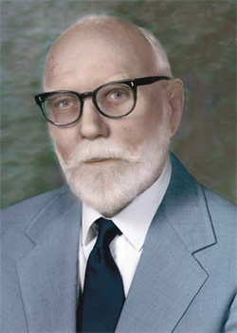
Frank N. Low (1911-1998)
"He was a gifted and charismatic mentor who taught through example that the quest for scientific knowledge and truth need not exclude respect for and appreciation of art, history, other cultures, and particularly fellow human beings.”
-Edward Carlson, The Anatomical Record, 1999

Slide 3
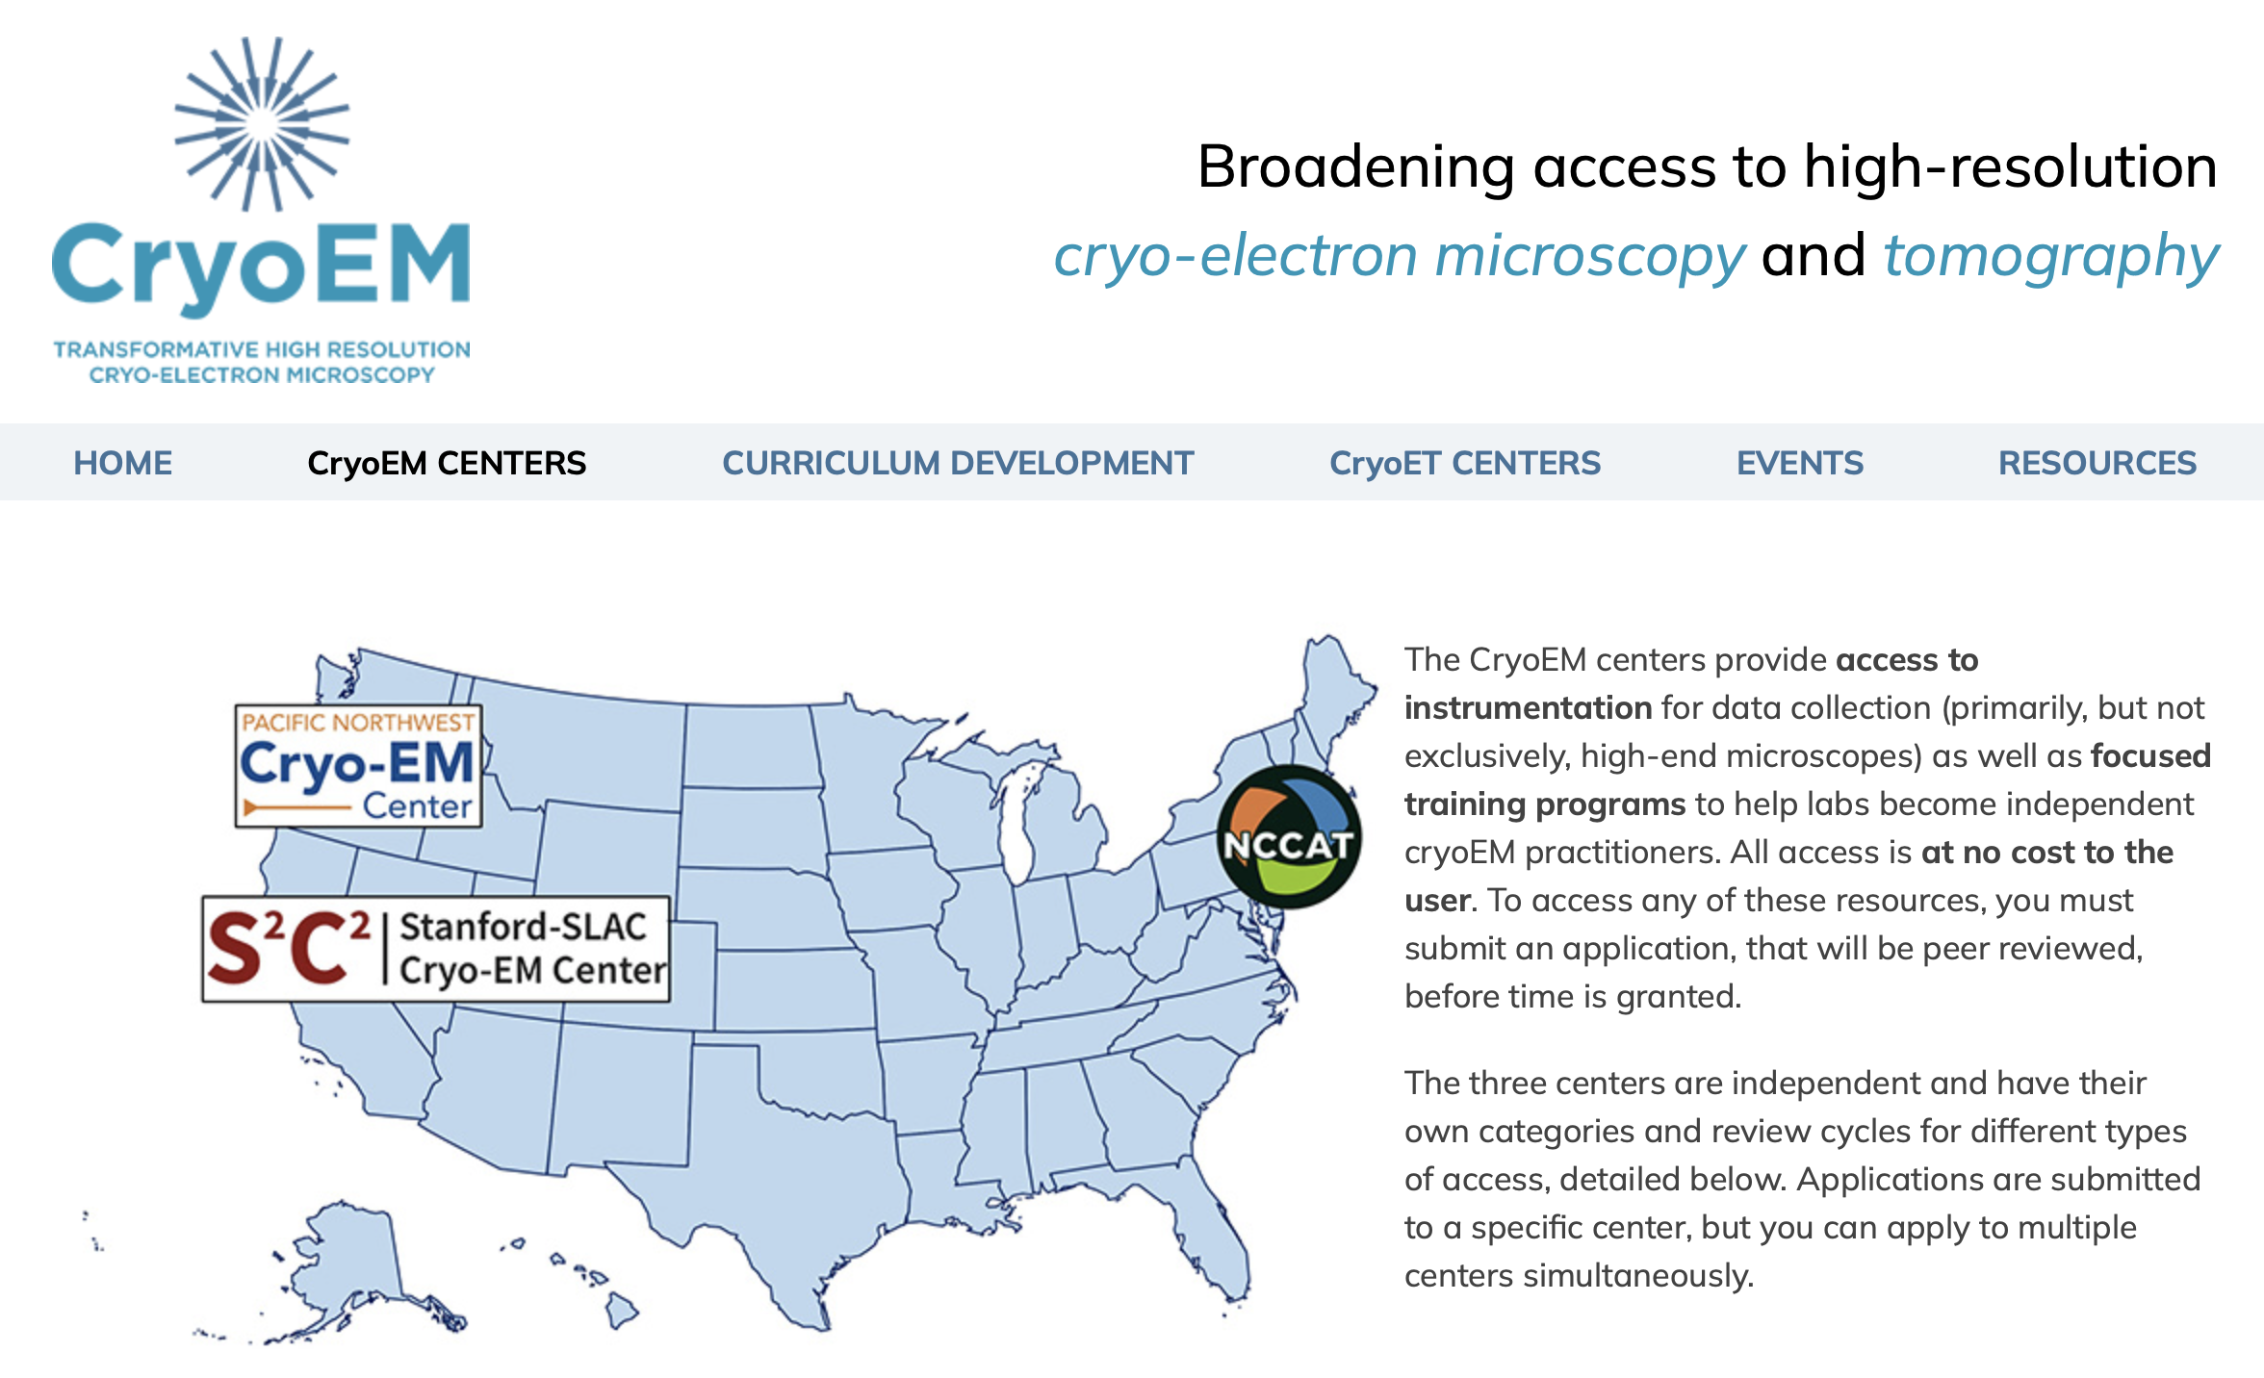

Slide 4
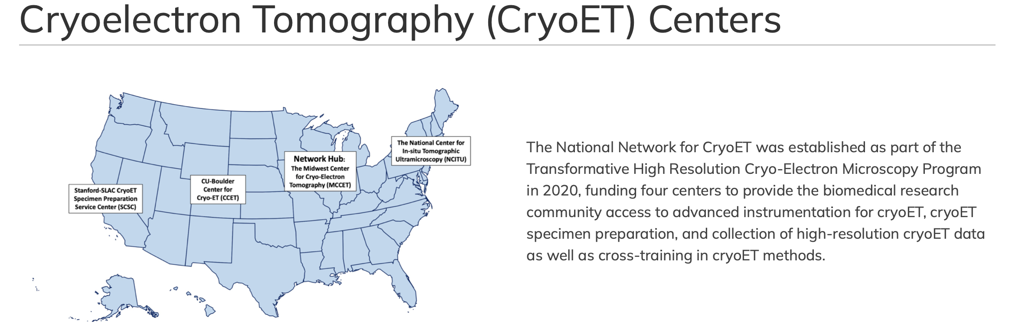

Slide 5



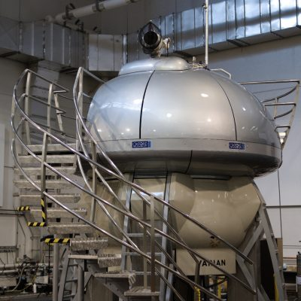


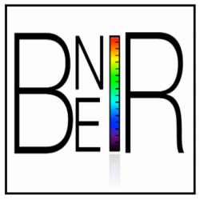

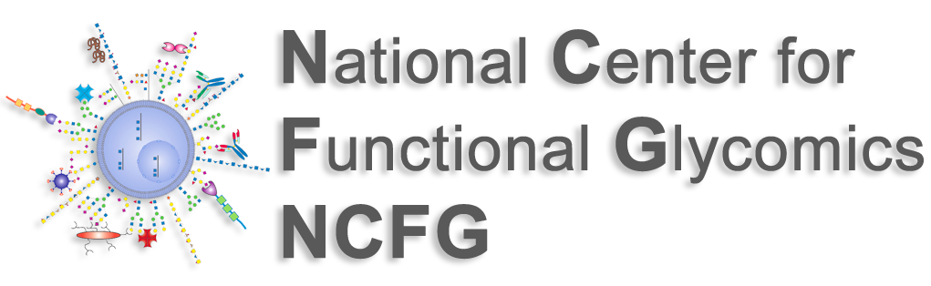

NIGMS National and Regional Resources Program (R24)
The NIGMS National and Regional Resources (R24) Program supports resources that provide access to state-of-the-art facilities, equipment, technologies, research tools, software, and service to a substantial number of users on a national or multi-state regional basis to yield significant economies of scale in biomedical research.
5
https://www.nigms.nih.gov/Research/mechanisms/Pages/NIGMS-National-and-Regional-Resources-(R24).aspx

Slide 6


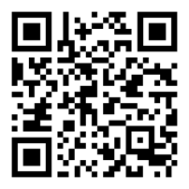


PAR-19-301: NIGMS to support mission relevant resources with economy of scale to provide access to state-of-the-art services for national/regional user base
Goal: Provide unmatched and most cost effective access to state-of-the-art quantitative proteomics platforms and skilled bioinformaticians, which will increase the capacity of NIH-supported researchers to perform cutting-edge research
Specific Aim 1. Provide quantitative proteomics services to NIH-supported researchers.
Increase efficiency of operation and leverage economy of scale to minimize recharge
Year 1: >3300 samples, >20,000 hours MS time, 76 NIH grants supported (Approx. $27M NIH funding)
Specific Aim 2. Provide outreach opportunities to NIH-supported researchers.
Voucher program
Internship
Specific Aim 3. Provide educational opportunities to NIH-supported researchers.
Workshops
Symposia
Web Resources
Grant #: R24GM137786
@ideaproteomics

Slide 7
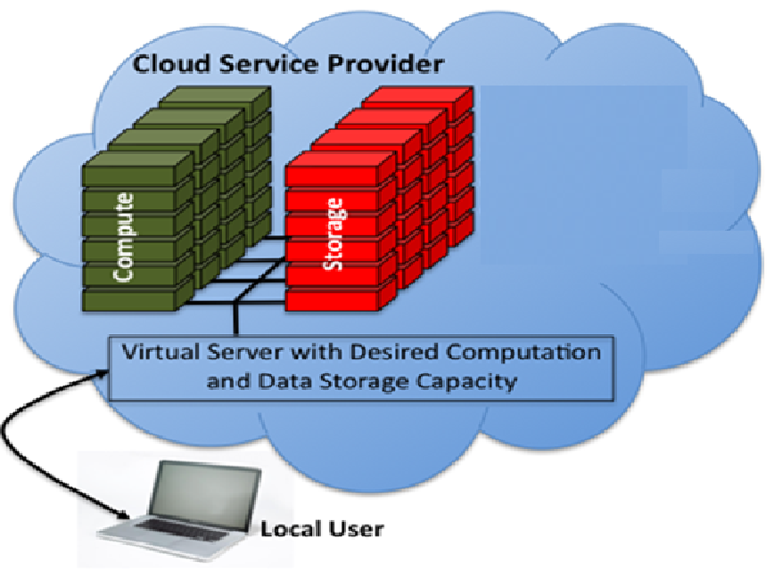
Cloud-Computing: A Potential Game Changer
The cloud enables any institution to access high performance computation and tools, including artificial intelligence, and make use of “big data”
NIGMS supports capacity building and training at many under-resourced institutions
  ~400 institutions in the 24 IDeA states
  ~100 Minority Serving Institutions

Slide 8
Some Concrete Steps toward Cloud-Computing?
Provide students and biomedical researchers basic training in how to use cloud computing for biomedical research
Demonstrate to investigators and institutional leaders the benefit of migrating research functions from local servers to the cloud
Seeking stakeholder input (NIH ODSS/NIGMS/NIMHD/CIT-STRIDES)
  Request for Information (NOT-OD-21-158): NIH Programs to Increase Access to Cloud Computing to Diverse Biomedical Research Institutions
  Cloud Computing at Under-Resourced Institutions Workshop, September 13 -14, 2021

Slide 9
Initial NIGMS Initiatives in Cloud Computing for IDeA State and Minority-Serving Institutions
Interactive training on Cloud fundamentals for students and investigators supported by NIGMS programs (IDeA-INBREs and Diversity Enhancing Training programs)
Building cloud-based learning tools that enable large number of students to learn biomedical research content on their own
Facilitating migration of institutions’ existing research functions to the Cloud via the NIH STRIDES* program

Slide 10


Interactive Training on Cloud Fundamentals
48 classes (through 60 six-hour sessions) by Google or AWS;
June–December 2021
Beginner (Cloud Basics) 24 classes; 24 sessions
Intermediate (App Development) 12 classes; 16 sessions
Advanced (Architecture) 12 classes; 20 sessions
15 students/class; 720 class seats;
500 participants from ~ 90 Institutions
Notes:
Each valued at $10,000/session

Slide 11
Examples of Training Classes by Google Cloud
GCP Fundamentals: Core Infrastructure
Fundamentals of Life Science Tools in Google Cloud (Custom)
GCP Fundamentals: Big Data & Machine Learning
Beginner
Developing Application with Google Cloud
Getting Started with Google Kubernetes Engine
From Data to Insights with GCP
Intermediate
Architecting with Google Kubernetes Engine
Data Engineering on Google Cloud
Architecting with GCP: Design and Process
Advanced
Similar courses from AWS at the 3 levels
Notes:
We are engaging Azure for training.

Slide 12
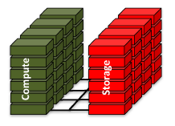

Institutional Versus Cloud-Based Learning
Online Training Offered on Institutional/Public Servers
Institutional Servers
Access to servers limited
Need to install software and backup data
Limited computing and storage capacity
Institution must support staff, maintenance, security, etc.
Cloud Servers
Easy access via cloud user accounts
Capable of serving large number of students
Maintenance, security, enhancement, etc. managed
by cloud provider
Cloud-based Learning

Slide 13
Pilots: Building Cloud-based Learning Modules
Learning Modules
Cloud engineers, through a three-month Professional Service Engagement, guided the PIs to convert the training materials into cloud-based Workflows
Instruction Video
Interactive
Demos
&
Practicum
Genomics/
Proteomics
Curricula
by PIs
Sandbox
Train-the-Trainer:
NIGMS-supported investigators gain programing skills to develop cloud-based training materials
Notes:
Going forward, we would like to use more modules to create a learning environment we call it a Sandbox.

Slide 14
An NIGMS “Sandbox” with Multiple Learning Modules
NIGMS Biomed Research Learning Sandbox
2
3
4
5
MassSpec
Data
Analysis
RNA-Seq
Analysis
Univ of
Maine,
MDIBL
Basics of
Cloud
Computing
(Google /
Amazon/ MS Azure )
1
Univ of
Arkansas
Med Sci
Maine
INBRE
By NIH STRIDES
By NIGMS Pilots
New Learning Modules
Work in Progress: 1. Funding 10 INBRE and MSI teams to build additional learning modules
2. Developing a platform to deploy the Sandbox
Notes:
We plan to provide access to the Sandbox to students supported by GM programs supported students first, and all students eventually

Slide 15
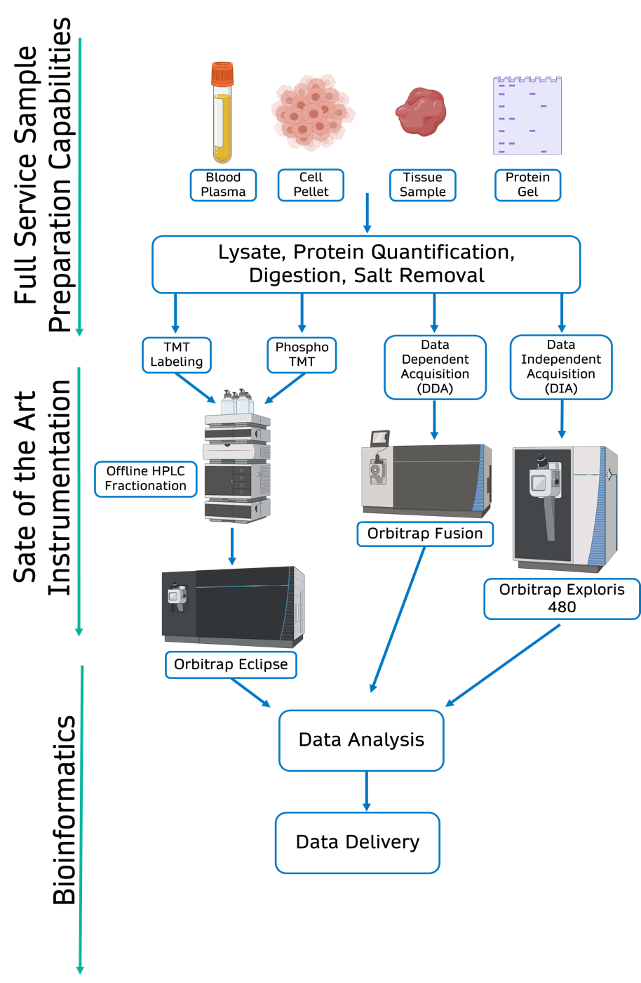
Bottleneck Halted Growth at IDeA National Resource for Quantitative Proteomics
Time needed for data processing, delivery, and consultation
Staff effort/time for data processing, delivery, and consultation
Cost of computational infrastructure and data storage
Bottleneck:

Slide 16
Migrating Research Functions to the Cloud: Lift-and-Shift
Cloud engineers, through a five-month Professional Service Engagement, guided the PIs to develop
a Cloud-based, automated analytic pipeline
Migrate the Pipeline to the institution’s own Cloud account for operation
Lift
Shift
Proteomics
analytic
pipeline
Train-the-Trainer:
GM-supported investigators gain programing skills to develop similar packages and help establish their institutions’ Cloud accounts

Slide 17
Transformative Impact of the Lift-and-Shift Project
Goal: Work with Google and NIH STRIDES to lift-and-shift proteomics pipeline to the cloud for automated data analysis, delivery, consulting, and data storage
Outcomes
    Led to the establishment of UAMS’ own GCP account
    System launched January 1, 2022
    Delivered 43 projects through signURL link using GCP workflow since launch
    Multi-plex 5 data searches at a time (previously one at a time)
    Automated data analysis 6-times faster than previous method
    Leveraging 5TB of cloud data
“This cloud environment has been absolutely transformative for our resource. I couldn’t be more pleased”
Alan Tackett, PhD, PI

Slide 18
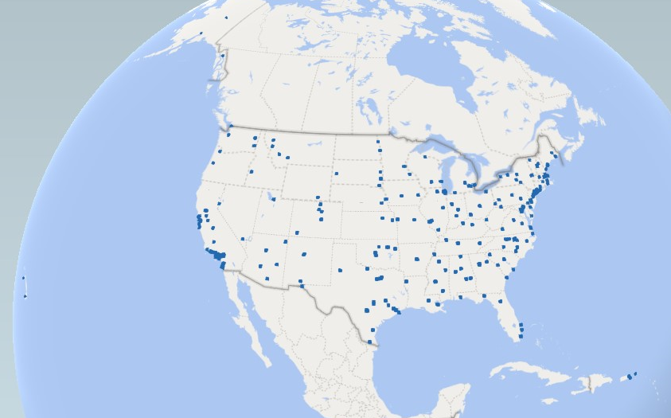
NIGMS Administers ~1,900 Training, Workforce Development, Diversity and Capacity Building Awards at ~400 institutions
~$900 million per year

Slide 19
19
NIGMS Training, Workforce Development, and Diversity Programs
preK-12
Community College
Undergraduate
Post-
bac
Graduate MS
Graduate PhD
Postdoctoral
Faculty
Innovative Programs to Enhance Research Training
NIGMS Diversity Supplement Program
National Research Mentoring Network
BUILD
G-RISE
U-RISE
Bridges to the Doctorate
SCORE/SURE
Bridges to the Baccalaureate
IMSD
MARC
NRSA Fellowships
SEPA
PREP
T32 NRSA
IRACDA
K Awards
MOSAIC – New!
IDeA Networks of Biomedical Research Excellence
Native American Research Centers for Health

Slide 20
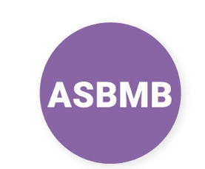

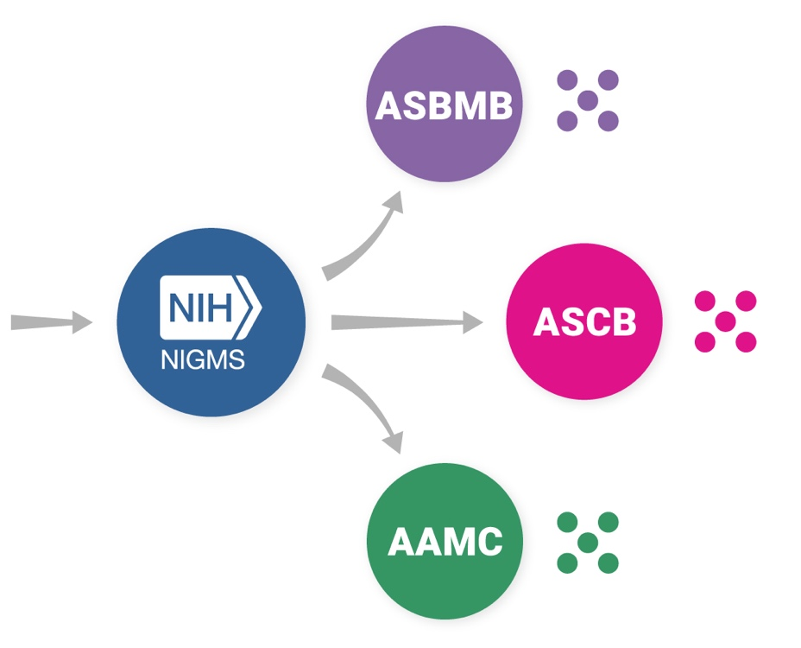


Maximizing Opportunities for Scientific and Academic Independent Careers (MOSAIC)
Postdoctoral Career Transition Award to Promote Diversity (K99/R00) – PAR-19-343
Institutionally Focused Research Education Cooperative Agreement to Promote Diversity (UE5) – PAR-19-342
Awards to scientific societies (UE5)
MOSAIC K99/R00 Applicants Compete
MOSAIC K99/R00 Scholars Participate in Cohorts Organized by UE5
https://www.nigms.nih.gov/training/careerdev/Pages/MOSAIC.aspx
Notes:
ASCB/ASBMB – biological lab sciences – biophysics, chemistry, cell and developmental biology, cellular neuroscience, etc.
AAMC – social, behavioral, population science and clinically
relevant
We’ll do this each year, so as the program expands the networking within your society’s UE5 will increase
UE5s:
Team building
Professional skills
Mentoring
Network development
Career development
Institutional responsibility
K99/R00s:
Funding
Mentoring (PIs & POs)
Near-peer mentoring (senior to junior cohorts)
Independence

Slide 21
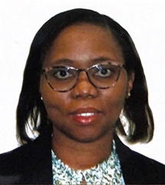

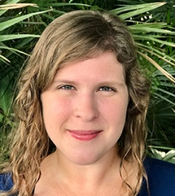


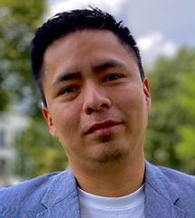
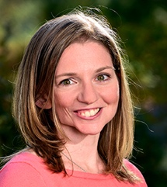
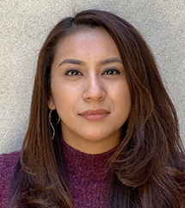
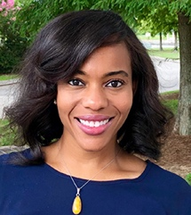
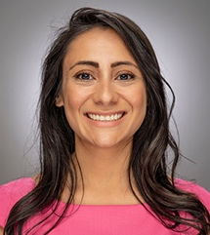
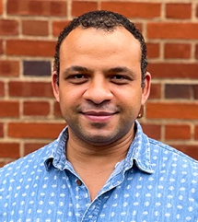
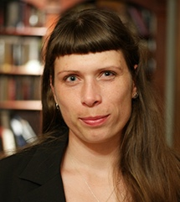
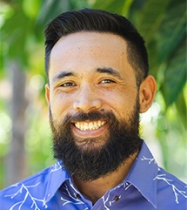
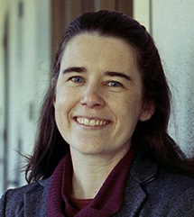
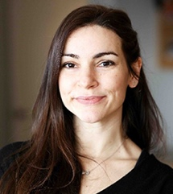
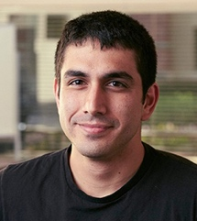
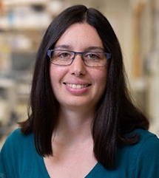
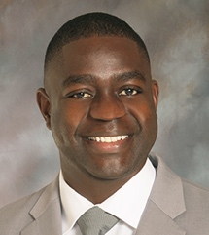
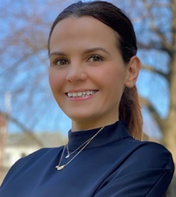
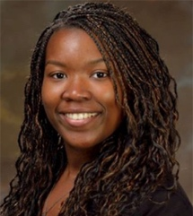
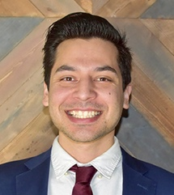
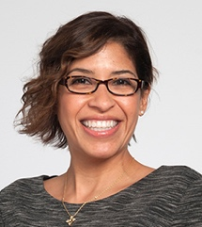
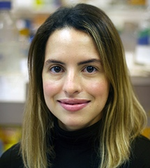
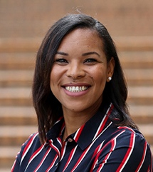
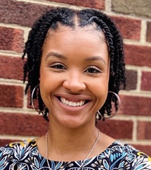
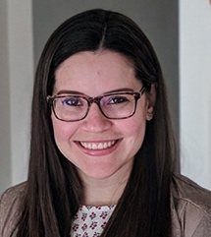
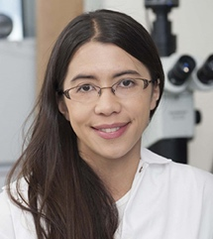
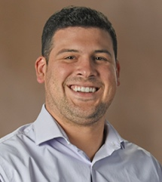
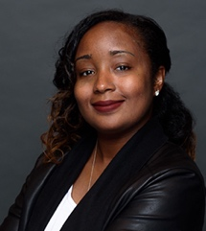

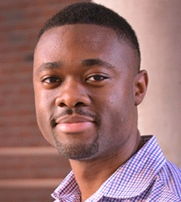
2021 MOSAIC Scholars
21
https://www.nigms.nih.gov/training/careerdev/Pages/mosaic-scholars.aspx

Slide 22

Apply to the MOSAIC Program!
23 NIH institutes, centers and offices participate in MOSAIC so a broad variety of biomedical research can be supported
Watch the 2021 webinar for prospective applicants:
  https://www.youtube.com/watch?v=awPtipA8KNs&t=11s
22
https://www.nigms.nih.gov/training/careerdev/Pages/MOSAIC.aspx

Slide 23
23
NIGMS Training, Workforce Development, and Diversity Programs
preK-12
Community College
Undergraduate
Post-
bac
Graduate MS
Graduate PhD
Postdoctoral
Faculty
Innovative Programs to Enhance Research Training
NIGMS Diversity Supplement Program
National Research Mentoring Network
BUILD
G-RISE
U-RISE
Bridges to the Doctorate
SCORE/SURE
Bridges to the Baccalaureate
IMSD
MARC
NRSA Fellowships
SEPA
PREP
T32 NRSA
IRACDA
MSTP for IDeA and MSIs – Coming Soon!
K Awards
MOSAIC – New!
ARC – Coming Soon!
IDeA Networks of Biomedical Research Excellence
Native American Research Centers for Health

Slide 24
Also Coming Soon: Enhancements to the Native American Research Centers for Health (NARCH) Program
Based on an evaluation and Tribal Consultation
Enhancements will include increased emphasis on capacity building projects; increased emphasis on tribal ownership of research; use of culturally appropriate research assessment measures
Once a year receipt dates for applications, simplification of application process and grants administration
Development of additional programs to support NARCH goals, e.g.,
  NARCH application planning grants
  Sponsored programs administrative development support
  Tribal Institutional Review Board (IRB) development and enhancement grants
  Undergraduate and graduate training grants
24
https://www.nigms.nih.gov/training/careerdev/Pages/MOSAIC.aspx

Slide 25
Do You Know the Name Sheri Sangji?

Slide 26
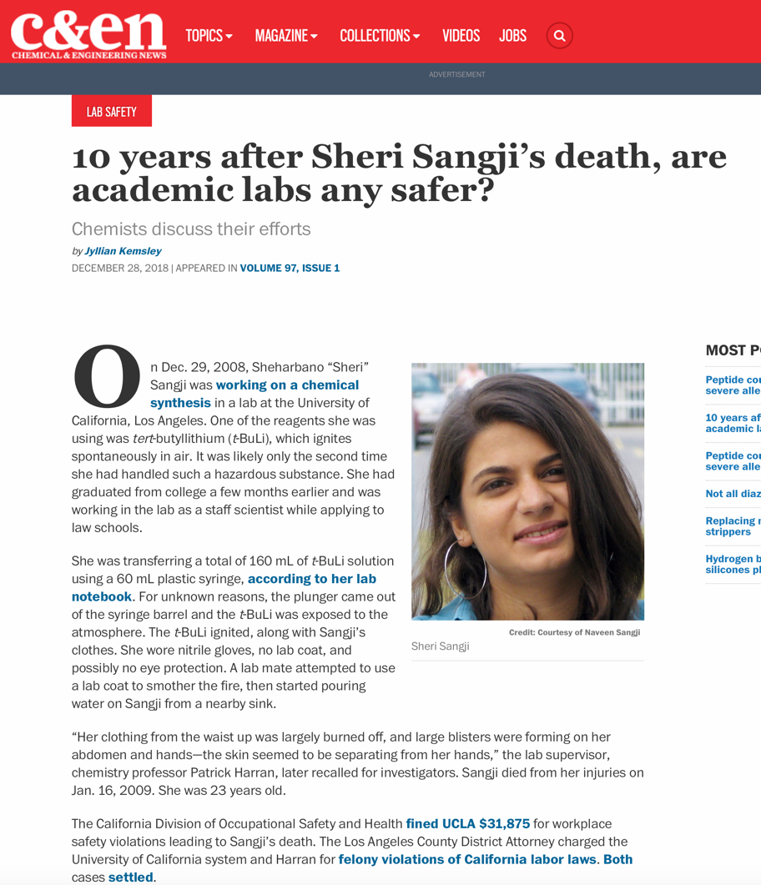
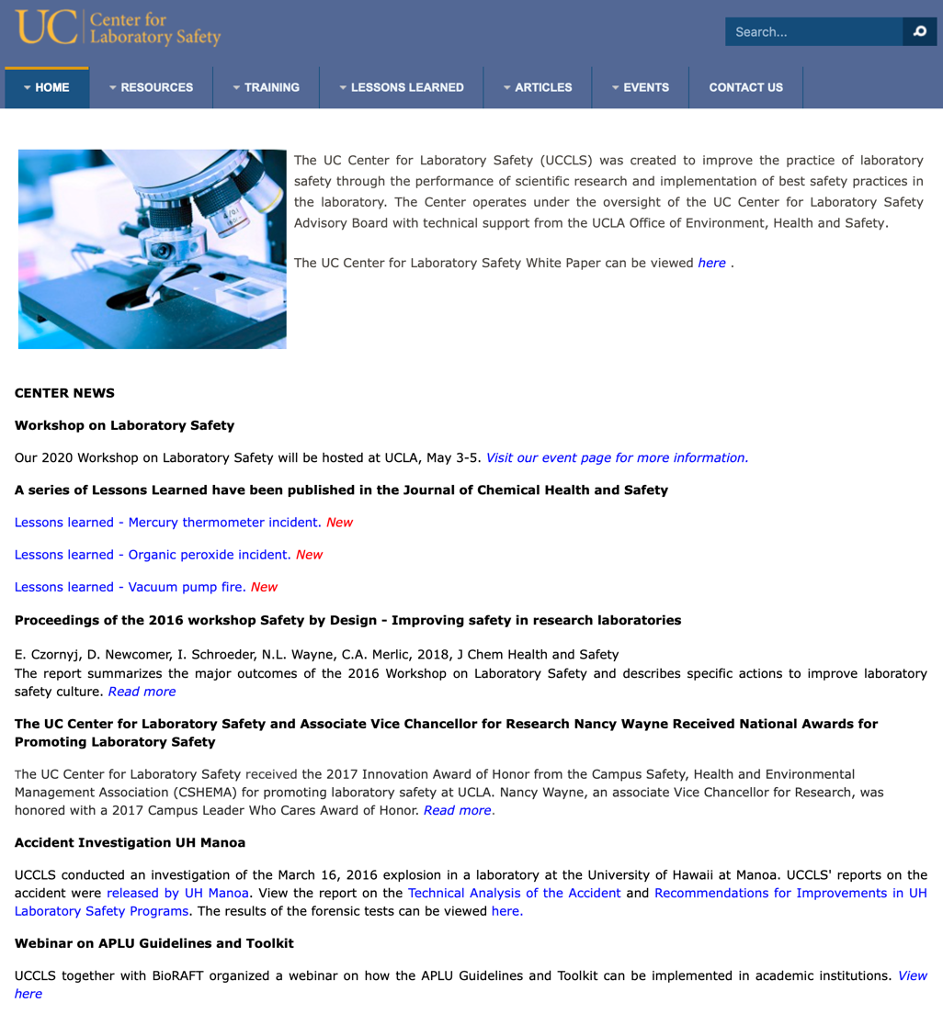
https://cen.acs.org/safety/lab-safety/10-years-Sheri-Sangjis-death/97/i1
Sheri Sangji’s Death Led to Criminal Charges against the PI and UCLA and to the Formation of the UC Center for Laboratory Safety

Slide 27
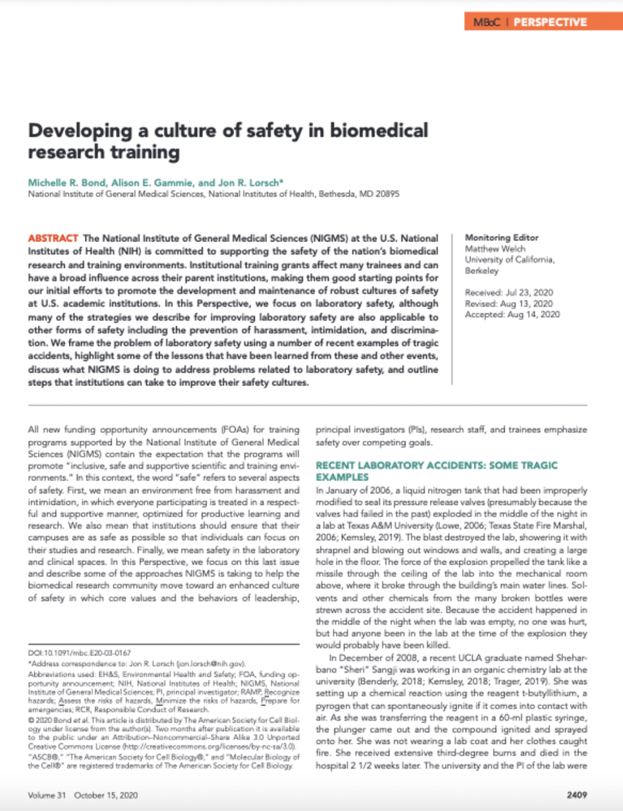
Bond et al. (2020) Molecular Biology of the Cell 31: 2409-2414 https://doi.org/10.1091/mbc.E20-03-0167
Please Read Our Paper!

Slide 28

Institutions
Values and behaviors emphasize safety and respect
Training program funding announcements emphasize safety – required in the training plan and part of the scored review criteria
Inclusive, supportive environments free from harassment and intimidation
Strong culture of safety in laboratory and clinical settings
Supplements to training awards to develop a culture of safety and to create safe, supportive, and inclusive research training environments
Laboratory and clinical leadership exemplify and reinforce the culture of safety
Safety training and oversight permeate all aspects of the enterprise
Funding announcement to develop training modules freely available to the community
Individuals practice the highest standards for safety
Hazards assessments are routine and pervasive
Promote safety through webpages, webinars, and meetings for training directors
Collaborative working relationships among Health and Safety Officials, leadership, scientists, and clinicians
Near miss accidents are widely reported, analyzed, and used to catalyze change
https://www.nigms.nih.gov/research-training/resources/laboratory-safety-and-guidelines

Slide 29
Questions?

