Slide 1


Slide 2
Staffing Updates
Brittany Belgarde—leaving to TMCC
Dr. Yvette LaPierre—Welcome!

Slide 3
COVID-19 Updates
National
  Total cases: 632,548
  Total deaths: 31,071
State of ND
  Total cases: 393
  Total deaths: 9
Impact on UND SMHS
  All classes through distance or online
  No on-campus classes/events through end of summer (will discuss in more detail in program updates)

Slide 4

INMED Director’s Report
Tribal Advisory Board Meeting
April 17, 2020
UND SMHS

Slide 5
INMED Director’s Report
Incoming students—8
COBRE
Endowed Scholarships
New Programming
  Indigenous Health MPH
  Indigenous Health PhD
  INMED Pre-Med
Program Updates
  INMED Students
  Summer Institute
  MCAT—Kathleen
  CLIMB—Kathleen
  NEURO—Erica

Slide 6
Honoring of Graduates
INMED Class 2020 document
Considering FB Live (no wacipi this year…)
Star Quilts

Slide 7
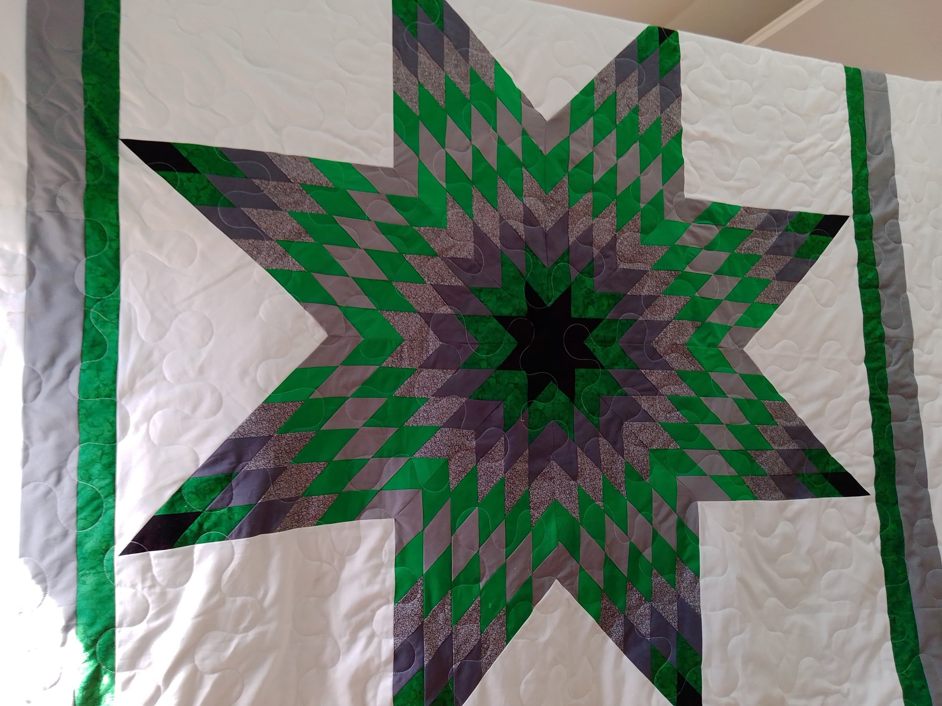

Slide 8
Funding/IHS Grant
IHS grant awarded through 2021
COBRE pending
NIH, NSF, NDDOH, ACS, others…
Open Discussion—Q and A with Board

