Slide 2

INMED Director’s Report
Tribal Advisory Board Meeting
July 18, 2019
UND SMHS

Slide 3
INMED Director’s Report
Brief History
Staffing—Drs. Wescott, Nadeau, Redvers
Funding & Programming
Vision and Future Opportunities
  INMED Pre-med, MPH, PhD, MD/MPH, MD/PhD, 4 + 1, Residency, etc.
Endowments Strategy
Indigenous Health Collaborations
Logo update
“Indian Health Teaching Hospitals” (1pm)
Banquet Discussion (6pm Alerus Center)

Slide 4
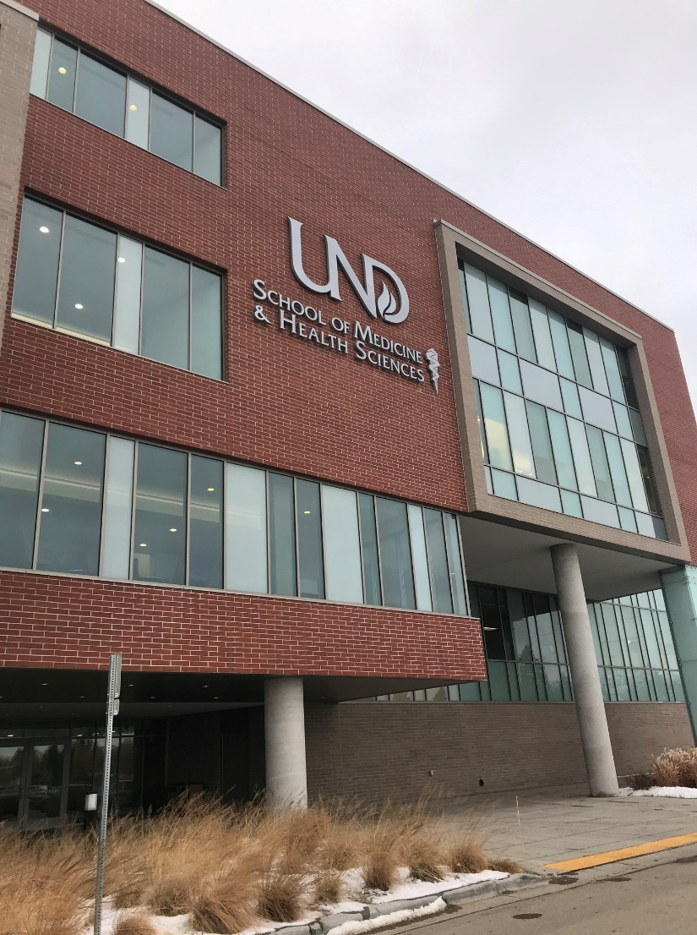

UND SMHS Academic Programs
Doctor of Medicine (MD)
Physician Assistant (PA)
Master of Public Health (MPH)
Occupational Therapy (OT)
Physical Therapy (PT)
Medical Laboratory Science (MS)
Biomedical Sciences (PhD)
Athletic Training

Slide 5
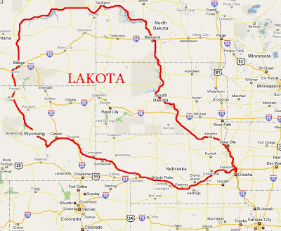
NAKOTA
DAKOTA

Slide 6
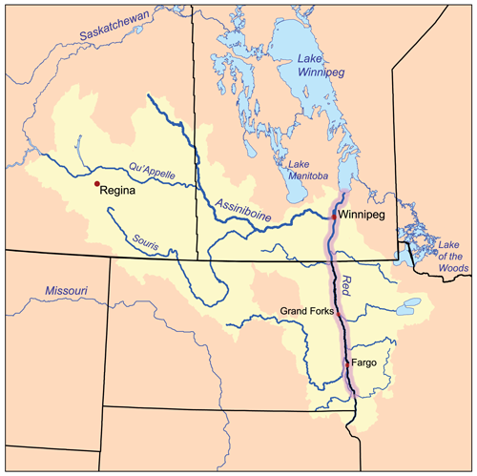
ND
MN
SD

Slide 7
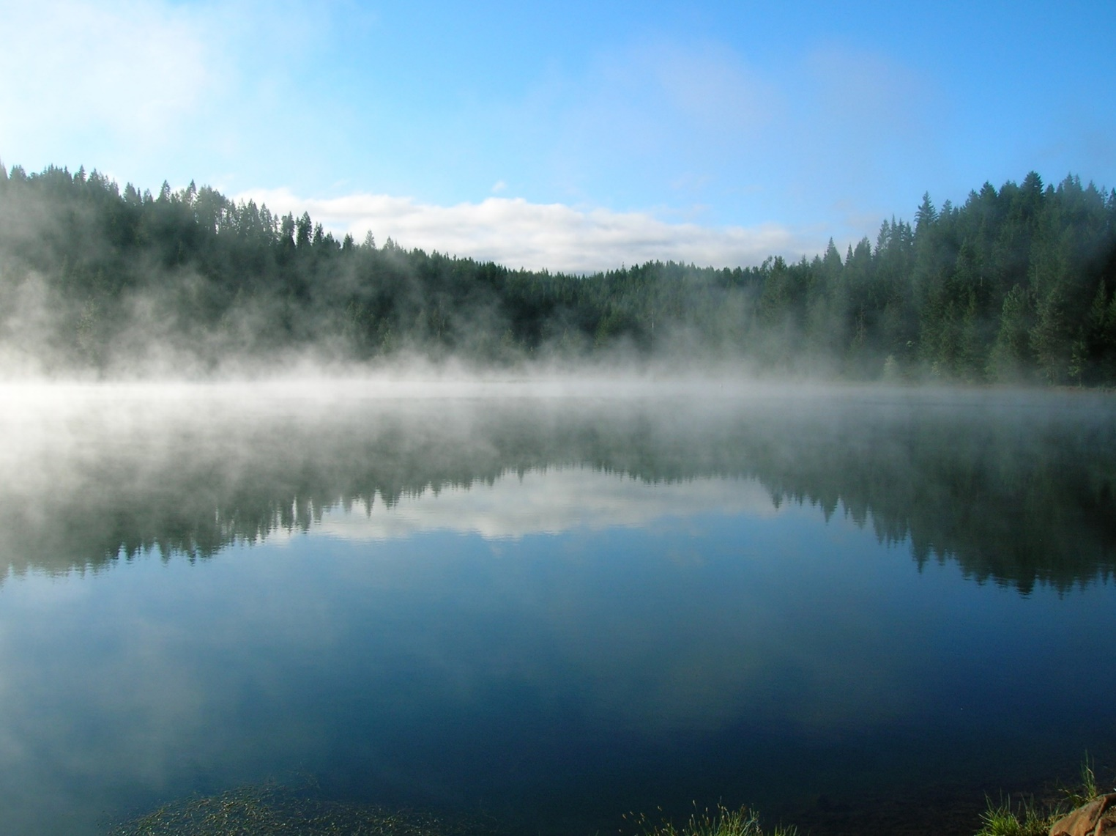

Slide 8
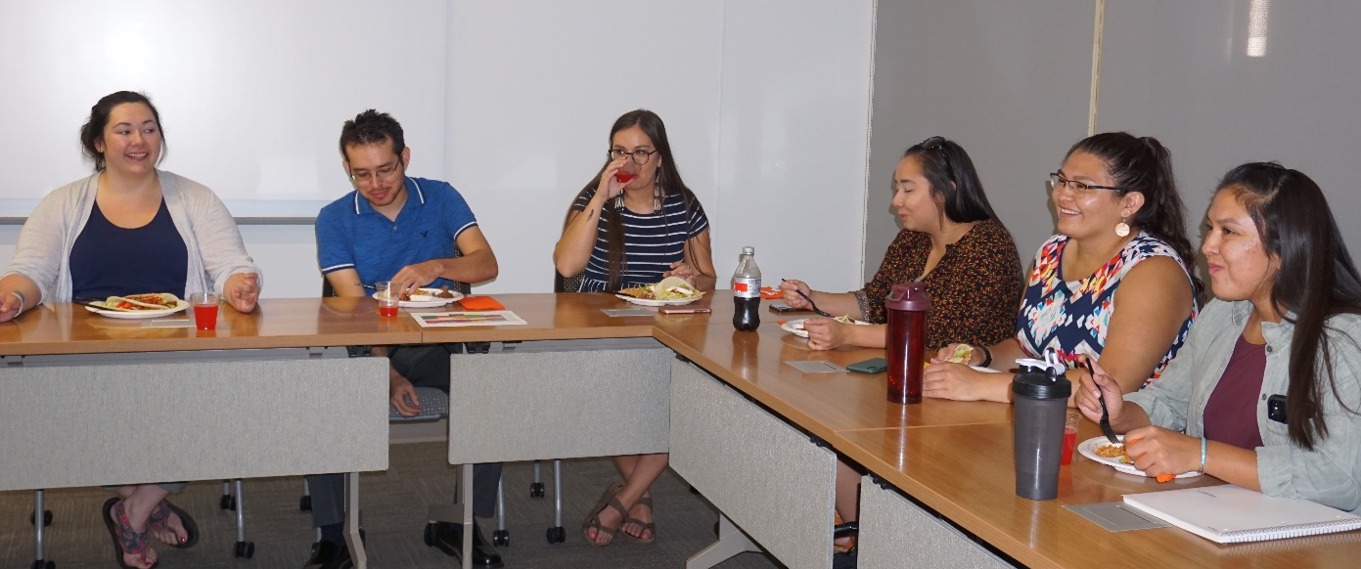
INMED History
INMED was established in 1973 to address the need for health professionals to serve reservation populations. The program is located where American Indian health needs are the greatest–
24 reservations in ND, SD, MT, WY, and NE are among the most underserved in the country.
Incoming Class of 2023 (6 AI/AN)—50th year anniversary class of INMED!

Slide 9
Staffing
Assistant Director—INMED
  Siobhan Wescott, MD, MPH
Assistant Director—MPH
  Melanie Nadeau, PhD, MPH
Assistant Professor—Indigenous Health
  Nicole Redvers, ND, MPH(c)
Assistant Professors (2)—MPH
Diversity and Equity Coordinator
  Lynn Mad Plume, MPH
ND Opioid Response Program Tribal Engagement Coordinator
  Kalisi Uluave
DaCCOTA Community Engagement Coordinator
  Danielle Thompson

Slide 10
Funding
$700K from IHS—NOA for 2019-2020 Program Year
CTR, MFP-TI, ACS, NEURO, NSF, INBRE, UNMC salary offsets
Endowments
  Scholarships and Professorships
  MHAN—Endowed Chair
  MN-Dakota Tribes
  Alums, donors…
Greg and Amy Shega
  Legacy Gift

Slide 11
Funding

Slide 12
Funding
$700K from IHS—NOA for 2019-2020 Program Year
CTR, MFP-TI, ACS, NEURO, NSF, INBRE, UNMC salary offsets
Endowments
  Scholarships and Professorships
  MHAN—Endowed Chair
  MN-Dakota Tribes
  Alums, donors
Greg and Amy Shega
  Legacy Gift

Slide 13
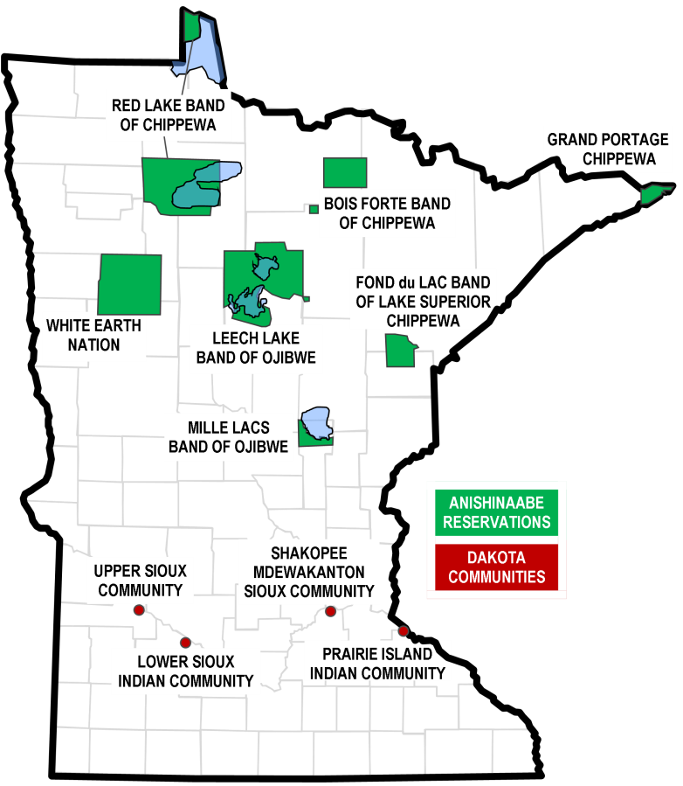
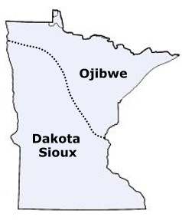
Funding
$700K from IHS—NOA for 2019-2020 Program Year
CTR, MFP-TI, ACS, NEURO, NSF, INBRE, UNMC salary offsets
Endowments
  Scholarships and Professorships
  MHAN—Endowed Chair
  MN-Dakota Tribes

Slide 14

Funding
$700K from IHS—NOA for 2019-2020 Program Year
CTR, MFP-TI, ACS, NEURO, NSF, INBRE, UNMC salary offsets
Endowments
  Scholarships and Professorships
  MHAN—Endowed Chair
  MN-Dakota Tribes
  Alums, donors (“Sacred Hoops Scholarship”), ideas?

Slide 15

Funding
$700K from IHS—NOA for 2019-2020 Program Year
CTR, MFP-TI, ACS, NEURO, NSF, INBRE, UNMC salary offsets
Endowments
  Scholarships and Professorships
  MHAN—Endowed Chair
  MN-Dakota Tribes
  Alums, donors
Greg and Amy Shega
  Legacy Gift
Other Ideas??

Slide 16
INMED Programming
Middle School High School Bachelor’s Medical Graduate School Residency
Summer Institute
NEURO
MCAT Prep
INMED
SMHS
Indigenous Health MPH & PhD

Slide 17
INMED Programming
Pre-K/ Elementary
Middle School
High School
Graduate School
Residency/Fellowship
Bachelor’s Medical Leadership
Summer Institute
NEURO
MCAT Prep
INMED
SMHS
Indigenous Health MPH & PhD

Slide 18
INMED Programming
Pre-K/ Elementary
Middle School
High School
Graduate School
Residency/Fellowship
Bachelor’s Medical Leadership
Summer Institute
NEURO
MCAT Prep
INMED
SMHS
Indigenous Health MPH & PhD
Indigenous STEM
-INBRE
-SEPA

Slide 19
INMED Programming
Pre-K/ Elementary
Middle School
High School
Graduate School
Residency/Fellowship
Bachelor’s Medical Leadership
Summer Institute
NEURO
MCAT Prep
INMED
SMHS
Indigenous Health MPH & PhD
Indigenous STEM
-INBRE
-SEPA
INMED Pre-Med
-PH Education BS
-Biomedical Sciences
-AIS Major/Minor

Slide 20
INMED Pre-Med
Key Components
Biomedical Sciences
American Indian Studies
Public Health Education
MCAT Prep / GRE Prep
Tutoring
Brief Proposal submitted to Provost, President

Slide 21
INMED Programming
Pre-K/ Elementary
Middle School
High School
Graduate School
Residency/Fellowship
Bachelor’s Medical Leadership
Summer Institute
NEURO
MCAT Prep
INMED
SMHS
Indigenous Health MPH & PhD
Indigenous STEM
-INBRE
-SEPA
INMED Pre-Med
-PH Education BS
-Biomedical Sciences
-AIS Major/Minor
Dual Degrees
-MD/MPH
-MD/PhD
-JD/MPH

Slide 22
INMED Programming
Pre-K/ Elementary
Middle School
High School
Graduate School
Residency/Fellowship
Bachelor’s Medical Leadership
Summer Institute
NEURO
MCAT Prep
INMED
SMHS
Indigenous Health MPH & PhD
Indigenous STEM
-INBRE
-SEPA
INMED Pre-Med
-PH Education BS
-Biomedical Sciences
-AIS Major/Minor
Dual Degrees
-MD/MPH
-MD/PhD
-JD/MPH
Family Medicine Residency
Rural/Tribal Preventive Medicine Residency

Slide 23
INMED Programming
Pre-K/ Elementary
Middle School
High School
Graduate School
Residency/Fellowship
Bachelor’s Medical Leadership
?
-MPH?
-Certificate?
Summer Institute
NEURO
MCAT Prep
INMED
SMHS
Indigenous Health MPH & PhD
Indigenous STEM
-INBRE
-SEPA
INMED Pre-Med
-PH Education BS
-Biomedical Sciences
-AIS Major/Minor
Dual Degrees
-MD/MPH
-MD/PhD
-JD/MPH
Family Medicine Residency
Rural/Tribal Preventive Medicine Residency

Slide 24
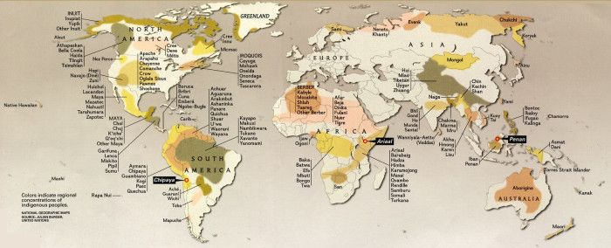
Indigenous Health Collaborations

Slide 25
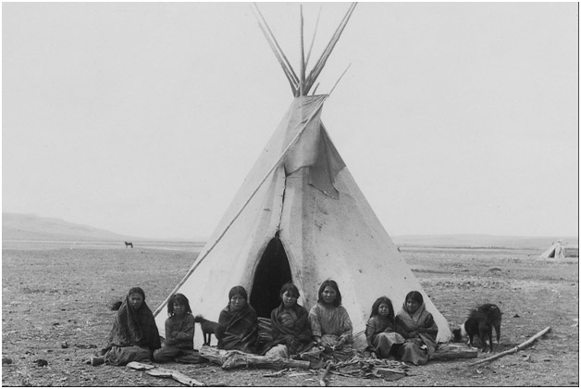
Lakota
North America

Slide 26
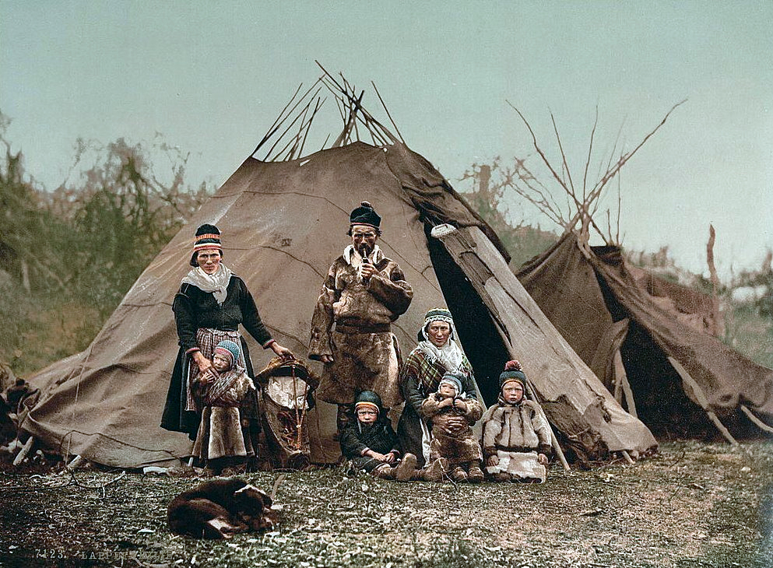
Sami
Norway – Europe

Slide 27
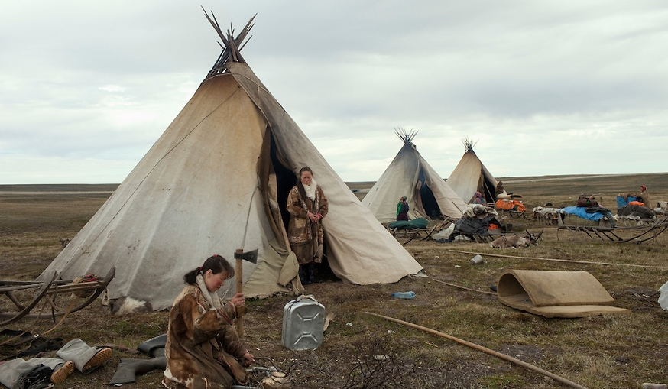
Nenets
Siberia

Slide 28
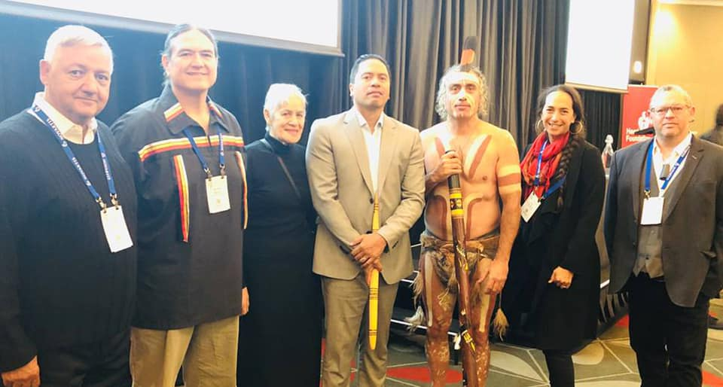
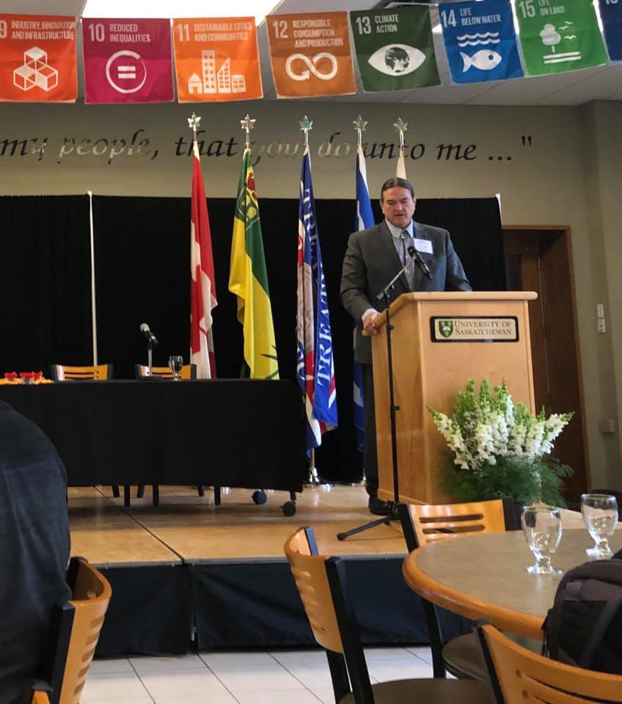
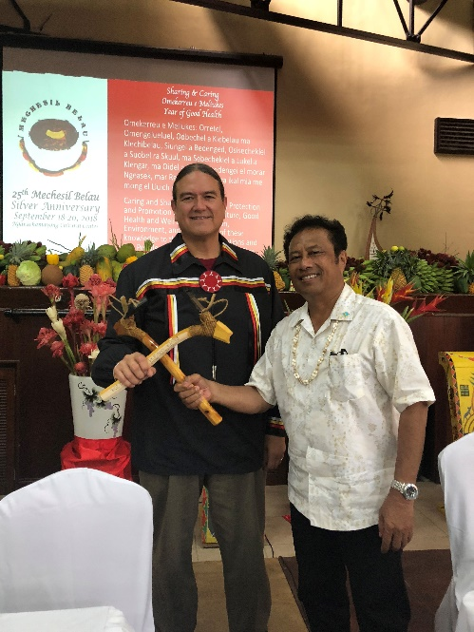
Indigenous Health Collaborations
Canada
Australia
New Zealand
Samoa
Tonga
Palau
Guam
Norway
Others…

Slide 29
Logo Discussion

Slide 30
Logo Discussion

Slide 31

Logo Discussion

Slide 32

Questions?
Input/Ideas?
Discussion

Slide 33
INMED Programming
Pre-K/ Elementary
Middle School
High School
Graduate School
Residency/Fellowship
Bachelor’s Medical Leadership
?
-MPH?
-Certificate?
Summer Institute
NEURO
MCAT Prep
INMED
SMHS
Indigenous Health MPH & PhD
Indigenous STEM
-INBRE
-SEPA
INMED Pre-Med
-PH Education BS
-Biomedical Sciences
-AIS Major/Minor
Dual Degrees
-MD/MPH
-MD/PhD
-JD/MPH
Family Medicine Residency
Rural/Tribal Preventive Medicine Residency

Slide 34
INMED Programming
Pre-K/ Elementary
Middle School
High School
Graduate School
Residency/Fellowship
Bachelor’s Medical Leadership
?
-MPH?
-Certificate?
Summer Institute
NEURO
MCAT Prep
INMED
SMHS
Indigenous Health MPH & PhD
Indigenous STEM
-INBRE
-SEPA
INMED Pre-Med
-PH Education BS
-Biomedical Sciences
-AIS Major/Minor
Dual Degrees
-MD/MPH
-MD/PhD
-JD/MPH
Family Medicine Residency
Rural/Tribal Preventive Medicine Residency
“Indian Health Teaching Hospitals”

Slide 35


Next Steps
Indian Health Teaching Hospitals?
  Endowed Clinical Professors
North Dakota—UND/MGH
  Belcourt (Turtle Mountain)
  Ft. Yates (Standing Rock)
South Dakota—USD/MGH
  Cheyenne River
  Pine Ridge
  Rosebud
  Sioux San
Collaborate with clinic sites

Slide 36
Next Steps
Indian Health Teaching Hospitals?
  Endowed Clinical Professors
North Dakota—UND/MGH
  Belcourt (Turtle Mountain)
  Ft. Yates (Standing Rock)
South Dakota—USD/MGH
  Cheyenne River
  Pine Ridge
  Rosebud
  Sioux San (Oyate Health Center)
Collaborate with clinic sites
  Elbowoods

Slide 37
Indian Health Teaching Facilities
Community Engagement
  SRST—Ft. Yates Hospital
  MHAN—Elbowoods Clinic
  TMBCI—Belcourt Hospital
  SLSN—Clinic (Title V 638)
South Dakota
  Sioux San (GPTCHB)
  CRST, OST, RST
Funding
  ND—100% FMAP cost savings
    Governor, legislature
  SD?
  Endowments

Slide 38
Family Medicine Residencies
Community Engagement
  SRST—Ft. Yates Hospital
  MHAN—Elbowoods Clinic
  TMBCI—Belcourt Hospital
  SLSN—Clinic (Title V 638)
  WEN—collaborate with UMD?
North Dakota
  Establish Continuity Clinic Sites/MOAs
  Maintain accreditation
  Evaluate outcomes
    Clinical, Financial, Staffing, etc.
South Dakota
  Next Steps?
  Feasibility Study?

Slide 39
Discussion
What are we missing?
Next steps?
  Who will follow up?
  Reporting back?
  Timeline?
Next meeting?
  When?
  Where?
Other Considerations?

