Slide 1
State of the UND SMHS January 25, 2021
Joshua Wynne, MD, MBA, MPH
Vice President for Health Affairs, UND
Dean, UND SMHS

Slide 2
Overview of Today’s Presentation
Issues related to the pandemic
Strategic direction of the UND SMHS
Where we were
Where we are now, thanks in part to North Dakota’s Healthcare Workforce Initiative (HWI)
Where we hope to go
Executive Budget implications
Recommendations for the ND Legislature from the UND SMHS Advisory Council
Summary

Slide 3
Pandemic-related Issues
Teaching, research/scholarship, and service have continued to a remarkable degree
Hybrid approaches have been essential to the educational enterprise
We have continued to emphasize a low building population density approach to the maximum extent possible
Remarkable how much school business we have been able to do remotely!
But the emotional toll on faculty, staff and especially students has been (and continues to be) substantial

Slide 4
Pandemic-related Issues
Future UND/SMHS adjustments to the pandemic still in evolution
Recent announcement by UND of the decision to have a virtual spring commencement and student feedback
Vaccination status/prioritization and likely impact looking ahead

Slide 5
Reference Materials
Executive Summary of the Sixth Biennial Report – Health Issues for the State of North Dakota 2021 with link to the full web-based report
Vital Signs – 2020 Community Report

Slide 6
Healthcare Workforce Shortages in North Dakota Are Not New
Report of the Country Life Commission (1909) – President Theodore Roosevelt
“Physicians are further apart and are called in later in cases of sickness, and…medical attendance is…more expensive.”
Carnegie Commission’s Report on Medical Education (1970)
“The geographic distribution of health [providers] is highly uneven, and…there is little question that the supply of health [providers] is gravely deficient in some parts of the nation.”

Slide 7
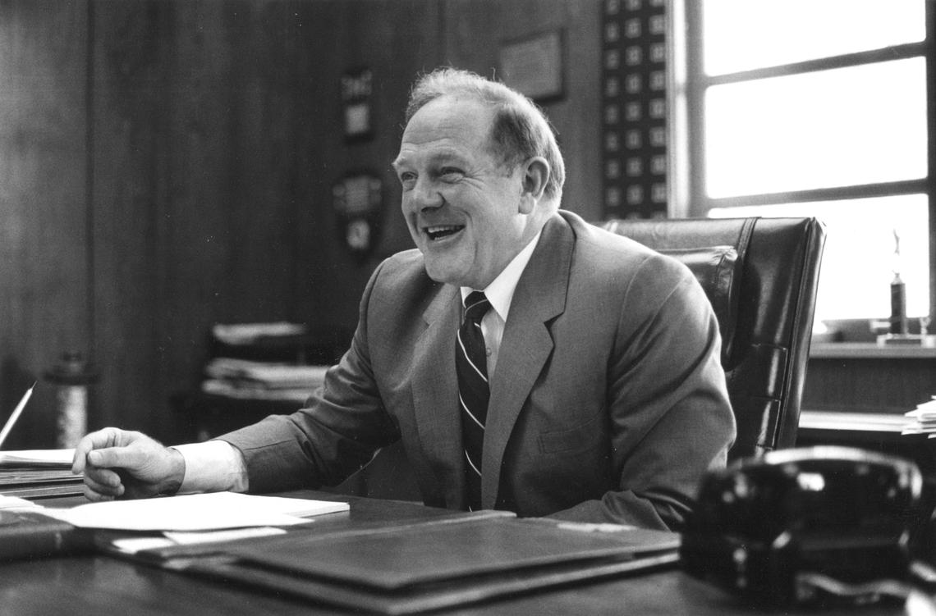
But We Have a Plan for Addressing Healthcare Workforce Shortages in North Dakota
“Perhaps the greatest achievement for Clifford was the establishment of the M.D. program for the University's School of Medicine and Health Sciences. When it became clear that UND's two-year transfer curriculum would no longer be viable, he worked with Medical School officials to develop an innovative community-based M.D. program that avoided the need for an expensive teaching hospital and would help North Dakota "grow its own" physicians.”
From the biography of UND President Emeritus Thomas J. Clifford, written by the Grand Forks Herald
shortly after his death in 2009

Slide 8
Impact of the UND SMHS on Healthcare Workforce: Medicine
The first four-year medical school graduate was Dr. Robert Arusel, a North Dakota native, who graduated on May 5, 1976.
Dr. Arusel, a radiation oncologist at Sanford’s Roger Maris Cancer Center in Fargo and philanthropic supporter of the UND SMHS along with his wife Dr. Janelle Sanda, recently retired after over four decades of practice – in North Dakota!

Slide 9
Impact of the UND SMHS on Healthcare Workforce: Health Sciences
Athletic Training students Elizabeth Dub and Tyler Wheeler (right) spent 3 weeks with the UND men’s hockey team in Nov. and Dec. 2020 in Omaha in NCHC “pod.”
In fall 2020, Dept. of OT had 3 students complete fieldwork at facilities that serve adolescent populations with mental health needs in ND – Dakota Boys and Girls Ranch in Minot and Bismarck, and Trinity Child/Adolescent Partial Psychiatric Hospitalization program in Minot.

Slide 10
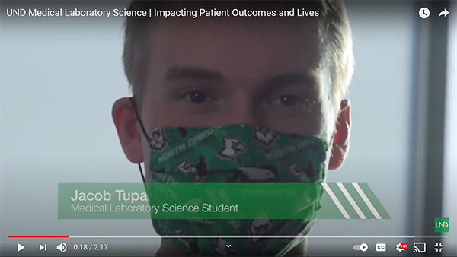
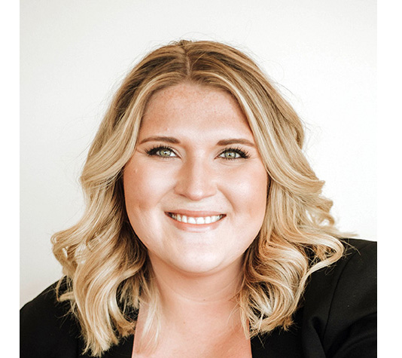
Impact of the UND SMHS on Healthcare Workforce: COVID-19
Jacob Tupa, a Medical Laboratory Science student, orchestrated 40+ volunteers to hand-write and mail letters to the elderly in nursing homes at height of COVID-19.
Katarina Domitrovich, MPH, graduated from our MPH Program in 2020 and was soon named the program’s COVID-19 case manager (work she was already doing). Katarina has been featured on local television news and quoted in local newspapers.

Slide 11
What is new is that we have a plan to address healthcare workforce issues
North Dakota’s Healthcare Workforce Initiative
Notes:
The entire report is available on-line. The Report outlines in detail the implementation and accomplishments of the Healthcare Workforce Initiative (HWI).

Slide 12
Percent of ND Medical Students Going to UND SMHS
ND tied for second-highest retention rate in the country!
Source: AAMC 2007 and 2019 State Physician Workforce Data Books
Notes:
This chart looks at the cohort of North Dakotans who matriculate in any medical school in the United States in the specified year. In 2007, two out of three North Dakotans who entered medical school came to the UND SMHS. Last year that percentage increased to more than nine out of ten.

Slide 13
Retention of UND SMHS Medical Student Graduates for Practice In-State
Source: Missions Management Tool 2013 – 2020, Association of American Medical Colleges
Notes:
This chart looks at the retention of UND SMHS medical student graduates for practice in-state. The data are shown as percentile, where our results are compared with all other medical schools. We have gone from well below average in 2013 to well above average in 2020. In 2020, our retention rate was better than that at more than two-thirds of the medical schools in the US.

Slide 14
UND SMHS Medical Student Cost to Attend (In-State Rate)
Percentile
Source: Missions Management Tools 2010-2020, Association of American Medical Colleges
Notes:
This chart again looks at percentile rank (UND SMHS compared with all other medical schools). In 2020, the cost to attend UND SMHS for a student from North Dakota was lower than at nine out of ten of the medical schools in the US.

Slide 15
UND SMHS Medical Student Debt
Percentile
RuralMed Scholarship program
Increased philanthropy directed at student debt
Notes:
This chart uses percentile rank to look at student debt over time. Our medical students in 2010 had average debt levels well about the national average at other medical schools, and we have now driven the debt level down so that in 2020 the medical students at more than two out of three medical schools had average debt levels more than our students did.

Slide 16
UND SMHS Outcomes
Metric | Percentile Rank
Percent of graduates practicing in rural areas (graduates 2005–2009) | 99th
Percent of graduates entering family medicine (2018) | 99th
Percent of graduates who are American Indian or Alaska Native | 100th
Source: Association of American Medical Colleges Missions Management Tool 2020

Slide 17
UND SMHS Outcomes
Metric | Percent
Completion rate for medical students (MD program) (average of last five years) | 93%
Completion rate for 4 major UND SMHS graduate programs (including MD) (average of last 5-9 years depending on program) | 94%
Source: Vital Signs – 2020 Community Report prepared by UND SMHS
Notes:
This chart looks at percent (not percentile). 93% of medical and 94% of all of our students graduate.

Slide 18
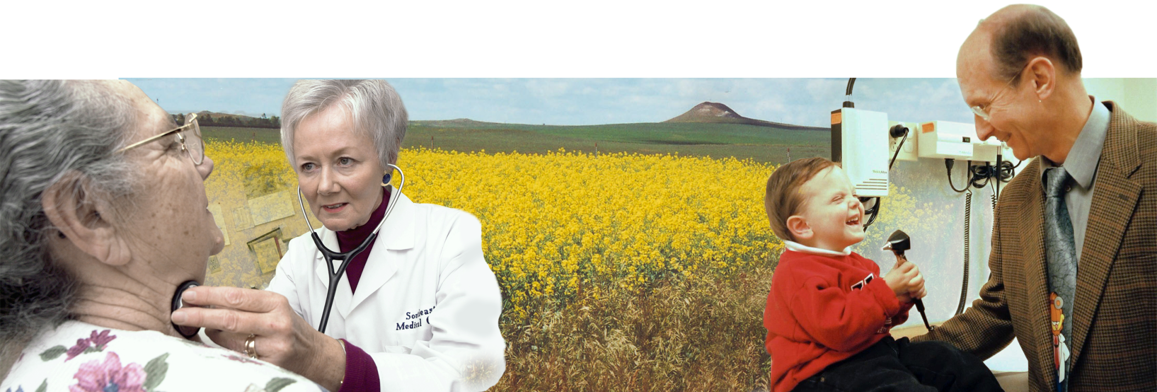
Value of the School and its Programs to the State
Providing healthcare professionals
74% of Family Medicine Physicians
46% of Physicians
51% of Physical Therapists
52% of Occupational Therapists
39% of Physician Assistants
47% of Medical Laboratory Scientists
Source: Sixth Biennial Report 2021 – Health Issues for the State of North Dakota

Slide 19
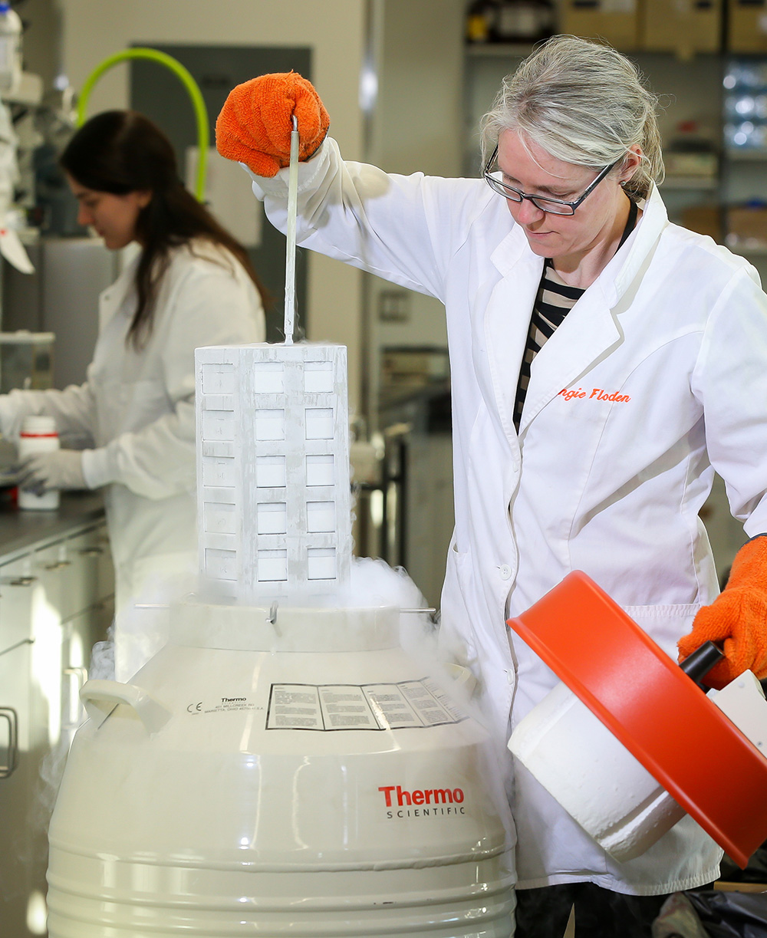
Research Funding – FY2007 to FY2020
Over those 14 years, UND SMHS faculty and staff submitted $1,301,697,374 in grant requests (over $1.3 billion!).
Over those same 14 years, they were awarded $298,722,775 in grants (over a quarter of a billion dollars!).
This is an effective yield of 23%!

Slide 20
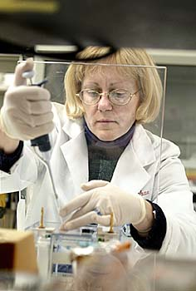
Example of the Value of Research That Should Resonate!
Dec. 31, 2019 - First confirmed case of SARS-CoV-2 (COVID-19) reported in Wuhan, China
Jan. 10, 2020 – Genetic sequence of the virus first reported
Sept. 2020 – 321 candidate vaccines in development
Dec. 8, 2020 – First human inoculated with the Pfizer vaccine in the UK

Slide 21
Research and Scholarship in 2020
Biomedical Sciences Postdoc Ping Lin was named an American Association of Immunologists “2020 AAI Careers in Immunology Fellow” with Prof. Min Wu.
Colin Combs was awarded a $1.4 million grant focusing on improving researchers’ understanding of how the brain communicates with the gastrointestinal tract via the gut-brain axis.
The Rural Health Information Hub in the UND Center for Rural Health received $14.5 million in funding from the Health Resource and Services Administration’s Federal Office of Rural Health Policy. The funds allow RHIhub to continue as a national clearinghouse for rural health scholarship.

Slide 22
UND SMHS Sponsored Funding
5% increase/year
53% increase since 2009
Notes:
This chart looks at external (sponsored) funding over time. Most of the funding comes from the federal government, especially the National Institutes of Health. Other important funding sources include state agencies (especially the North Dakota Department of Health) and foundations.

Slide 23
North Dakota’s Healthcare Workforce Initiative Started in the 2011-13 Biennium
Reduce disease burden ➔ focus on population health
Masters and Ph.D. public health degree programs (coordinated public health programs at UND and NDSU)
Retain more healthcare provider graduates for North Dakota
RuralMed Program (that has been expanded over time to include more specialties needed in North Dakota)

Slide 24
Healthcare Workforce Initiative
Train more healthcare providers
Medical student class increased by 16/year (total of 64)
86% of medical students are from ND or have strong ties here
Health sciences students increased by 30/year (total of 90)
Resident (post-MD training required prior to clinical practice) slots increased by 35 with a plan to ramp up to 51 or more (aided by public “private” partnerships with healthcare systems)
Improve the efficiency of the healthcare delivery system
Training in interprofessional healthcare teams
Developing “virtual care” approaches that bring the clinic to the patient rather than the other way around (especially important in rural areas)

Slide 25
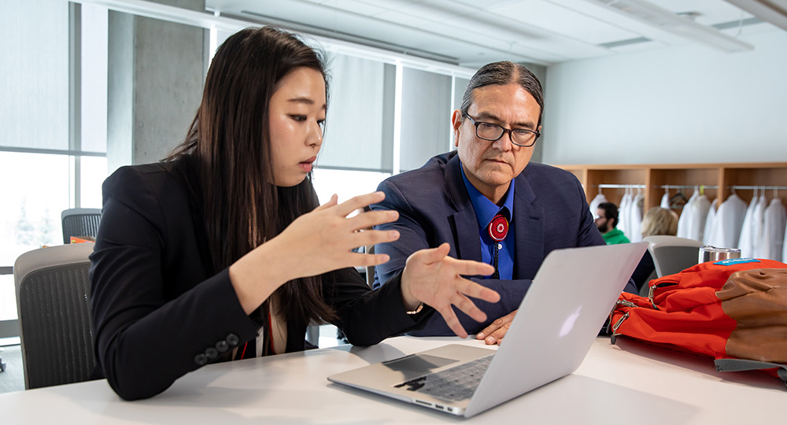
Implementation of Healthcare Workforce Initiative Over the Past Five Biennia
Increased medical school class size by 25% and residencies by 35%
Expanded medical student and other academic programs
Minot Integrated Longitudinal Experience (MILE) program for medical students
Departments of Population Health,
Geriatrics, and Emergency Medicine
Public Health program
Masters in Public Health
First-ever Ph.D. program in
Indigenous Health

Slide 26
Growth in Number of UND SMHS Public Health Students (Masters and Ph.D. Degrees)

Slide 27
Implementation of Healthcare Workforce Initiative Over the Past Five Biennia
Added new residency programs focusing on rural primary care and other physician provider shortage needs identified in North Dakota
Intensified clinician retention efforts
Attract the vast majority of future doctors who are from North Dakota to the UND SMHS
RuralMed program
Intensified efforts to train providers dedicated to transforming healthcare delivery
Interprofessional teams
Virtual medicine

Slide 28
Summary of Impact of HWI over the Past Decade
Retained more ND medical school matriculants than ever before (tied for second-highest in US)
Retained more physicians and other clinicians for practice in North Dakota
Trained more physicians and other clinicians for practice in North Dakota

Slide 29
Limited Options for UND SMHS to Adjust to Executive Budget Recommendations
Available options
Admit additional students to increase revenue
Admit out-of-state students
Limited clinical slots available in the state
Increase tuition more than planned
Eliminate programs to reduce expenses

Slide 30
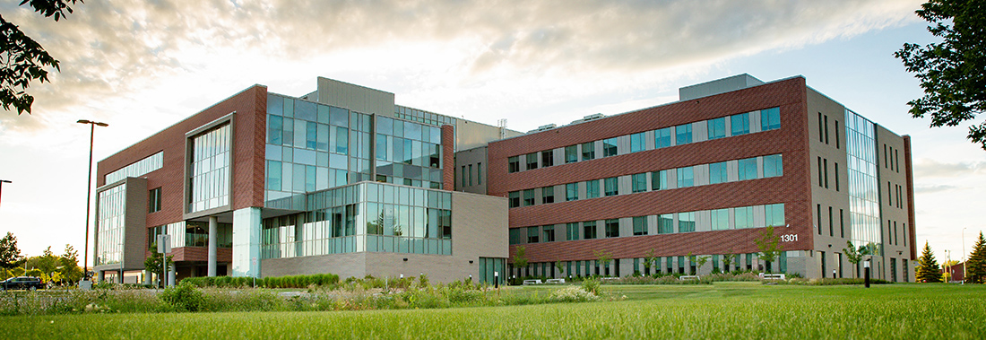
UND SMHS Degree Programs
Doctor of Medicine
Physical Therapy
Occupational Therapy
Medical Laboratory Science
Physician Assistant Studies
Sports Medicine/Athletic Training
Public Health (Masters and PhD in Indigenous Health)
Graduate programs in biomedical/translational sciences

Slide 31
Executive Budget Compared With UND SMHS Needs-Based Budget
The Executive Budget entails a $4,396,310 cut in appropriated funding compared with the UND SMHS needs-based budget submitted by the NDUS
There are two major components to this shortfall:
A shortfall due to the proposed reduction of 7.5% in student credit hour funding
A shortfall due to the proposed 3% + 3% merit increase (to cover the additional expenses for non-appropriated salaries)

Slide 32
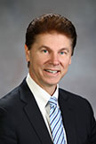
David Molmen, MPH
Chair, UND SMHS Advisory Council
CEO, Altru Health System, Grand Forks, ND

Slide 33
Responsibilities of the UND SMHS Advisory Council
“The advisory council…shall study and make recommendations regarding the strategic plan, programs, and facilities of the school of medicine…The recommendations must:
(1) Address the healthcare needs of the people of the state;
(2) Provide information regarding the state's healthcare workforce needs; and
(3) Provide information that specifies the contributions that the university of North Dakota school of medicine and health sciences and the residency training programs in the state are making to meet the healthcare provider workforce needs of the state.”
Source: North Dakota Century Code Section 15-52-04

Slide 34
UND SMHS Budget Proposal
The Healthcare Workforce Initiative (HWI) involved an agreement between the School and the Legislature for increased healthcare clinicians and healthcare programming for North Dakota provided by the UND SMHS to be supported by increased financial resources provided by the state.
The UND SMHS is keeping its side of the agreement.
Now the state needs to do the same.
The School is not asking for more to do less; it is asking for the necessary funding so it can do even more (including further expansion of residency programs).

Slide 35
Recommendations UND SMHS Advisory Council Meeting 12/11/20
The highest recommendation is to provide the requisite funding for the UND SMHS and its Healthcare Workforce Initiative by approving the needs-based budget (an increase of $4,396,310 over the Executive Budget).
To ensure the recruitment and retention of high-performing faculty and staff, it is important to endorse the 3%+3% salary merit increases proposed by NDUS/SBHE.

Slide 36
Comparison of UND SMHS Faculty Base Salaries (Basic Sciences Faculty)
UND | All Other Medical Schools
Assistant Professor | -2%
Associate Professor | -7%
Full Professor | -22%
All medical school faculty | -10%
Source: Association of American Medical Colleges Adjusted FY 2019-20 public medical schools mean salary survey data
Notes:
This chart shows basic sciences faculty salaries at the UND SMHS compared with those at all other medical schools in the US. Overall, our salaries are 10% below the average salaries elsewhere, and the disparity increases as faculty progress through the academic ranks. Thus, retention becomes an issue. A robust merit pool (3% + 3%) will help reduce this salary inequity and hopefully help with retention.

Slide 37
Recommendations UND SMHS Advisory Council Meeting 12/11/20
3. Because appropriated funding does not cover all the costs associated with a merit increase (non-appropriated salary sources and associated fringe benefits), it is strongly recommended that an additional amount be allocated to cover the remaining shortfall.

Slide 38
Recommendations UND SMHS Advisory Council Meeting 12/11/20
Endorsement of these three funding recommendations by the legislature will enable the UND SMHS to continue its efforts to provide the necessary healthcare workforce and programing to improve the quality of life of North Dakotans (as specified in the North Dakota Century Code).

Slide 39
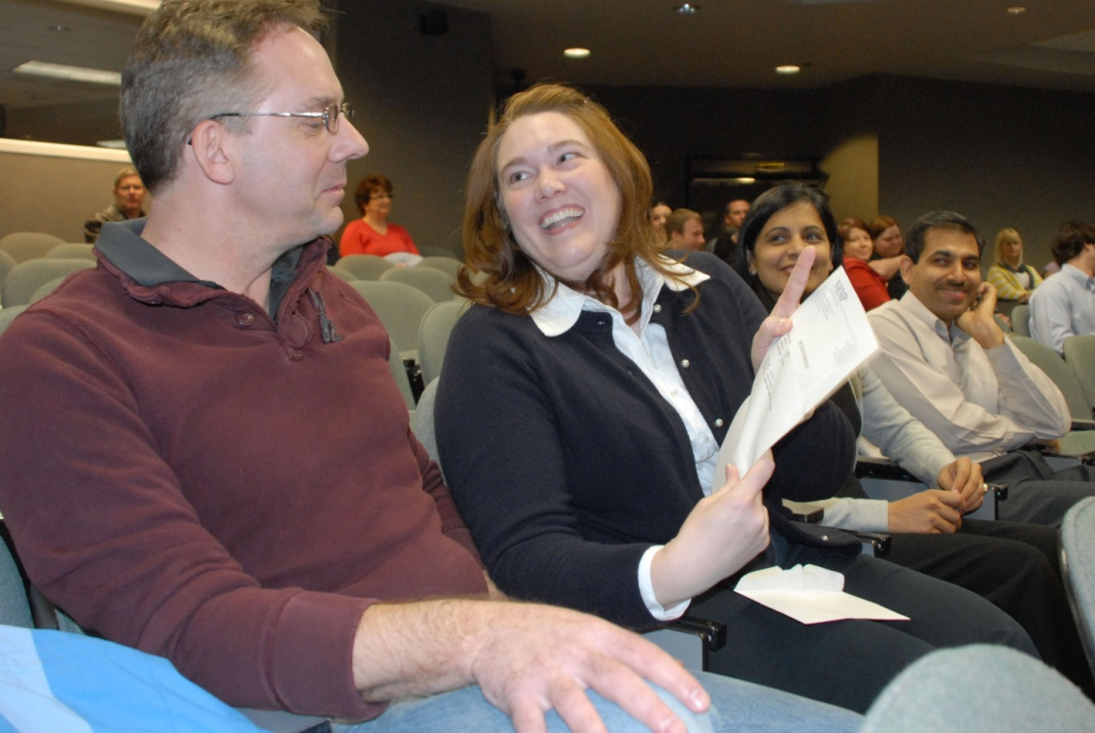
Our Purpose as a School
Educate
Discover
Serve

Slide 40
Our Goals
To be the best community-based school in the country
To continue to be an innovator in education (with a focus on interprofessional teams)
To continue to develop focused programs of research excellence
To serve the people of North Dakota and beyond
Rural health
Healthcare workforce
Primary care (especially family medicine)
Health promotion
Interprofessional care
Virtual care

Slide 41
