Slide 1
Interim Higher Education Committee Meeting
September 14, 2020
Joshua Wynne, MD, MBA, MPH
Chief Health Strategist, State of North Dakota
Vice President for Health Affairs, UND
Dean, UND SMHS
Executive Secretary, UND SMHS Advisory Council

Slide 2
Outline of This Afternoon’s UND SMHS Briefing Where We Are and Where We Hope to Go
Overview of duties of the UND SMHS Advisory Council
Overview of the UND School of Medicine & Health Sciences
Mission/Purpose – What we do
Overview of our student classes
COVID-19 Impact
Financial status
Education
Discovery (research and scholarship)
Service – Mr. Molmen
Status of the Healthcare Workforce Initiative (HWI)
Preview of Sixth Biennial Report 2021 – Health Issues for the State of North Dakota
SMHS Agenda for the upcoming biennium and beyond ➔Where we hope to go

Slide 3
The Duties of the SMHS Advisory Council NDCC Section 15-52-04
The advisory council, in consultation with the school of medicine and health sciences and the other agencies, associations, and institutions represented on the advisory council, shall study and make recommendations regarding the strategic plan, programs, and facilities of the school of medicine and health sciences.

Slide 4
Legislators |  |  | State Board of Higher Education
Sen. Robert Erbele, Lehr |  |  | Dr. Casey Ryan, Grand Forks
Sen. Tim Mathern, Fargo
Rep. Gretchen Dobervich, Fargo |  |  | Veterans Administration
Rep. Jon Nelson, Rugby |  |  | Dr. Breton Weintraub, Fargo
North Dakota Department of Health |  |  | ND Hospital Association
(Dr. Paul Mariani) |  |  | Dr. Michael LeBeau, Bismarck
ND Medical Association |  |  | UND SMHS Center for Rural Health
Dr. Misty Anderson, Valley City |  |  | Brad Gibbens, Grand Forks
North Dakota Department of Human Services |  |  | Members selected by the Dean
Christopher Jones, Bismarck |  |  | John Kutch, Minot
 |  |  | Dr. Shari Orser, Bismarck
Executive Secretary |  |  | Dr. Thomas Arnold, Dickinson
Dr. Joshua Wynne, UND SMHS |  |  | Dr. Stephen Tinguely, Fargo
Chairperson
David Molmen, Altru Health System
Ex-Officio
Courtney Koebele, Bismarck
Executive Secretary Dr. Joshua Wynne, UND SMHS
Chairperson David Molmen, Altru Health System
Ex-Officio Courtney Koebele, Bismarck
North Dakota Center for Nursing
Dean Gross, Fargo

Slide 5
Our Purpose as a School
“The primary purpose of the University of North Dakota School of Medicine and Health Sciences is to educate physicians and other health professionals and to enhance the quality of life in North Dakota. Other purposes include the discovery of knowledge that benefits the people of this state and enhances the quality of their lives.”
Source: North Dakota Century Code
Section 15-52-01

Slide 6
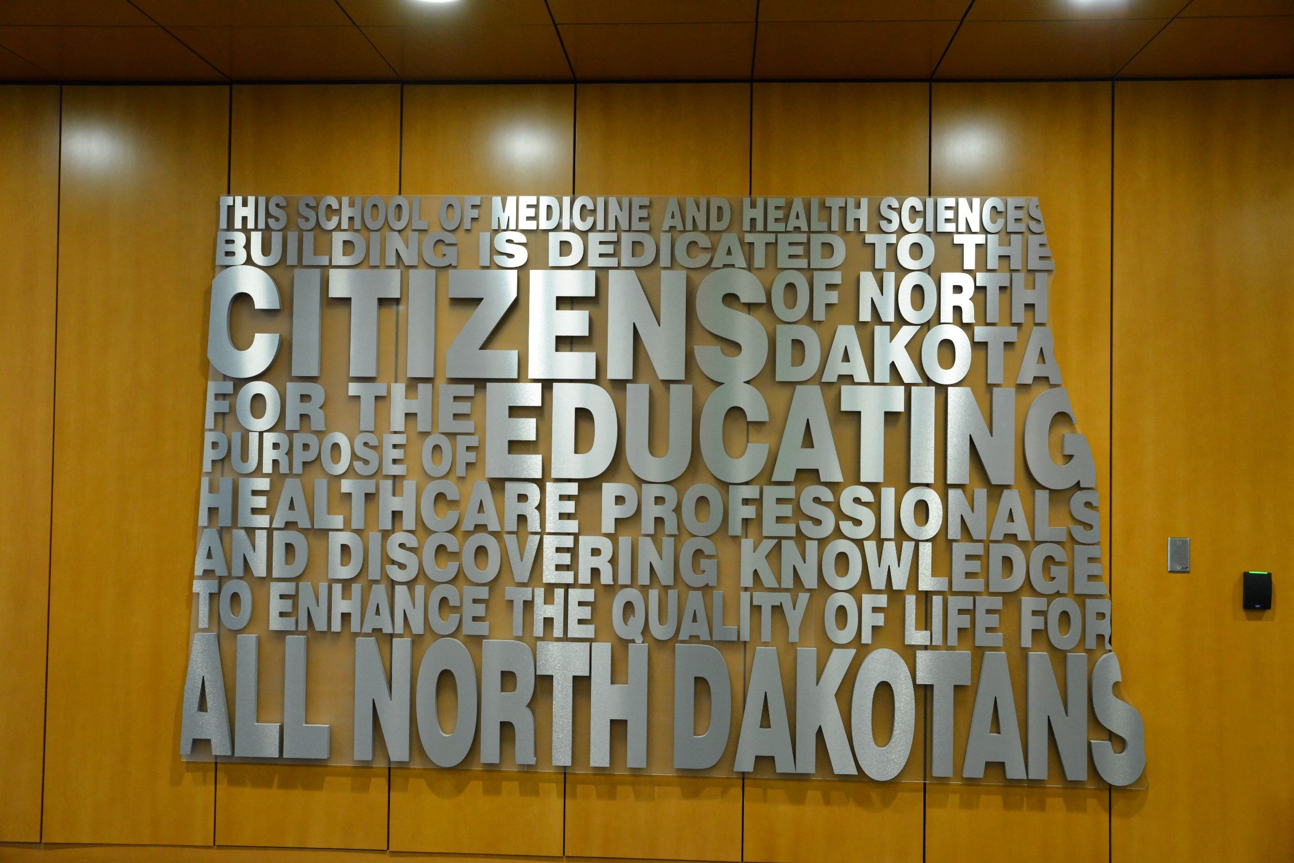

Slide 7
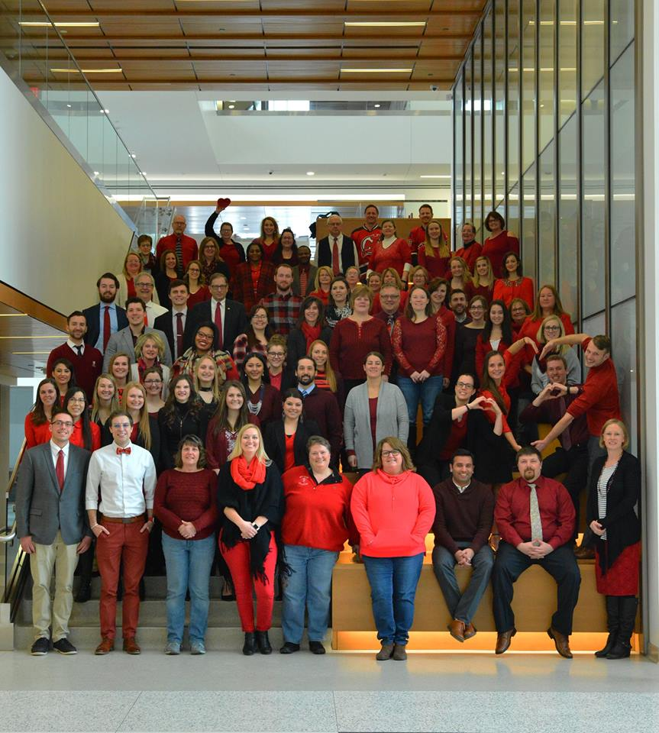
Who We Are
174 full-time academic faculty
Over 1,300 volunteer faculty members ➔2 out of 3 of all physicians in North Dakota!
249 benefited staff
Over 2,000 students

Slide 8
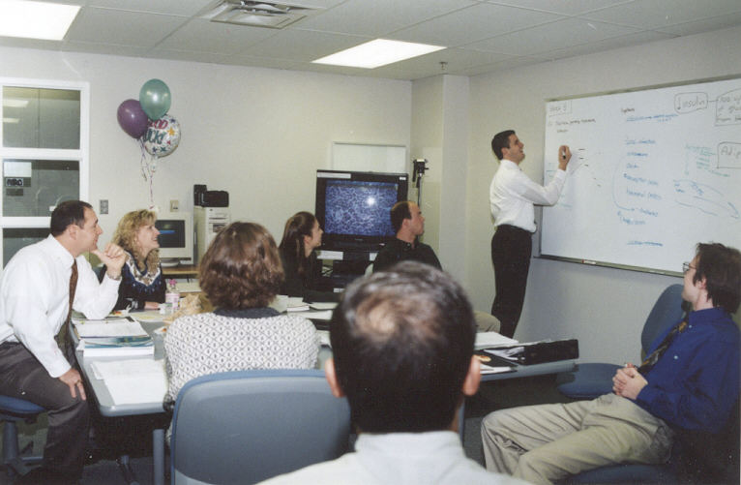
What We Do

Slide 9
UND SMHS offers a wide variety of academic programs
Medicine
Doctor of Medicine
Residency programs in:
Family Medicine (Sanford)
Rural tracks
Internal Medicine
Surgery
Rural track
Orthopedic Surgery (Sanford)
Psychiatry
Telepsychiatry
Transitional
Health Sciences/Related
Physical Therapy
Occupational Therapy
Medical Laboratory Science
Master and PhD of Public Health
Physician Assistant Studies
Sports Medicine/Athletic Training
Graduate programs (masters and PhD) in biomedical sciences

Slide 10
COVID-19 Impact
Since March, classroom education had been completely on-line
With the start of the fall semester, we have largely transitioned back to in-person classes, although many of our courses have used a hybrid approach with inclusion of on-line learning for quite some time
Almost all clinical experiences in hospitals and clinics have re-started (they all were temporarily suspended previously)
The financial impact on the UND SMHS was limited by the reduction in effort program, but we encountered real losses due to a temporary downturn in patient visits ( and thus revenue) at our Centers for Family Medicine in Bismarck and Minot. The losses total almost $500,000.
Fall student enrollment numbers at the SMHS are essentially as previously anticipated (slight reduction in international graduate students)

Slide 11
Sources of Revenue
FY19 & FY20 Estimated
Revenue $207,169,222

Slide 12
Tuition and Fee Comparison
 | 2014-15 | 2015-16 | 2016-17 | 2017-18 | 2018-19 | 2019-20 | FY20 Increase from FY19 | FY20 Increase from FY15
Minnesota | $ 36,800 | $ 38,601 | $ 38,537 | $ 38,518 | $ 39,342 | $ 40,231 | 2.2% | 8.5%
AAMC Midwest Mean | $ 34,386 | $ 35,466 | $ 35,989 | $ 36,640 | $ 39,455 | $ 40,134 | 1.7% | 14.3%
South Dakota | $ 33,554 | $ 34,924 | $ 33,373 | $ 33,946 | $ 35,054 | $ 36,204 | 3.2% | 7.3%
Nebraska | $ 31,145 | $ 31,199 | $ 32,465 | $ 34,302 | $ 38,052 | $ 39,427 | 3.5% | 21.0%
North Dakota | $ 28,614 | $ 29,496 | $ 30,239 | $ 31,433 | $ 32,601 | $ 33,588 | 2.9% | 14.8%

Slide 13
UND SMHS Medical Student Cost to Attend (Percentile Comparison) (In-state rate)
Source: Missions Management Tools 2010-2020, Association of American Medical Colleges

Slide 14
UND SMHS Medical Student Debt (Percentile Comparison)
RuralMed Scholarship program
Increased philanthropy directed at student debt

Slide 15
Uses of Revenue
FY 19 & 20 Estimated Expenditures $207,169,222

Slide 16
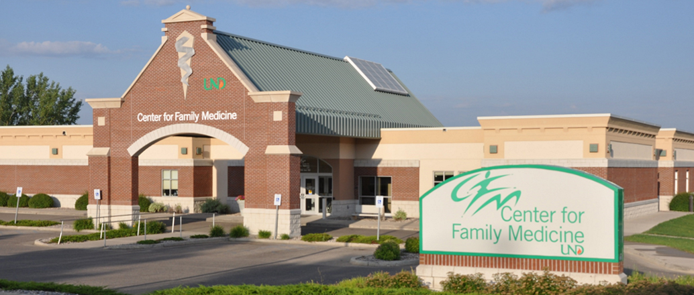
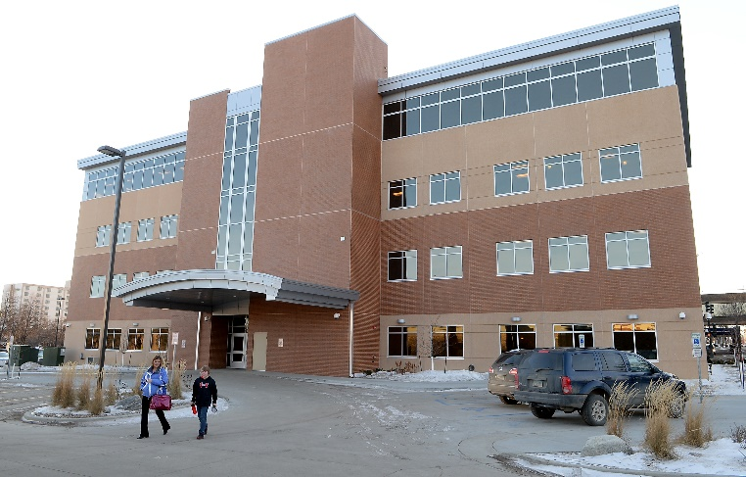
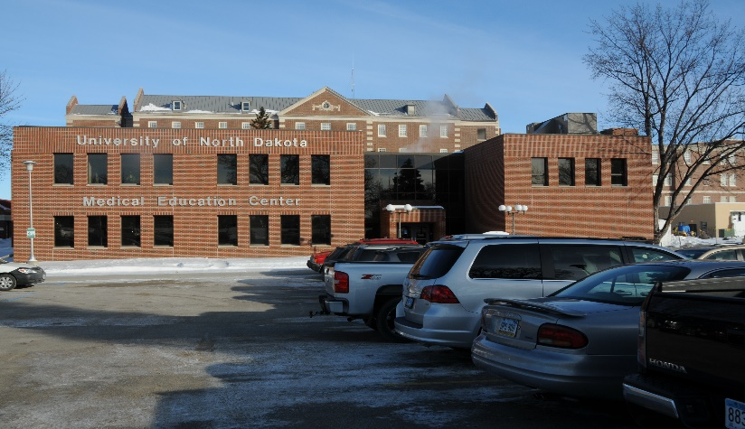
A School Without Walls
The UND SMHS is one of 35 community-based medical schools (those that don’t own or operate a hospital) out of a total of 155 medical schools in the United States.
We rely on over 1,300 part-time (voluntary) clinical faculty members in over 30 communities throughout the state to educate medical students and residents.
More than two out of three of all of the physicians in the state are voluntary members of our faculty

Slide 17
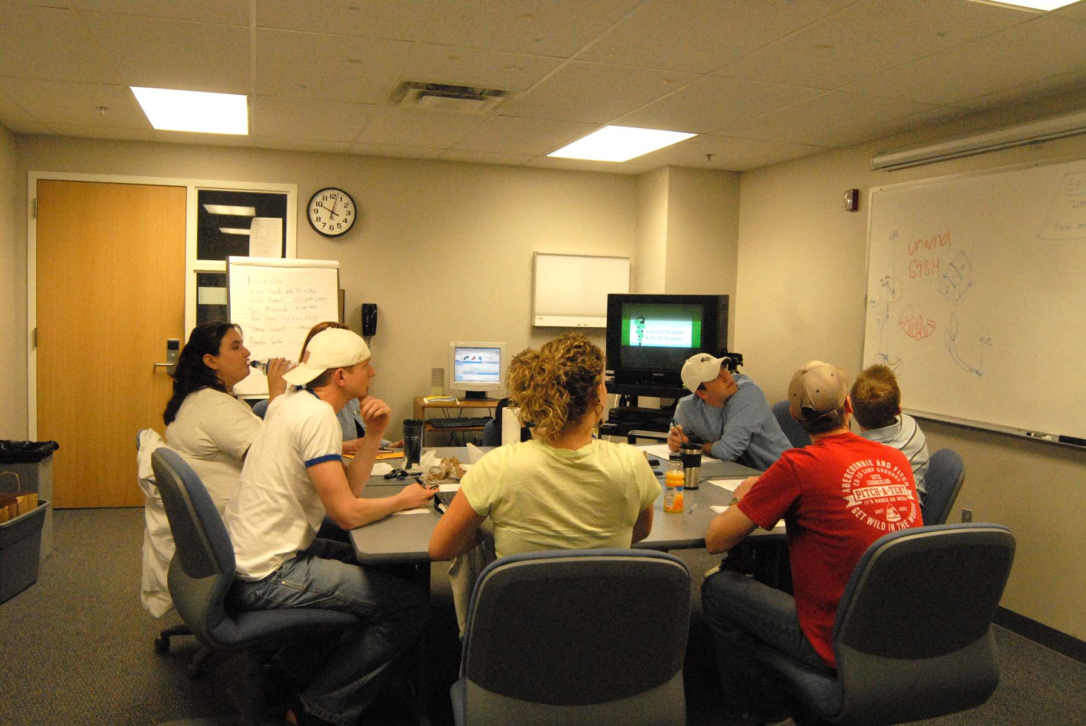
Small Group Patient-Centered Learning

Slide 18
UND SMHS Simulation Center SIM-ND - Four mobile vans that cover each quadrant of North Dakota

Slide 19
Interprofessional Health Care
Interprofessional education ensures that future healthcare professionals can better communicate and work as a team.
Involves students from the full spectrum of healthcare – medicine, nursing, physical therapy, social work, communication sciences, dietetics, occupational therapy, health sciences.

Slide 20
Primary Care
Focus on primary care education, especially for rural areas of North Dakota
Educate medical and health sciences students in rural communities
Nationally cited Rural Opportunities in Medical Education (ROME) program

Slide 21
INMED (Indians into Medicine) Program
Nearly twenty percent of all of the American Indian physicians practicing in the United States are graduates of the UND SMHS Indians into Medicine (INMED) program.
Our school is at the 100th percentile as to the fraction of our class that is American Indian – best in the country!

Slide 22
Rural Health
Center for Rural Health is one of the nation’s best
Home to the only national Rural Health Information Hub
Improve health in rural communities through community medicine and prevention programs
Extensive research on the healthcare needs of people in rural communities
Promulgate rural health policy

Slide 23
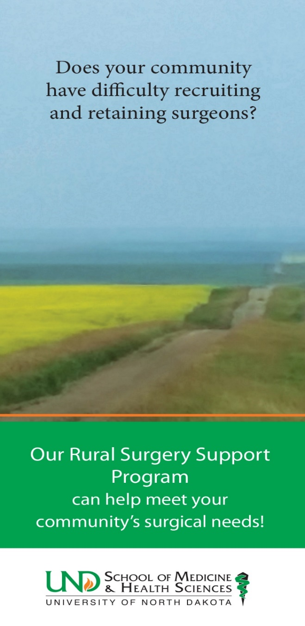
Service to the Community
RuralMed
Rural Opportunities In Medical Education (ROME)
Center for Rural Health
SCRUBS Academy and camps
Rural residencies
Rural Surgery Support Program
Provides temporary surgical support and coverage
SIM-ND
Provides simulator training in vans to each quadrant of the state

Slide 24
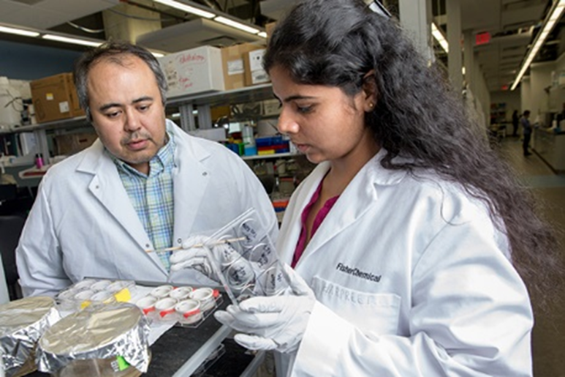
Research Programs
We focus on studying diseases of relevance to North Dakota
Alzheimer’s and other neurodegenerative diseases
Diseases of aging
Cancer
Infectious diseases
Opioid addiction
Epigenetics
New record of external funding for
research for FY20 – $30.8M

Slide 25
UND SMHS Research Opportunities
UND SMHS Grand Challenge➔ Clinical and Translational Medicine – We have the opportunity to build on a $20M CTR grant from the federal government
Virtual care delivery
Artificial intelligence/machine learning analysis of health data – Electronic Health Record
Opioid/substance disorders and behavioral health

Slide 26
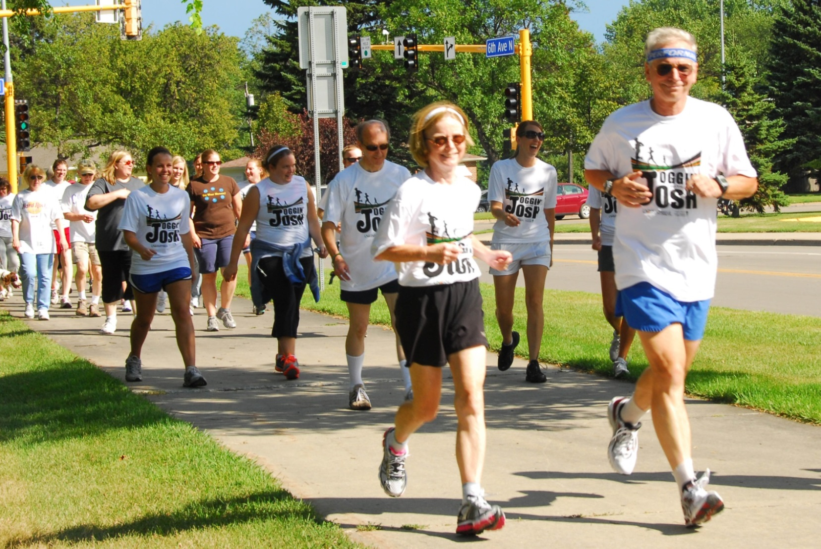
We Practice What We Preach!
The first ever virtual Joggin’ with Josh took place this past Saturday

Slide 27
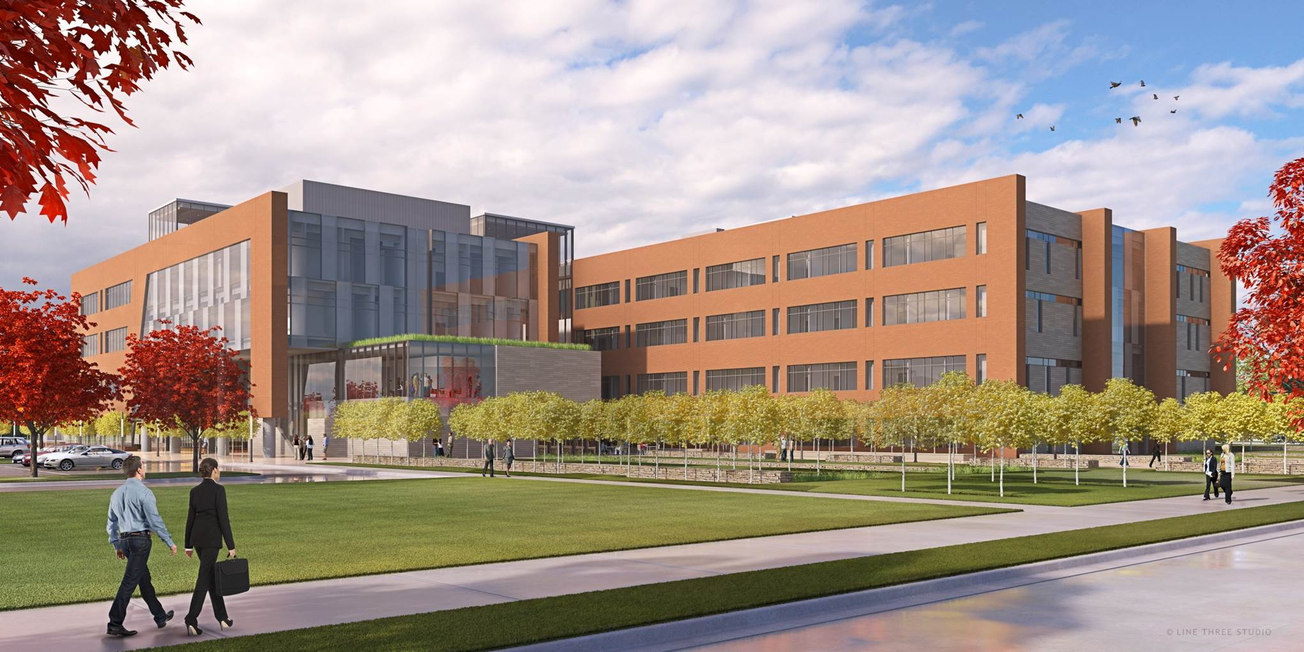
Healthcare Workforce Initiative Dave Molmen, MPH Interim CEO, Altru Health System Chair, UND SMHS Advisory Council

Slide 28
Healthcare Workforce Initiative
Reduce disease burden
Master and Doctorate of Public Health degree programs
Further programming approaches under study to address mental and behavioral health issues in the state
Retain more healthcare provider graduates for North Dakota
RuralMed program (we are at the 99th percentile for producing rural physicians)
UND SMHS recognized as one of the top schools in the nation for the percentage of its graduating class going into family medicine (99th percentile)

Slide 29
UND SMHS Healthcare Workforce Initiative
Train more healthcare providers
Medical student class increased by 16/year
Health sciences students increased by 30/year
Increased resident slots
Approved additional slots in rural family medicine, rural general surgery, hospitalist, internal medicine
Improve efficiency of delivery system
Training in inter-professional healthcare teams
Use of “learning communities” in new building
Increased use of telehealth

Slide 30
Preview of Sixth Biennial Report Health Issues for the State of North Dakota
Chapter 1 – The Population of North Dakota and the Attendant Health Needs
Population trends in the state have remained relatively stable in relation to total population, age, insurance status, and poverty rates.
Chapter 2 – Social Determinants of Health in ND
New chapter
Have gathered data points specific to North Dakota around social determinants of health including:
The economy and employment
Education
Food access
Physical infrastructure
Social support and community context
Health and healthcare

Slide 31
Preview of Sixth Biennial Report Health Issues for the State of North Dakota
Chapter 3 – The Health of North Dakota
The percentage of people reporting one or more days of poor health (in the last 30 days) decreased.
The percentage of adults who smoke, drink alcohol, binge drinks, or drink and drive has decreased.
Chapter 4 – Physician Workforce in North Dakota
North Dakota continues to have less physicians per 10,000 people compared to the Midwest and the US
North Dakota has more female physicians per 10,000 than previous years.
The rate of IMGs and USMGs has increased in North Dakota and the United States, while the Midwest had a much larger increase in USMGs.

Slide 32
Preview of Sixth Biennial Report Health Issues for the State of North Dakota
Chapter 5 – Primary Care Providers and Specialty Physician Workforce in ND
North Dakota now has more office-based primary care physicians than previous years. North Dakota continues to have more hospital-based primary care providers than the upper Midwest and US.
Number of psychiatrists has increased.
Chapter 6 – Nursing Workforce in ND
Obtained new data from the Long Term Care Association
North Dakota has seen an increase in both RN and LPNs.
In 2019 North Dakota saw a slight increase in LPNs licensed in North Dakota who graduated from a nursing program in the state.
In 2019 North Dakota saw a slight increase in Nurse Practitioners licensed in North Dakota who graduated from a nursing program in the state.

Slide 33
Preview of Sixth Biennial Report Health Issues for the State of North Dakota
Chapter 7 – Behavioral Health and Non-Physician Healthcare Workforce in ND
New: Tiered system for defining behavioral health professionals and behavioral health paraprofessionals; Education and licensure requirements for behavioral health professional in ND; Behavioral health educational programs in ND
Chapter 8 – Healthcare Facility Workforce in North Dakota
New: Behavioral health facility workforce survey
The largest vacancies found among behavioral health facility staff were licensed professional counselors, licensed professional clinical counselors, physician assistants, and licensed clinical social workers.

Slide 34
Preview of Sixth Biennial Report Health Issues for the State of North Dakota
Chapter 9 – Healthcare Organization and Infrastructure in ND Hospitals
Reconfigured chapter with an emphasis on telemedicine
Chapter 10 – Quality and Value of Healthcare
Summarized the impact of the 2019 legislative authorization of the Department of Human Services to create a Medicaid 1915(i) State Plan Amendment.
Summarized the impact of the 2019 legislative authorization to extend Medicaid expansion, thus increasing access and coverage for those who qualified under expansion criteria.

Slide 35
Preview of Sixth Biennial Report Health Issues for the State of North Dakota
Chapter 11 – Conclusion
Content has been updated
Chapter 12 – Healthcare Workforce Development
Content has been updated
Chapter 13 – Recommendations: Healthcare Planning for North Dakota
Content has been updated
Appendices
Center for Rural Health has generated an updated appendix section of what has been done on the community development side

Slide 36
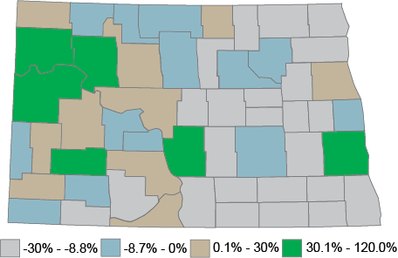
Percentage change in county population from 2000 to 2017
Nine counties have increased their population by an average of 10% or more from 2000 to 2017. The largest gains were in McKenzie, Williams, and Mountrail counties. Seven counties had population gains of less than 10%. 37 counties have lost population.

Slide 37
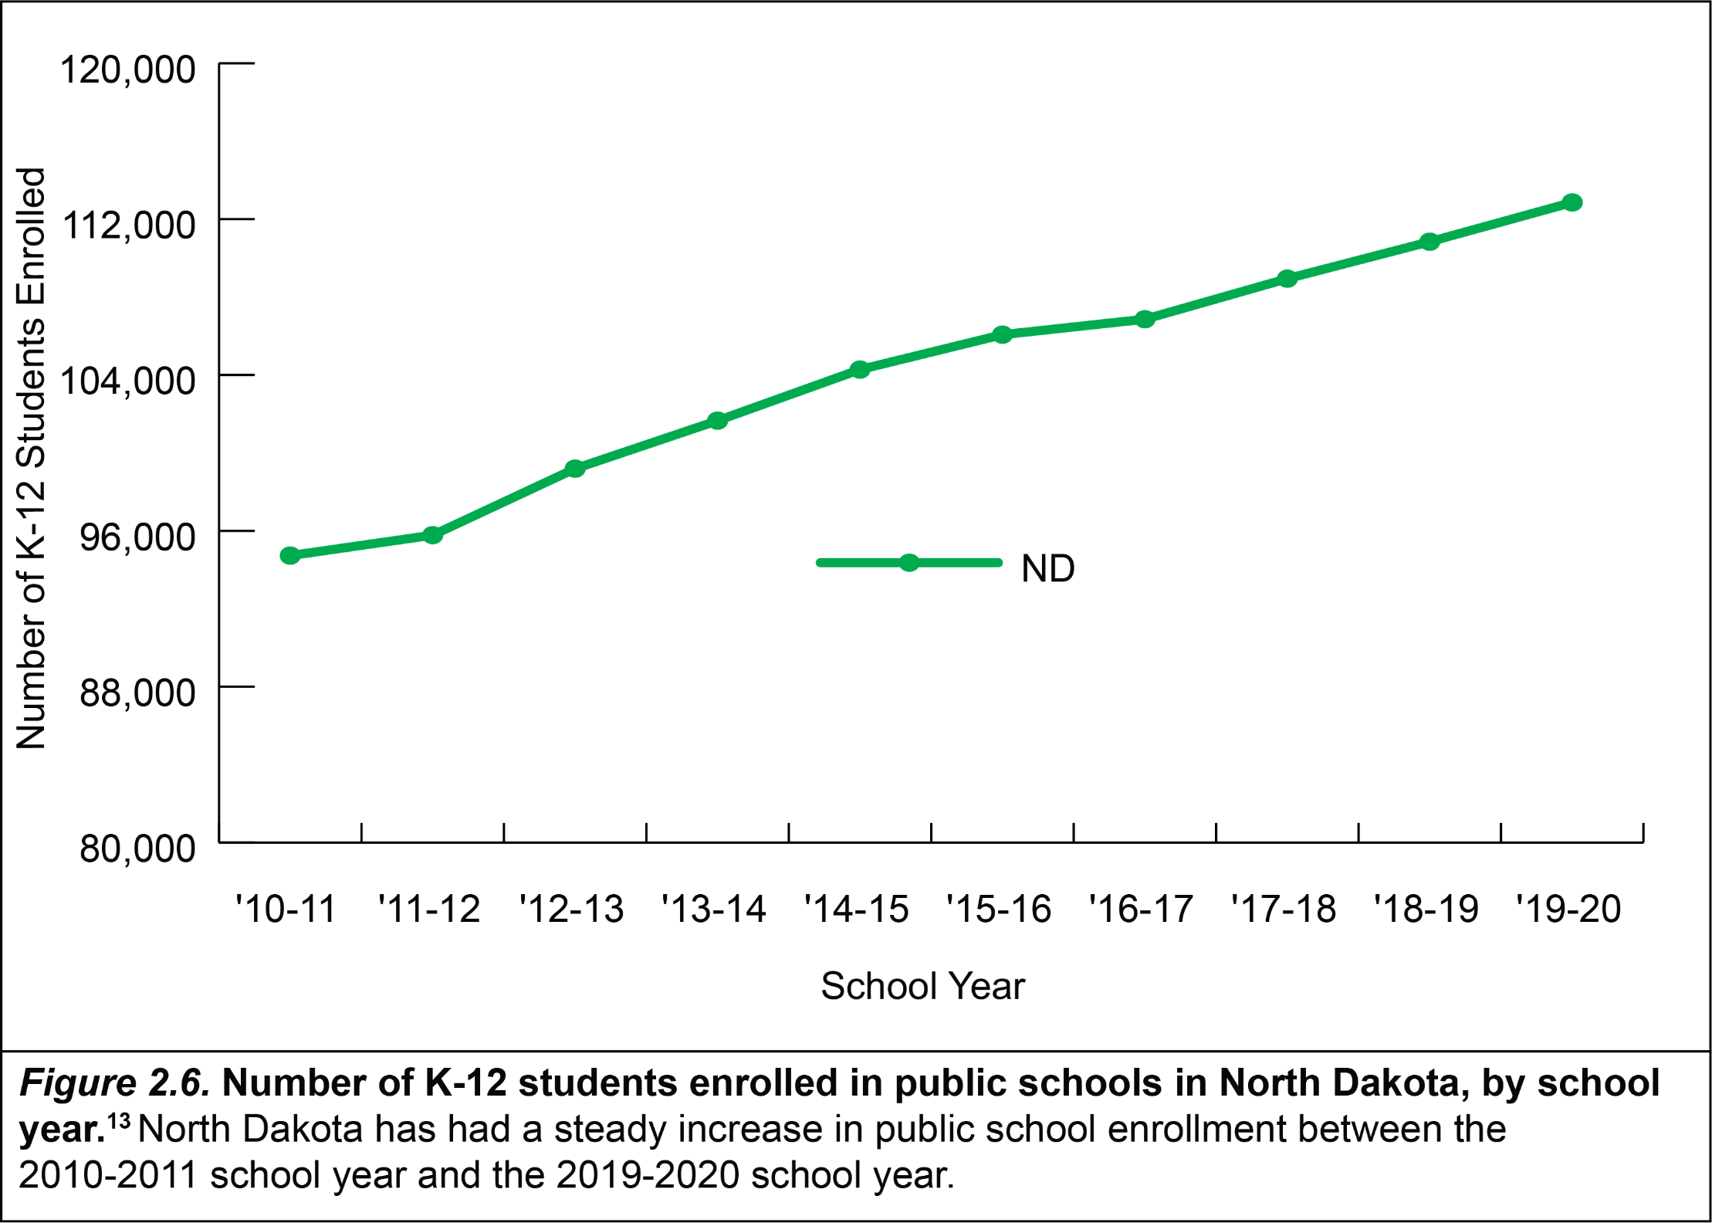

Slide 38
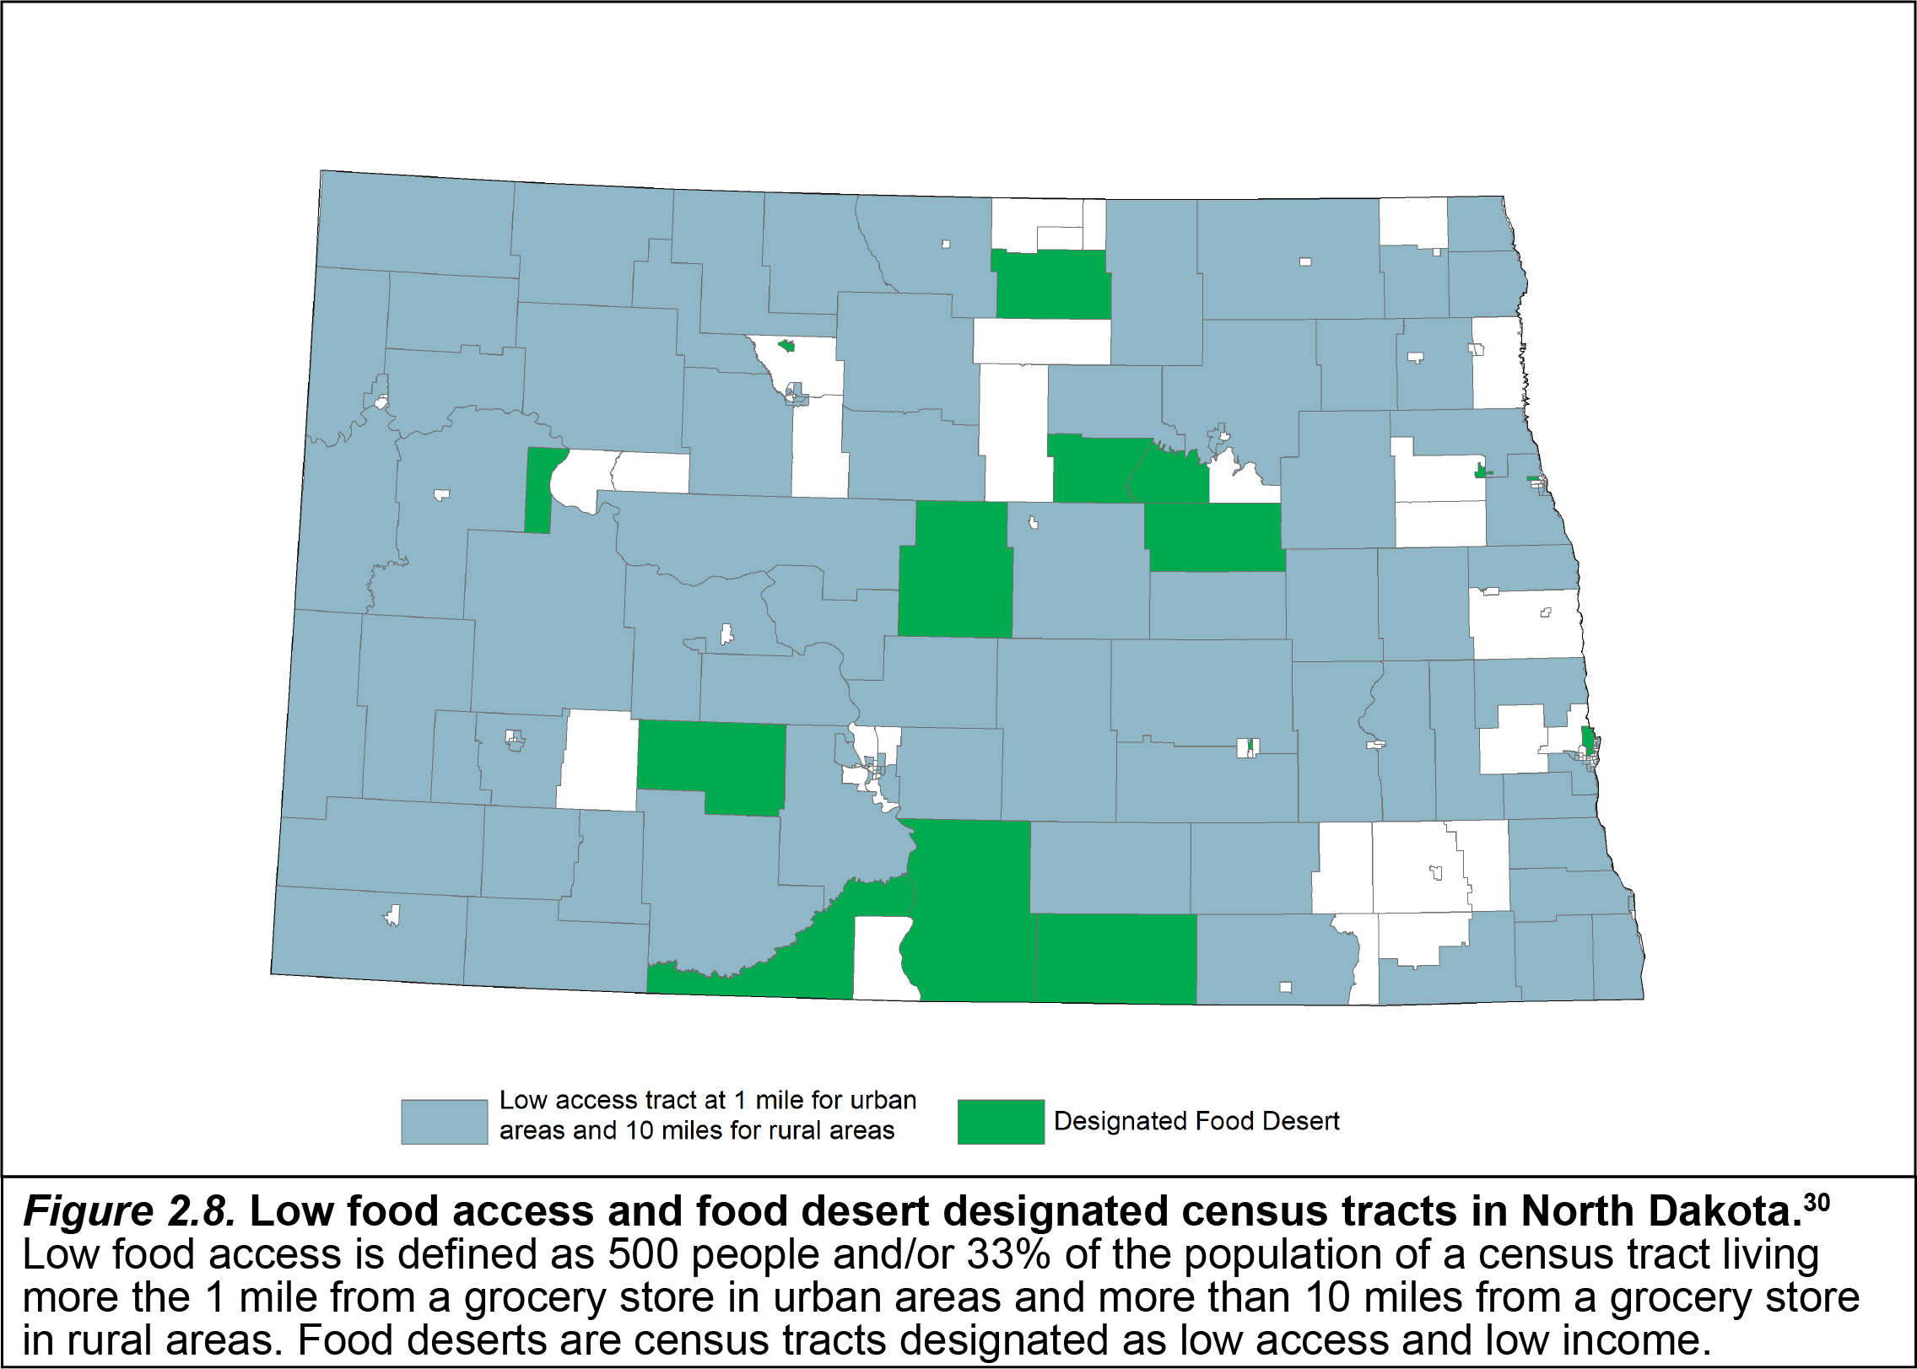

Slide 39
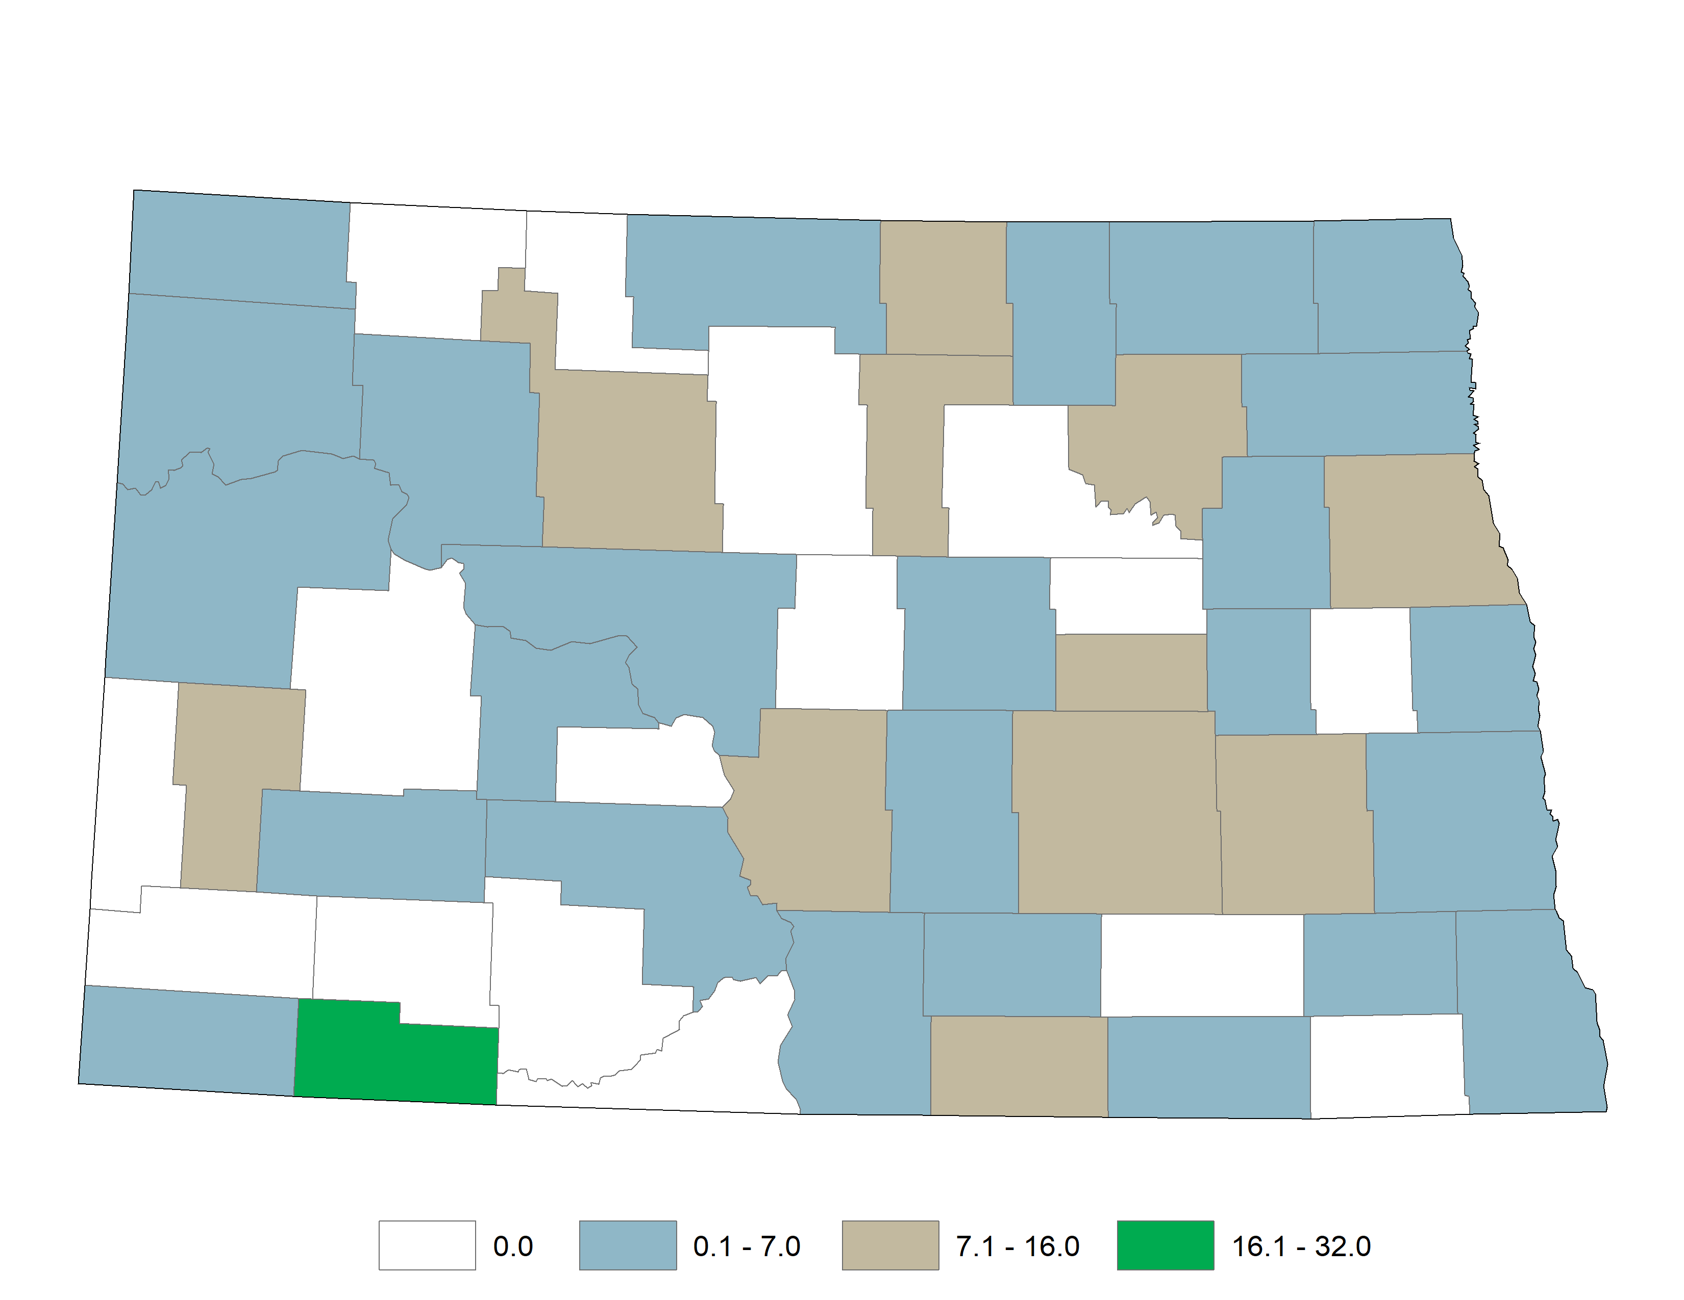
Number of primary care physicians per 10,000 residents in each North Dakota county
The following specialties were used to determine primary care physicians: Family medicine/Preventive Medicine, Family Practice, Family Practice Geriatric Medicine, General Practice, Internal Medicine – Family Practice, and Pediatrics. Sixteen counties do not have any primary care physicians working within the county.

Slide 40
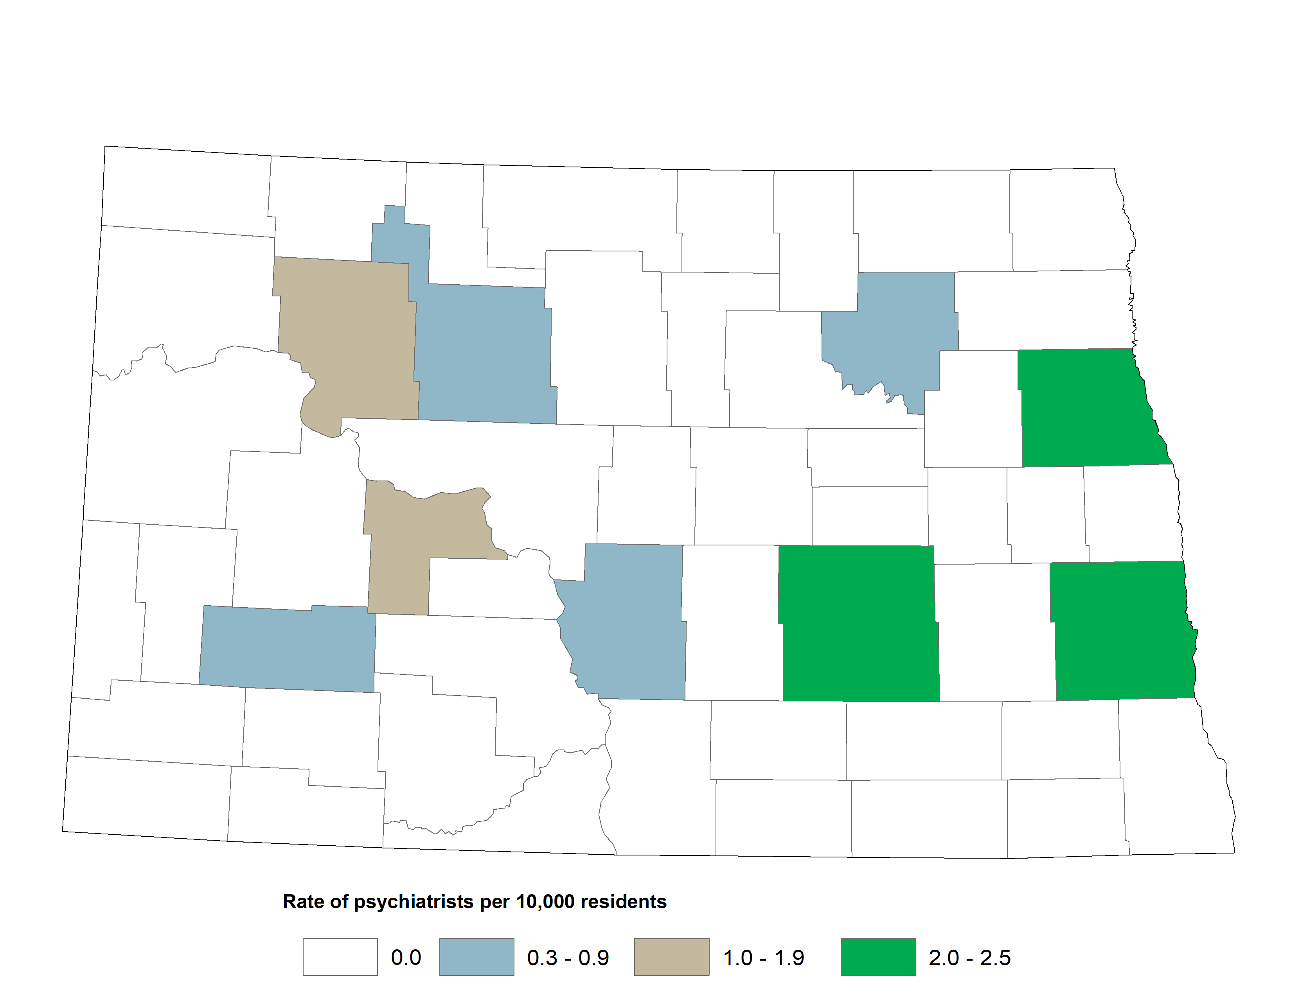
Number of psychiatrists per 10,000 residents in each North Dakota county

Slide 41
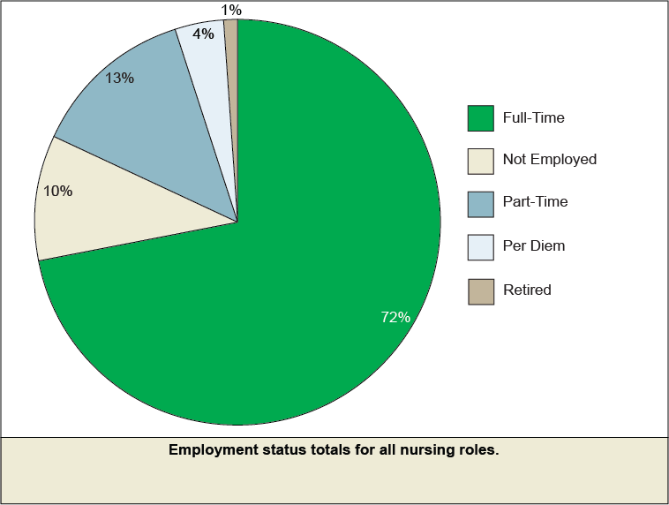

Slide 42
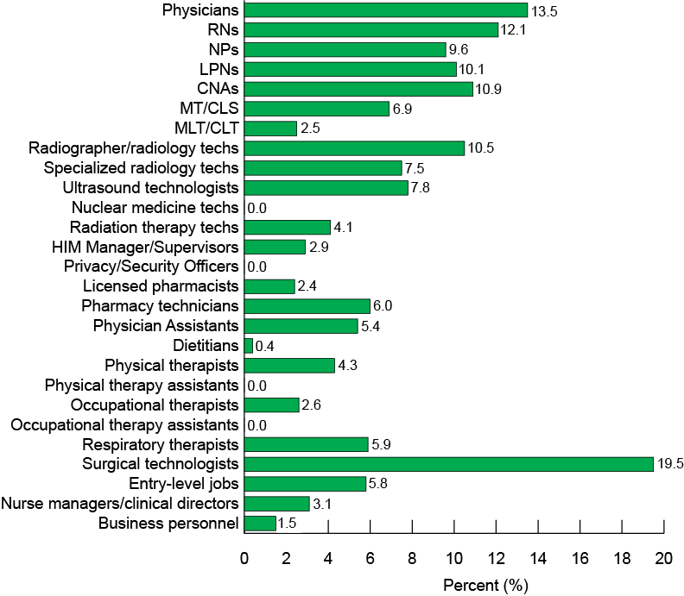
Statewide aggregate hospital (Big 6 and CAHs) workforce vacancy rates

Slide 43
Dr. Wynne

Slide 44
How Are We Doing? And Where Do We Hope to Go?
UND SMHS prepares an annual report that is widely distributed (internally and externally) in October of each year
Called Vital Signs, is a way for stakeholders to “take the pulse” of the UND SMHS
Incorporates a variety of objective metrics to assess the progress of the UND SMHS in meeting its educational, research and scholarly, and service missions and obligations

Slide 45
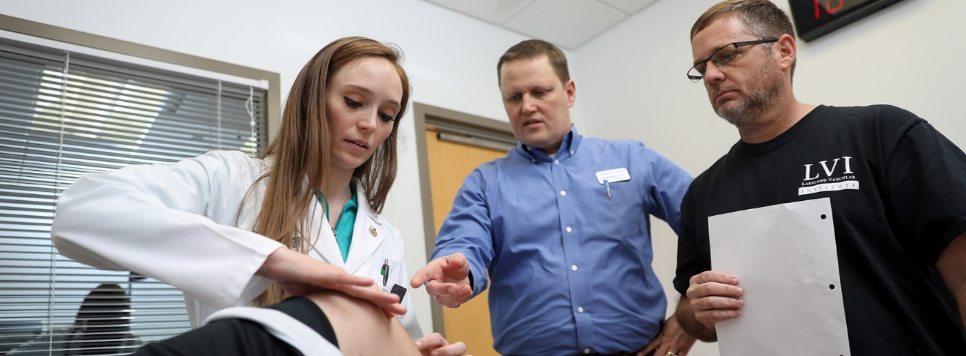
Value of the School to the State
Providing health care professionals
74% of Family Medicine Physicians
46% of Physicians
51% of Physical Therapists
52% of Occupational Therapists
39% of Physician Assistants
47% of Medical Laboratory Scientists

Slide 46
Retention of UND SMHS Medical Student Graduates for Practice In-State
Source: Missions Management Tool 2013 – 2020, Association of American Medical Colleges

Slide 47
UND SMHS Outcomes
Metric | Percentile Rank
Percent in primary care (graduates 2005 – 2009) | 94th
Percent in rural areas (graduates 2005 – 2009) | 99th
Percent in family medicine (graduates 2016-2018) | 99th
Source: Missions Management Tool 2020, Association of American Medical Colleges

Slide 48
Our Goals
To be the best community-based school in the country
To continue to be an innovator in education (with a focus on interprofessional teams)
To continue to develop focused programs of research excellence

Slide 49
Our Goals
To serve the people of North Dakota and beyond
Rural health
Healthcare workforce development
Emphasis on primary care (especially family medicine)
American Indian health care workforce development
Health advocacy
Interprofessional care
Virtual care (including telemedicine)
Use of “big data” to improve care
Substance abuse/behavioral health
Strategic planning for the future

Slide 50
Our Mission for the last 100 years:

Slide 51
