Slide 1
Interim Higher Education Committee Meeting
August 21, 2018
Joshua Wynne, MD, MBA, MPH
Vice President for Health Affairs, UND
Dean, UND SMHS
Executive Secretary, UND SMHS Advisory Council

Slide 2
Outline of This Morning’s UND SMHS Briefing
Overview of duties of the UND SMHS Advisory Council
Overview of the UND School of Medicine and Health Sciences
Mission/Purpose – What we do
Overview of our student classes
Financial status
Education
Discovery (research and scholarship)
Service
Status of the Healthcare Workforce Initiative (HWI)
Preview of Fifth Biennial Report – Health Issues for the State of North Dakota
SMHS Agenda for 2020/21 and beyond ➔Where we hope to go

Slide 3
The duties of the SMHS Advisory Council NDCC Section 15-52-04
The advisory council, in consultation with the school of medicine and health sciences and the other agencies, associations, and institutions represented on the advisory council, shall study and make recommendations regarding the strategic plan, programs, and facilities of the school of medicine and health sciences.

Slide 4
The duties of the SMHS Advisory Council NDCC Section 15-52-04
Biennially, the advisory council shall submit a report, together with its recommendations, to the agencies, associations, and institutions represented on the advisory council, to the University of North Dakota, and to the legislative council.
…The recommendations for implementing strategies through the school of medicine and health sciences or other agencies and institutions must:
(1) Address the healthcare needs of the people of the state
(2) Provide information regarding the state’s healthcare workforce needs

Slide 5
UND SMHS Advisory Council
Legislators |  | State Board of Higher Education
Sen. Robert Erbele, Lehr |  | TBD
Sen. Tim Mathern, Fargo
Rep. Lois Delmore, Grand Forks |  | Veterans Administration
Rep. Jon Nelson, Rugby |  | Dr. Breton Weintraub, Fargo
State Department of Health |  | ND Hospital Association
Mylynn Tufte, Bismarck |  | Dr. Craig Lambrecht, Bismarck
ND Medical Association |  | UND SMHS Center for Rural Health
Courtney Koebele, Bismarck |  | Dr. Gary Hart, Grand Forks
Department of Human Services |  | Members selected by the Dean
Christopher Jones, Bismarck |  | John Kutch, Minot
 |  | Dr. Shari Orser, Bismarck
Executive Secretary |  | Dr. Thomas Arnold, Dickinson
Dr. Joshua Wynne, UND SMHS |  | Dr. Stephen Tinguely, Fargo
Chairperson |  | North Dakota Center for Nursing
David Molmen, Altru Health System |  | Dean Gross, Fargo

Slide 7
Our Purpose as a School
“The primary purpose of the University of North Dakota School of Medicine and Health Sciences is to educate physicians and other health professionals and to enhance the quality of life in North Dakota. Other purposes include the discovery of knowledge that benefits the people of this state and enhances the quality of their lives.”
Source: North Dakota Century Code
Section 15-52-01

Slide 8
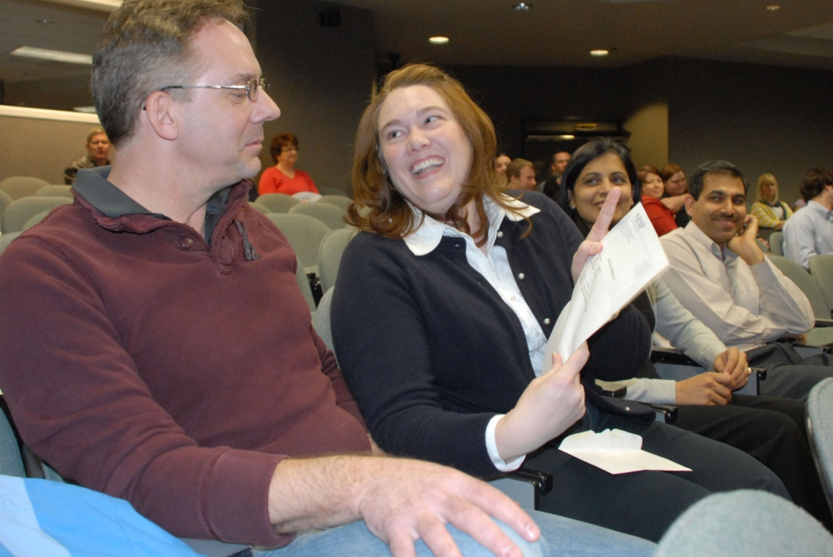
Our Purpose as a School
Educate
Discover
Serve

Slide 9
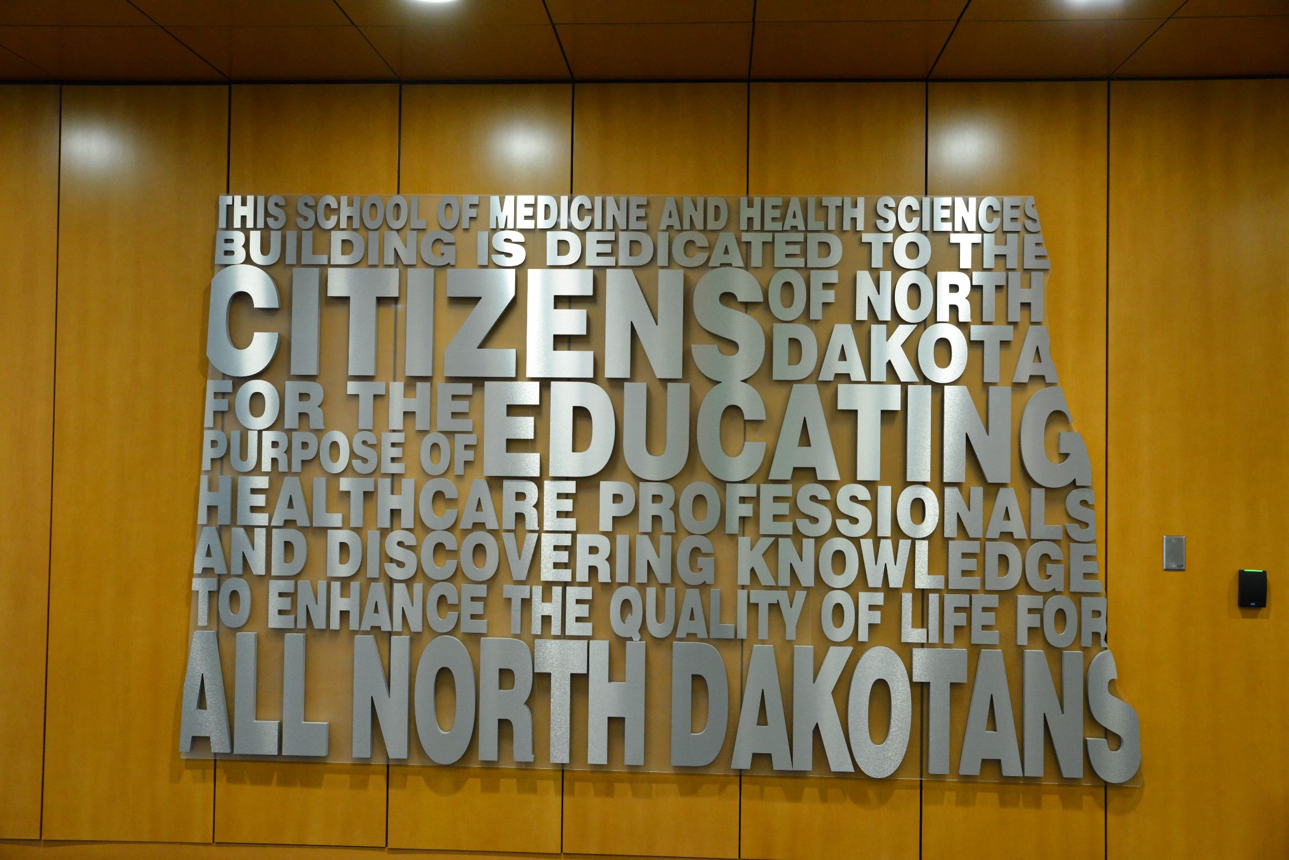

Slide 10
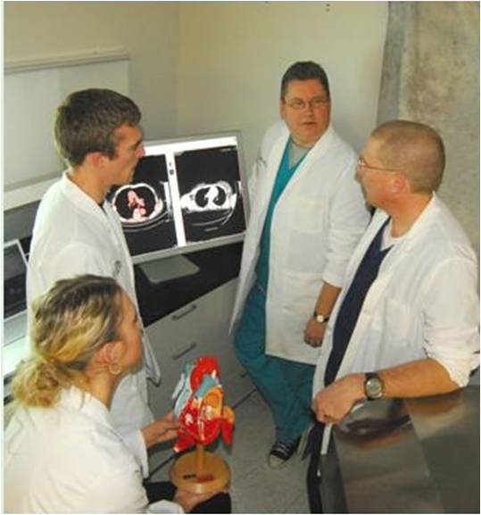
Who We Are
No. 1 in the country!
143 full-time academic faculty
About 1,239 voluntary faculty members – 2 out of 3 physicians in ND
252 benefited staff
Over 2,400 students

Slide 11
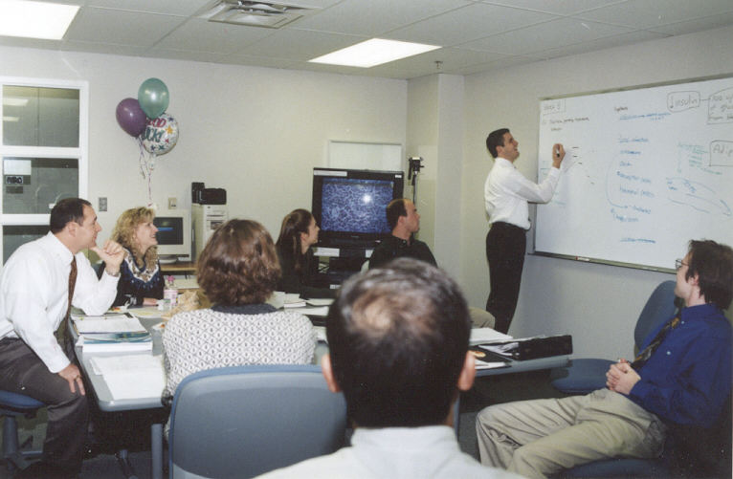
What We Do

Slide 12
UND SMHS Offers a Wide Variety of Academic Programs
Medicine
Doctor of Medicine
Residency programs in:
Family Medicine
Rural tracks
Internal Medicine
Surgery
Rural track
Psychiatry
Telepsychiatry
Transitional
Health Sciences/Related
Physical Therapy
Occupational Therapy
Medical Laboratory Science
Master of Public Health
Physician Assistant Studies
Sports Medicine/Athletic Training
Graduate programs (master’s and PhD) in biomedical sciences

Slide 13
Sources of Revenue
FY17 & 18 Estimated
Revenue
$213,545,483

Slide 14
Tuition and Fee Comparison
 | 2012-13 | 2013-14 | 2014-15 | 2015-16 | 2016-17 | 2017-18 | FY18 Increase from FY17 | FY18 Increase from FY13
Minnesota | $ 39,140 | $ 40,068 | $ 36,800 | $ 38,601 | $ 38,537 | $ 38,518 | 0.0% | -1.6%
AAMC Midwest Mean | $ 30,691 | $ 31,374 | $ 34,386 | $ 35,466 | $ 35,989 | $ 36,640 | 1.8% | 16.2%
South Dakota | $ 28,975 | $ 30,110 | $ 33,554 | $ 34,924 | $ 33,373 | $ 33,946 | 1.7% | 14.6%
Nebraska | $ 29,493 | $ 29,493 | $ 31,145 | $ 31,199 | $ 32,465 | $ 34,302 | 5.7% | 14.0%
North Dakota | $ 26,981 | $ 27,631 | $ 28,614 | $ 29,496 | $ 30,239 | $ 31,433 | 3.9% | 14.2%

Slide 15
Column: NYU medical school students are getting free tuition. But everyone will reap benefits
Encourage more medical school applications
Ensure a more diverse workforce
Rural
American Indian
Increase primary care practice
Reduce physician burnout
Source: Fourth-year medical student at NYU School of Medicine. It was first published on August 17, 2018.

Slide 16
Medical Student Cost to Attend (In-state) Percentile Comparison with other U.S. Medical Schools
Generous state support
Community-based school with small faculty
Good management of operations
Source: Missions Management Tools, 2010-2018 AAMC

Slide 17
Medical Student Debt Percentile Comparison
Source: Missions Management Tools, 2010-2013 AAMC

Slide 18
Why?
School has a focus on recruiting students from rural areas, where median family income traditionally has been lower than in the urban areas
Less scholarship and other philanthropic aid than many schools
Therefore, debt has been high despite low cost to attend. (This low cost has been due, in substantial measure, to strong public support from the ND Legislature)
Accordingly, the School made debt mitigation a priority

Slide 19
Medical Student Debt Percentile Comparison
RuralMed Scholarship program
Increased philanthropy directed at student debt
Source: Missions Management Tools, 2010-2018 AAMC

Slide 20
Uses of Revenue
FY 17 & 18 Estimated Expenditures
$213,545,483

Slide 21
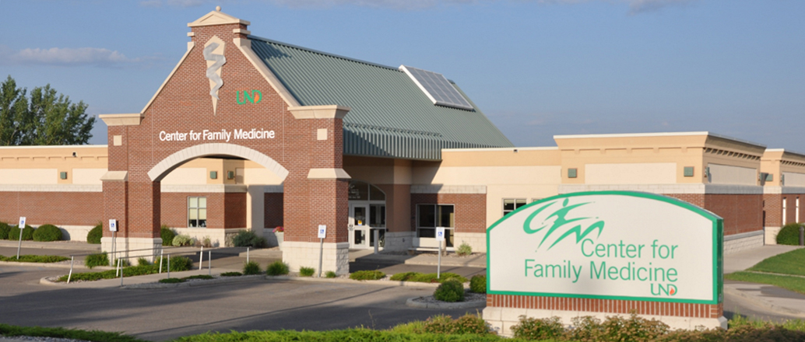
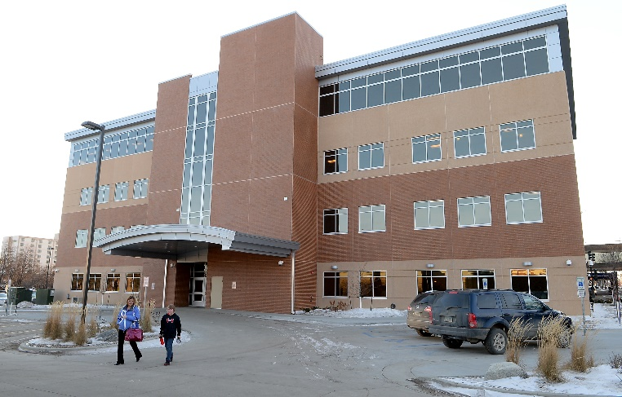
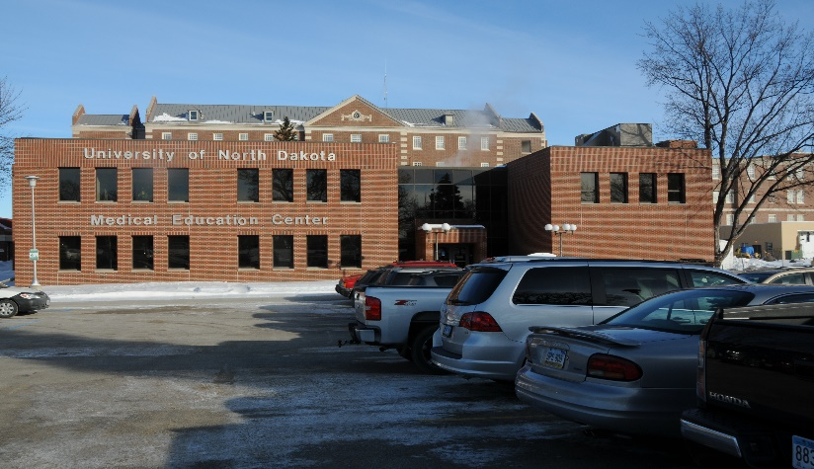
A School Without Walls
The UND SMHS is one of 28 community-based medical schools (those that don’t own or operate a hospital) in the country.
We rely on over 1,200 part-time (voluntary) clinical faculty members in over 30 communities throughout the state to educate medical students and residents.
Two out of three of all of the physicians in the state are voluntary members of our faculty

Slide 22
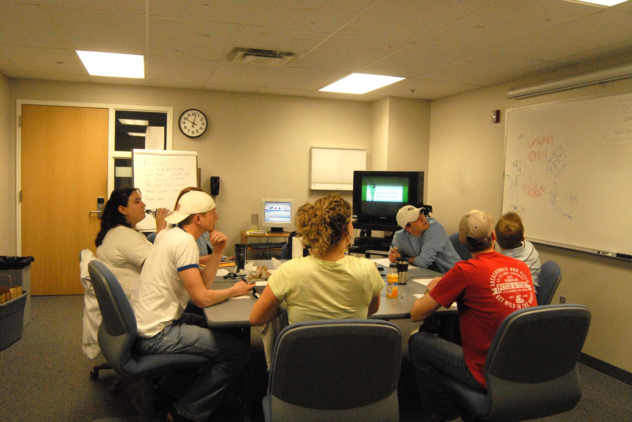
Small Group Patient-Centered Learning

Slide 23
INMED (Indians into Medicine) Program
Nearly twenty percent of all of the American Indian physicians practicing in the United States are graduates of the UND SMHS Indians Into Medicine Program.

Slide 24
UND SMHS Simulation Center SIM-ND - Four mobile vans that cover each quadrant of North Dakota

Slide 25
Interprofessional Health Care
Interprofessional education ensures that future healthcare professionals can better communicate and work as a team.
Involves students from the full spectrum of healthcare – medicine, nursing, physical therapy, social work, communication sciences, dietetics, occupational therapy, health sciences.

Slide 26
Primary Care
Focus on primary care education, especially for rural areas of North Dakota
Educate medical and health sciences students in rural communities
Nationally cited Rural Opportunities in Medical Education E (ROME Program)

Slide 27
Rural Health
Center for Rural Health is one of the nation’s best
Home to the only national Rural Health Information Hub
Improve health in rural communities through community medicine and prevention programs
Extensive research on the healthcare needs of people in rural communities
Promulgate rural health policy

Slide 28
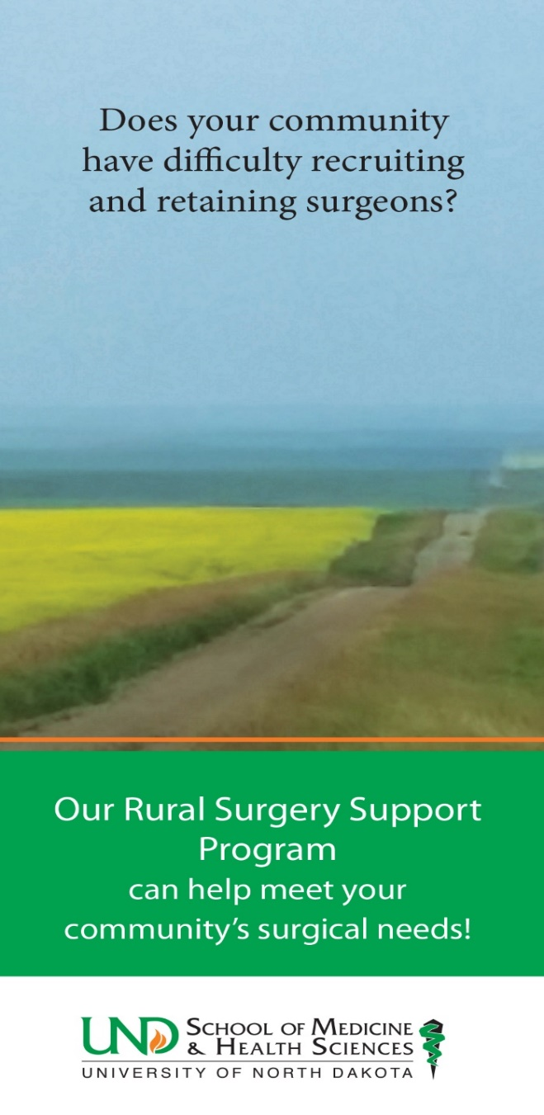
Service to the Community
RuralMed
Rural Opportunities In Medical Education (ROME)
Center for Rural Health
SCRUBS Academy and camps
Rural residencies
Rural Surgery Support Program
Provides temporary surgical support and coverage
SIM-ND
Provides simulator training in vans to each quadrant of the state

Slide 29
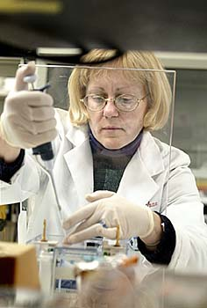
Research Programs
We focus on studying diseases of relevance to North Dakota
Alzheimer’s and other neurodegenerative diseases
Diseases of aging
Cancer
Eating disorders
Infectious diseases (vector-borne)
Opioid addiction

Slide 30
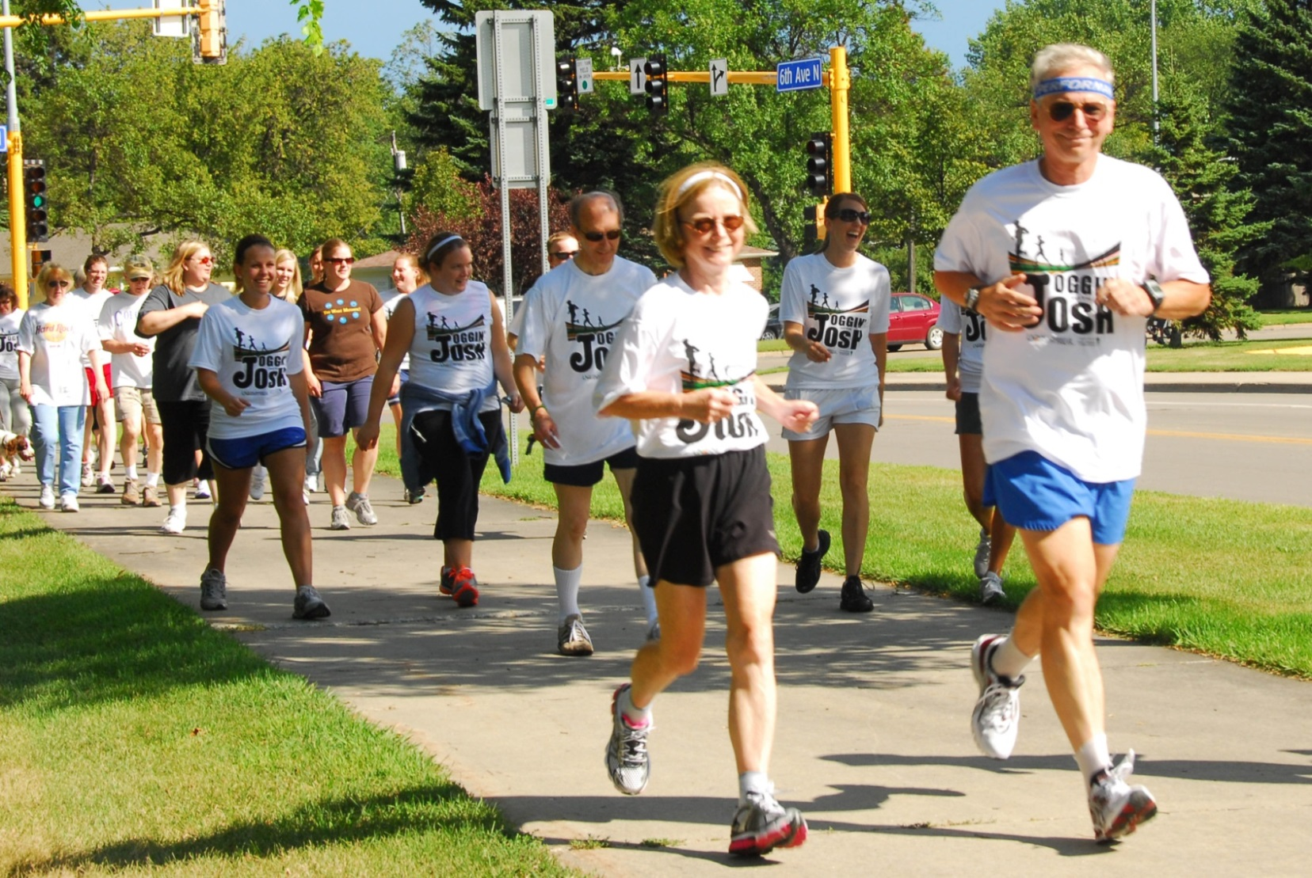
We Practice What We Preach!
Please join us for the next Joggin’ with Josh on September 6 at 4:00 p.m.

Slide 31
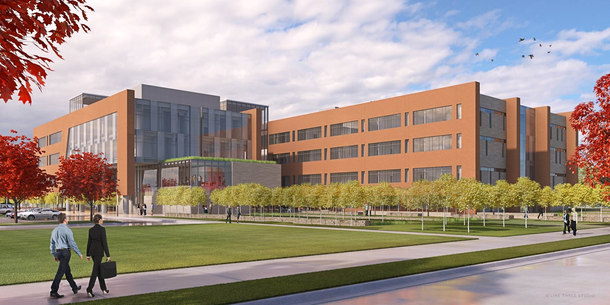
Healthcare Workforce Initiative

Slide 32
Healthcare Workforce Initiative
Reduce disease burden
Master of Public Health degree programs (UND and NDSU)
Further programming approaches under study to address mental and behavioral health issues in the state
Retain more healthcare provider graduates for North Dakota
RuralMed Program
UND SMHS recognized as No. 1 in the nation for the percentage of its graduating class going into family medicine

Slide 35
Best & Worst Places to Practice 2018: Happiness in Work and Home Life
Work Life
Good compensation
Low physician burnout rate (5th lowest in the country)
Low malpractice insurance rates
High quality health care
Home Life
High level of personal well-being
Longevity of the population
High-quality educational institutions
Low tax and unemployment rates
Source: Medscape, Carol Peckham | May 2, 2018 |

Slide 36
The doctor is out? Why physicians are leaving their practices to pursue other careers
“After 20 years, I quit medicine and none of my colleagues were surprised. In fact, they all said they wish they could do the same,” said one doctor.
by Nicole Spector / Aug.18.2018 / 2:54 PM ET

Slide 37
Best & Worst Places to Practice 2018: Happiness in Work and Home Life
Work Life
Good compensation
Low physician burnout rate (5th lowest in the country)
Low malpractice insurance rates
High quality health care
Home Life
High level of personal well-being
Longevity of the population
High-quality educational institutions
Low tax and unemployment rates
Source: Medscape, Carol Peckham | May 2, 2018 |

Slide 38
UND SMHS Healthcare Workforce Initiative
Train more healthcare providers
Medical student class increased by 16/year
Health sciences students increased by 30/year
Increased resident slots
Approved additional slots in rural family medicine, rural general surgery, hospitalist, internal medicine
Improve efficiency of delivery system
Training in inter-professional healthcare teams
Use of “learning communities” in new building
Increased use of telehealth

Slide 39
Preview of Fifth Biennial Report Health Issues for the State of North Dakota
Chapter 1: The Population of North Dakota and Attendant Healthcare Needs
Updated content to reflect newest data
Chapter 2: The Health of North Dakota Updated content to reflect newest data
Added new content on chronic conditions and cancer
Chapter 3: Physician Workforce in North Dakota
Updated content to reflect newest data
Added content on International Medical Graduates (IMGs)
Chapter 4: Primary Care and Specialty Physician Workforce in North Dakota
Updated content to reflect newest data
Outcomes of Rural Opportunities in Medical Education (ROME and Indians Into Medicine (INMED) added
Chapter 5: Nursing Workforce in North Dakota
New chapter completely written by UND College of Nursing and Professional Disciplines faculty
Contains new content from the 2018 Hospital Workforce Survey, the 2016 Nursing Facility Survey, and licensure data for licensed practical nurses (LPNs), registered nurses (RNs), and advanced practice registered nurses (APRNs)

Slide 40
Preview of Fifth Biennial Report Health Issues for the State of North Dakota
Chapter 6: Psychiatrists, Behavioral Health, and Non-Physician Healthcare Workforce
New chapter, previously was combined with chapter 7
Contains new licensure content from health professions boards
Chapter 7: Healthcare Facility Workforce in North Dakota
New chapter, previously was combined with chapter 6
Contains new content from the 2018 Hospital Workforce Survey including comparisons between the 2014 and 2018 surveys
Contains new content from the 2016 Nursing Facility Survey
Chapter 8: Healthcare Organization and Infrastructure in North Dakota
Updated content to reflect newest data
Chapter 9: Quality and Value of Healthcare
Updated content to reflect newest data
Chapter 10: Conclusions
Digital version of 4th Report chapter in Word has been created

Slide 41
Preview of Fifth Biennial Report Health Issues for the State of North Dakota
Chapter 11: Healthcare Workforce Development
Digital version of 4th Report chapter in Word has been created
Chapter 12: Recommendations: Healthcare Planning for North Dakota
Digital version of 4th Report chapter in Word has been created
Appendices
Updated previous appendix on K-12 activities including a new format
Added an appendix of acronyms
Added an appendix of terms

Slide 42
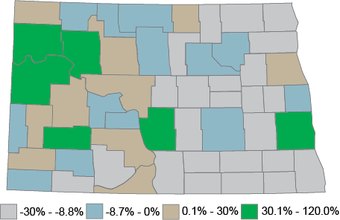
Percentage change in county population from 2000 to 2017.
Nine counties have increased their population by an average of 10% or more from 2000 to 2017. Seven counties had population gains of less than 10%. From 2000 to 2017, 37 counties have lost population. The largest gains seen from 2000 to 2017 were McKenzie, Williams, and Mountrail.

Slide 43
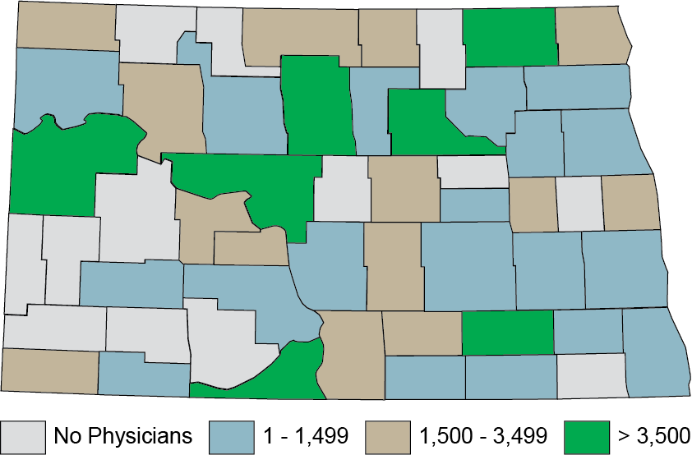
County population per patient-care physician for all specialties in North Dakota, 2017.

Slide 44
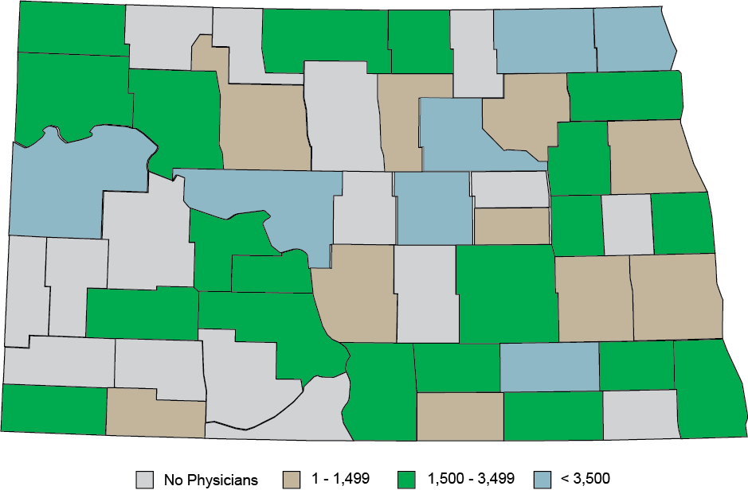
Population per primary care physician in North Dakota, 2017.

Slide 45
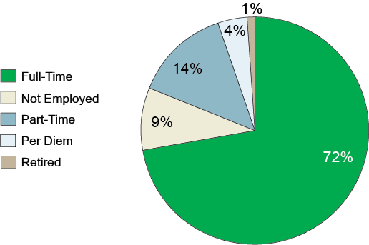
Employment status totals for all nursing roles.

Slide 46
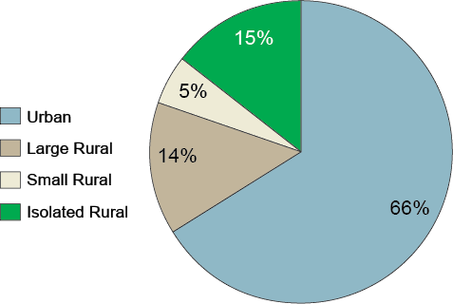
Nursing employer location by rural designation.

Slide 47
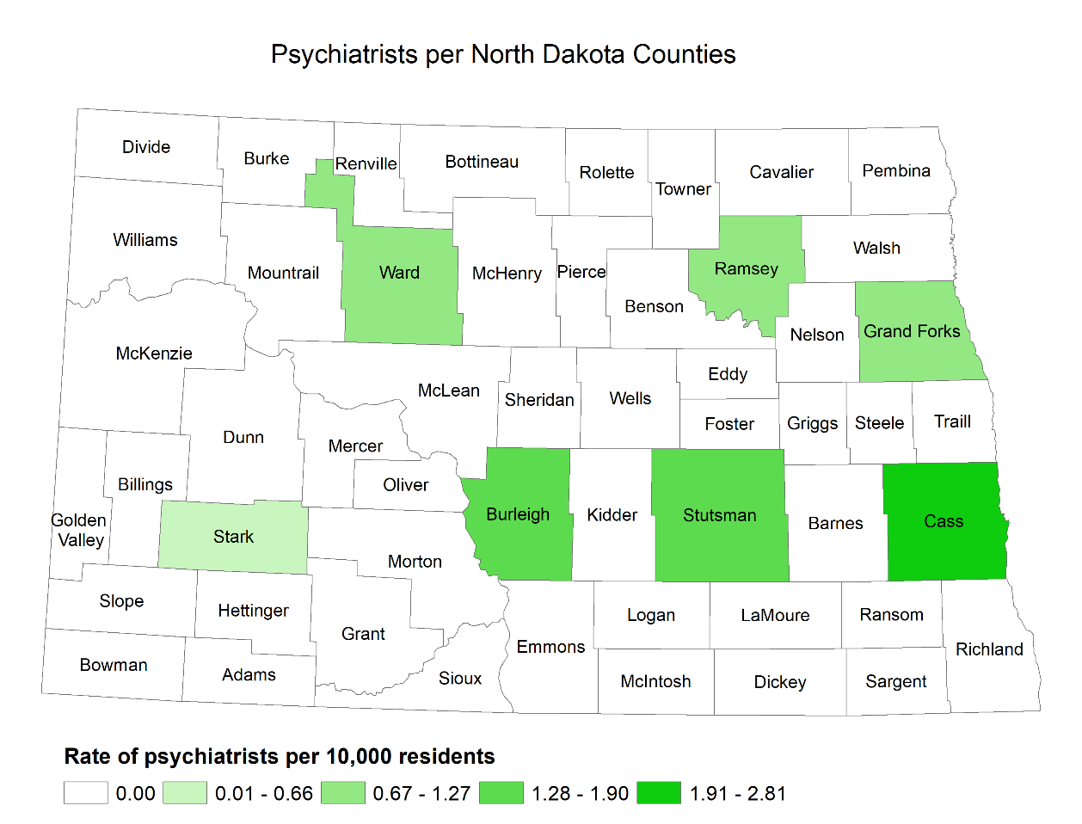
Ratio of psychiatrists per North Dakota county.

Slide 48
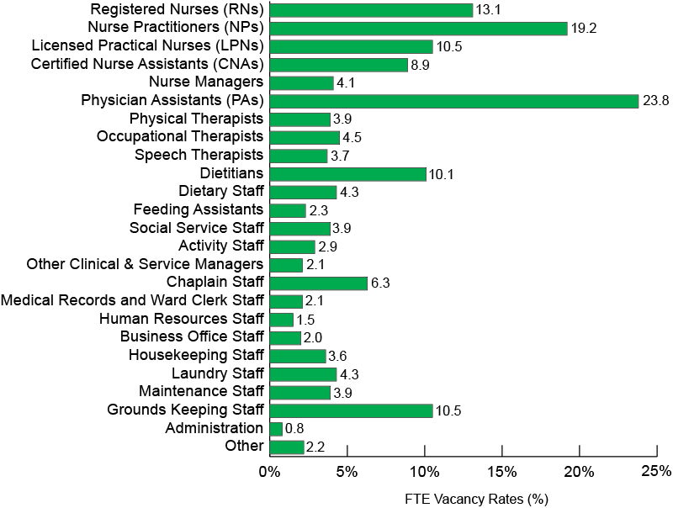
Aggregate statewide nursing facility workforce FTE vacancy rates.

Slide 49
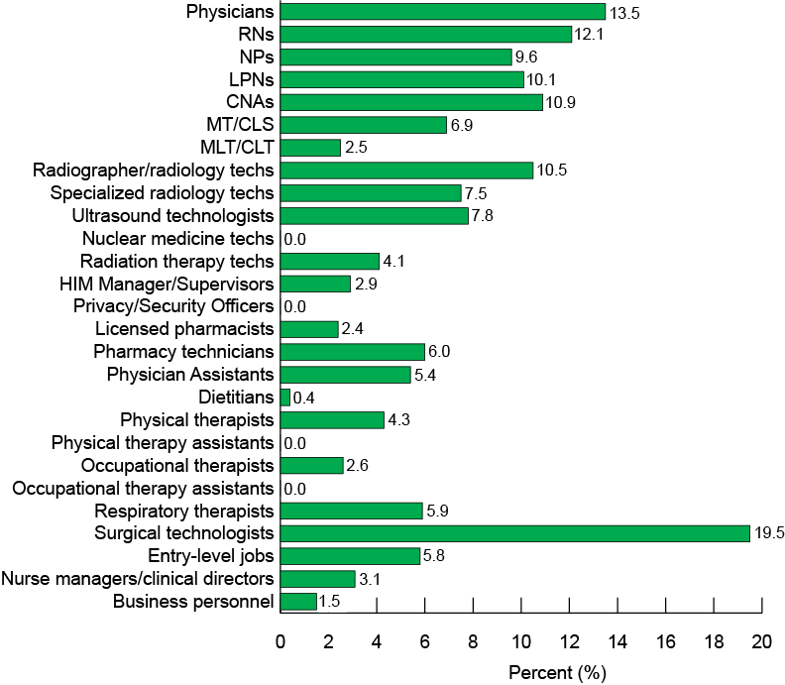
Statewide aggregate hospital workforce vacancy rates.

Slide 50
How Are We Doing? And Where Do We Hope to Go?
Annual report prepared in December of each year and widely distributed (internally and externally)
Called Vital Signs, is a way for stakeholders to “take the pulse” of the UND SMHS
Incorporates a variety of objective metrics to assess the progress of the School in meeting its educational, research and scholarly, and service missions and obligations

Slide 51
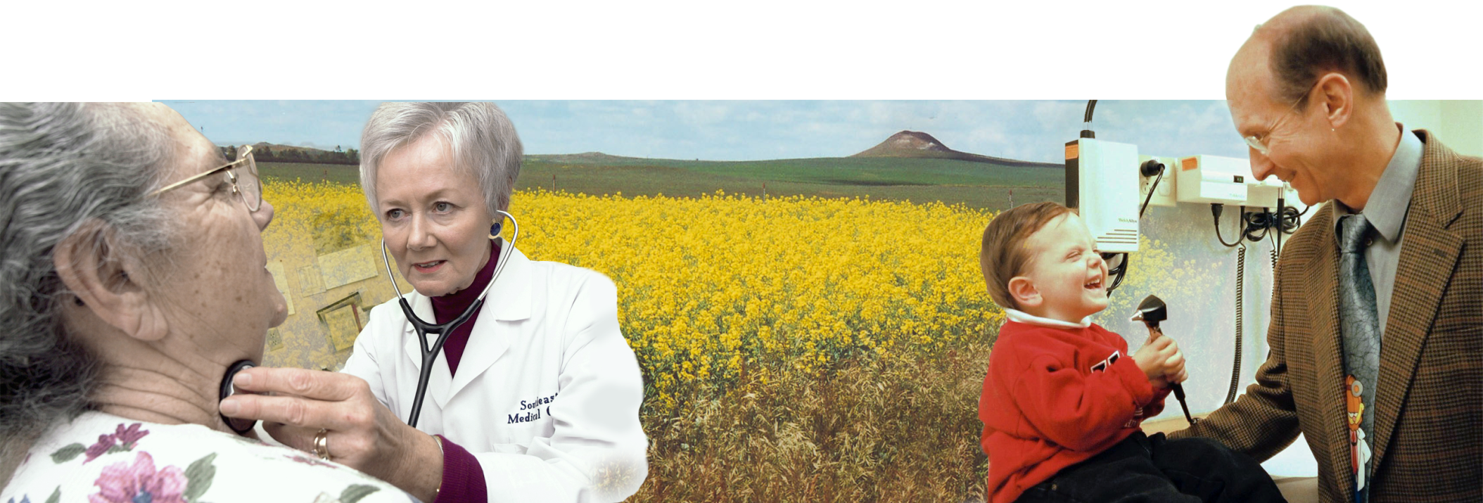
Value of the School to the State
Providing health care professionals
72% of Family Medicine Physicians
44% of Physicians
51% of Physical Therapists
52% of Occupational Therapists
38% of Physician Assistants
40% of Medical Laboratory Scientists

Slide 52
Retention of UND SMHS Medical Student Graduates for Practice In-State
Source: Missions Management Tool, 2018 AAMC

Slide 53
UND SMHS Outcomes
Metric | Percentile Rank
Percent in rural areas (graduates 2003–2007) | 98th
Percent of graduates entering family medicine (2018) | 100th
Source: Missions Management Tool, 2018 AAMC

Slide 54
Our Goals
To be the best community-based school in the country
To continue to be an innovator in education (with a focus on interprofessional teams)
To continue to develop focused programs of research excellence
To serve the people of North Dakota and beyond
Rural health
Healthcare workforce
Primary care (especially family medicine)
Health advocacy
Interprofessional care

Slide 55
Our Legislative Agenda
Make a persuasive case for continued robust funding for the Healthcare Workforce Initiative and our other programs of the UND SMHS that are designed to help provide the needed health care workforce for the state and improve the quality of life of North Dakotans
Work with the Legislature to keep tuition low

Slide 56
Our Legislative Agenda
Secure funding so that merit increases can be provided to faculty and staff this coming biennium to:
Those with outstanding performance (to be able to attract and retain the best and the brightest)
Those faculty and staff at the bottom of the pay scale
Make the case for UND’s Grand Challenges in research

Slide 57
UND Grand Challenges
Generate opportunity for the state by diversifying its economy and addressing societal grand challenges through cutting-edge research
Promote energy security and environmental sustainability.
Help rural communities solve their unique health and social problems.
Drive the world-changing developments of UAS and do so in a way that reflects UND's values.
Effectively, efficiently, and ethically produce, manage, and securely use information in the age of big data.
Address health challenges through basic, clinical and transitional discovery.

Slide 58
Our Legislative Agenda
Make the case for the UND SMHS Grand Challenge➔ Clinical and Translational Medicine Grand Challenge
Opioid abuse
Virtual care delivery
Artificial intelligence analysis of health data

Slide 59
UND Grand Challenges
Clinical and Translational Medicine
Rural
Big Data
UAS
Energy

Slide 60
Our Mission for the last 100 years:

Slide 61
