Slide 1
Production Strategies for Research Posters
Communications & Engagement
John Lee and Laura Stutrud
Graphic Design Specialists

Slide 2
What Software is used to build posters
Focus on PowerPoint
If using other software, choose software can:
  Save files as .pdf
  Dimensions (width x height) can be set.

Slide 3
I’m ready to build my poster, what do I do?
Step 1: Determine the size of your poster!
  There is no standard size
  Boards could be 8’x4’, 40”x30”, or another size.
  The poster could be portrait or landscape.
  Does the printer have a size limit?
    In Communications & Engagement, our rolls of paper are 42” wide

Slide 4
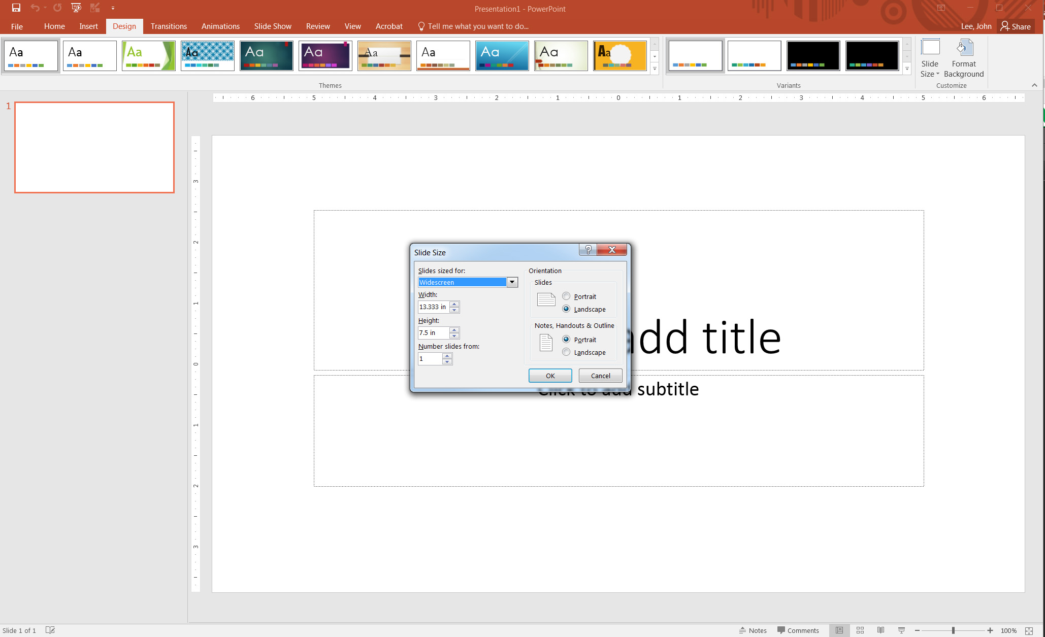
Setting the size of your poster
In PowerPoint, click on the “Design” tab
Click “Slide Size”
Click “Custom Slide Size”
Enter the width and height values
  Summer institute posters are 56” wide x 41” high

Slide 5
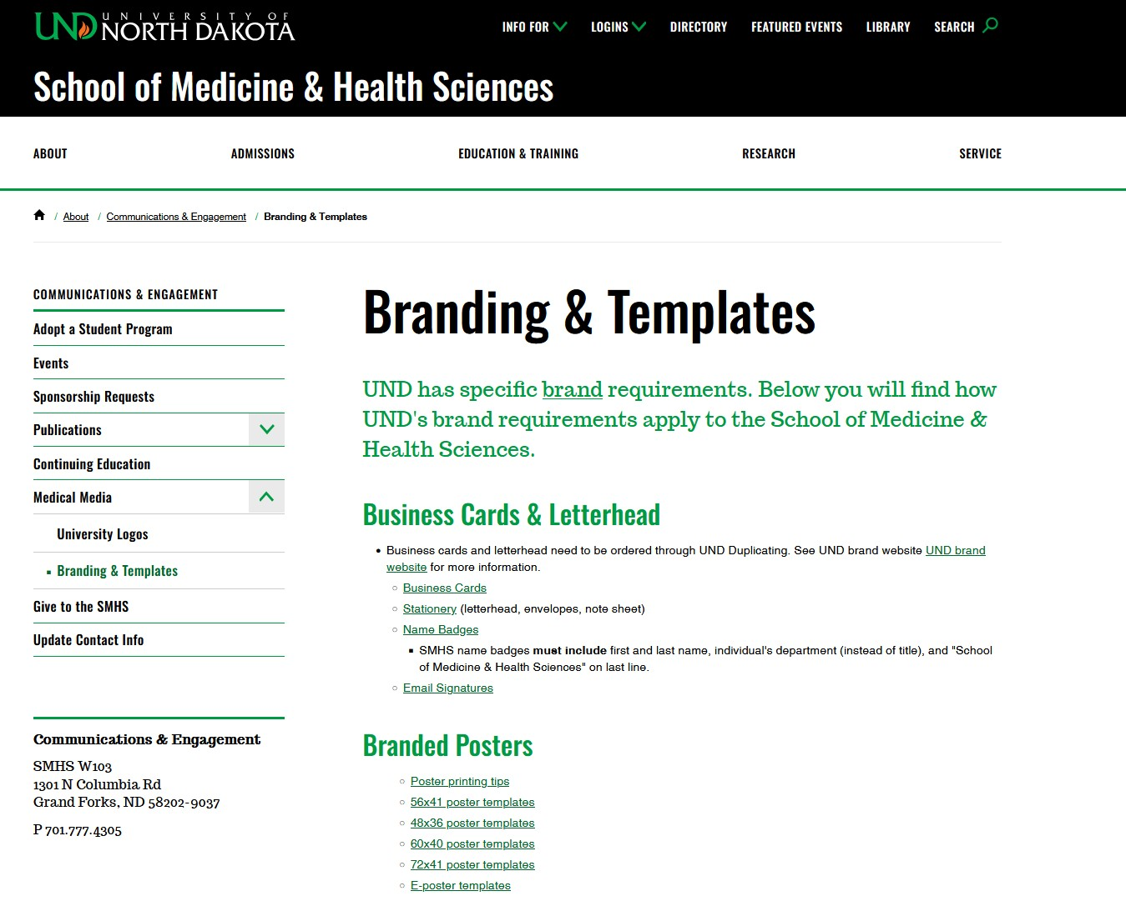
Using a template
Poster printing tips and poster templates
Do not adjust colors/positions, etc. of branding elements on the template.
You aren’t required to use the template, but you are encouraged to use them.
If you choose to create your own design, be aware that overall background gradients have caused printing issues.

Slide 6
Issues with adjusting the size
Don’t start with the default 13.333”x7.5” size and expect the poster to print large.
Common issues with resizing the poster after it’s built:
  Images (including logos) don’t maintain their proportions
  Text may have to be resized
  Charts and graphs may have to be adjusted

Slide 7
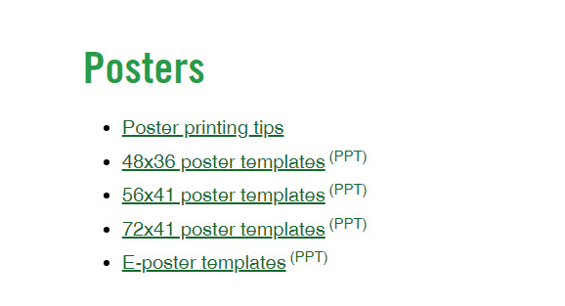
PowerPoint size limitation
PowerPoint limits the slide sizes to 56”
To make a larger poster, the poster
can be built proportionally smaller
(i.e. half-sized) – just be sure that
the person printing the poster
knows and is willing to print the poster larger

Slide 8
Poster Size
Please size posters correctly! Other than the poster’s message (data and research) this is perhaps the most important part of poster creation!

Slide 9
Questions on initial set-up?
Does anyone have any questions?

Slide 10
Adding Data
Type in text boxes
It’s okay to paste text (not images) from word and other sources
Create charts and graphs

Slide 11
Inserting Images
Insert photos and logos
Charts and graphs created in third party software need to be exported as a jpeg and inserted to your poster.
  Pasted images are often linked to a file on the author’s computer and may disappear or fail to print when they are opened by the printer’s computer.

Slide 12
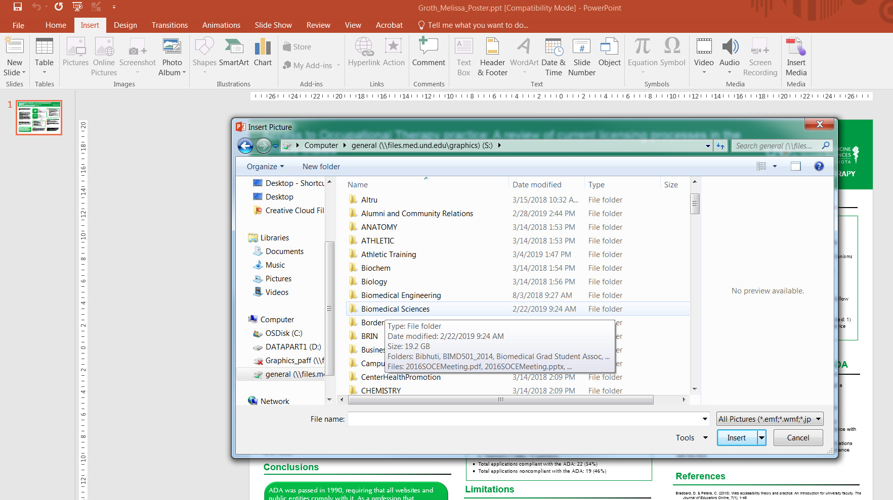
Inserting Images
Click the “Insert” tab
Click “Picture”
Browse to the image location and place it on your slide

Slide 13
Image Resolution
Posters are printed large and require high-resolution images
  Don’t download small internet images to use in your poster and expect them to look sharp
  Image sizes should be at least 1000 pixels x 1000 pixels
  (that is approximately 3”x3” at print resolution).
  Internet images may also be copyrighted (don’t steal!)

Slide 14
Adjusting Backgrounds
General Rules
  Nothing too busy
  Avoid intense gradients – these tend to cause printing issues
  Dark text on a light background is easier to read in printed materials.
  The data should be the star, not the background

Slide 15
Design Tab
Several pre-designed slides are available.
Some are better for posters than others – choose simplistic designs
The designs can be edited (usually in the master pages).
Discover your options

Slide 16
Text guidelines
Text size
  Text set at 72 point is almost 1 inch tall (X-height)
  Body text should be 24–34 point
  If a poster is doubled in size when printed, the text will also be twice as large (20 pt. text becomes 40 pt.)
  Not too much text
  Can data be expressed through photos or graphs
  50% text and 50% images is a good blend

Slide 17
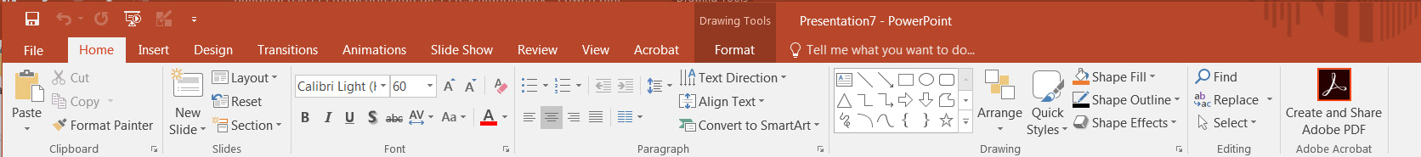
The Home Tab
Text boxes
Lines and arrows
Fonts, text size, paragraph alignment

Slide 18
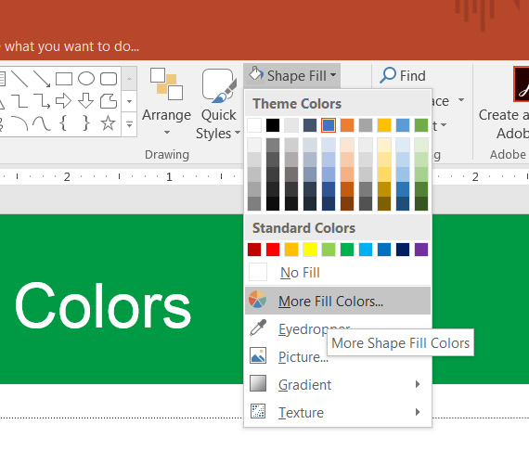
Customizing Colors
Choose colors from the “Shape Fill” and “Shape Outline” on the home tab
There are theme colors and standard colors
Can customize colors from “More Fill Colors?

Slide 19
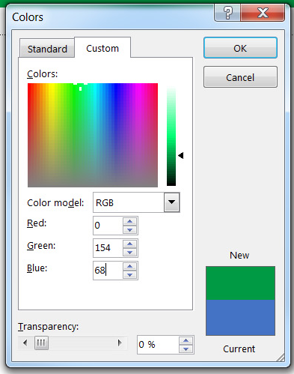
Customizing Colors
Create custom colors using RGB values
The RGB value of UND’s Green is 0/154/68

Slide 20
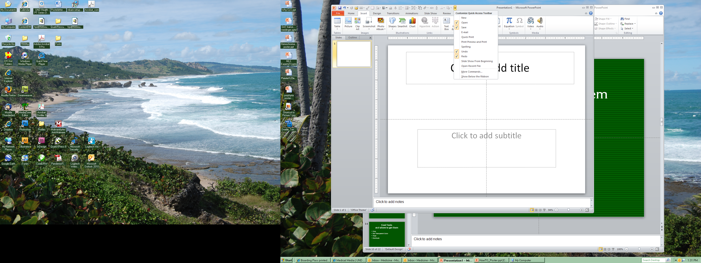
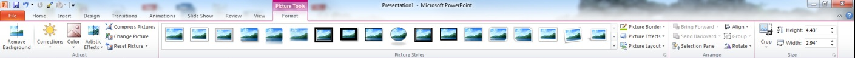
The Format Tab
Edits Graphics
Crop Tools
Align and Rotate Tools
Group Tools

Slide 21
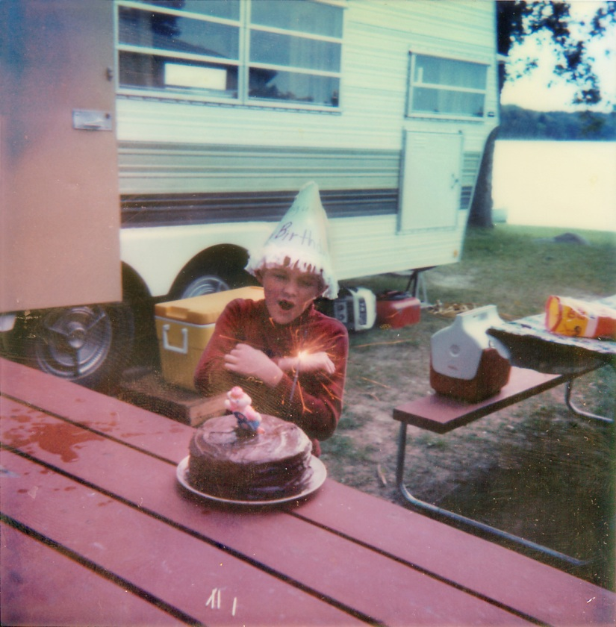
Crop
Eliminates unwanted data

Slide 22
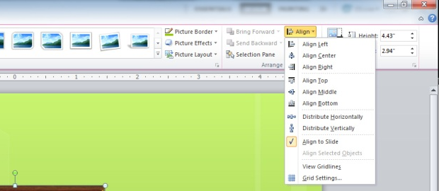
Align Options

Slide 23
Align
Aligning Text boxes and shapes
Discussion
Discussion
Introduction
  text
  text
Introduction
  text
  text
Method
Method
Conclusions
  even more lots of text
  even more lots of text
Conclusions
  even more lots of text
  even more lots of text

Slide 24
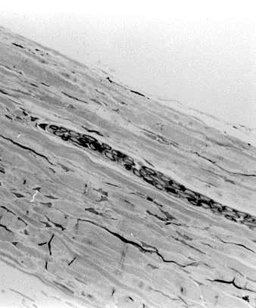
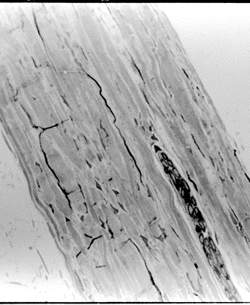
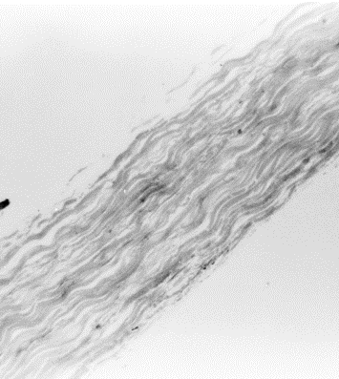
Distribute
Spaces text boxes and shapes evenly

Slide 25
Group and Ungroup
Links shapes, images, and/or text boxes
This can also be found in the Home tab under arrange

Slide 26
Customizing the Quick Access Toolbar
To add commands to your quick access toolbar:
  Click the carrot at the top
  Click “More Commands” from the dropdown list
  “Popular Commands” is the default list to choose from. “All Commands” is a more comprehensive list of tools.
  Select a command and click “Add” to have it available on the Quick Access Toolbar.

Slide 27
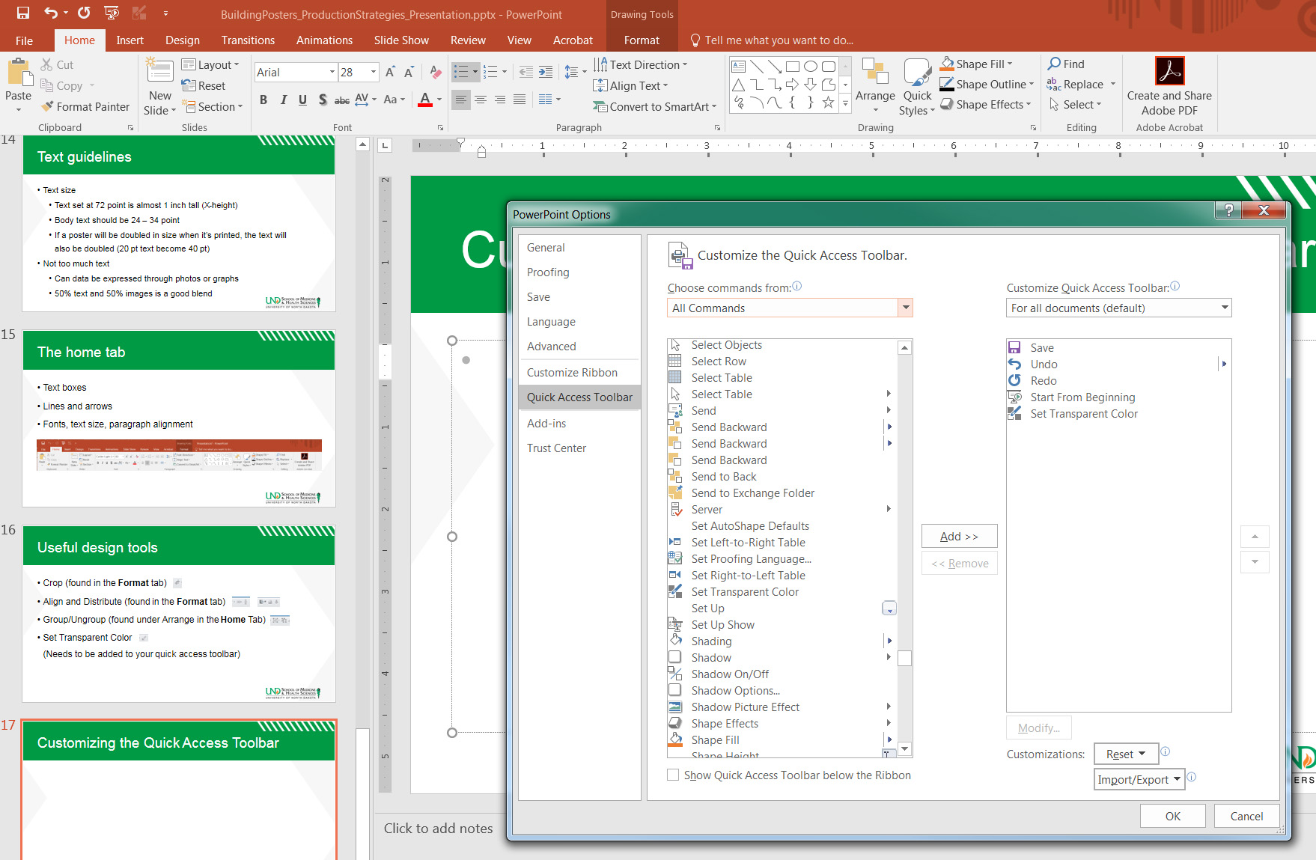
Customizing the Quick Access Toolbar

Slide 28


Logos with backgrounds
Png and gif files can be placed in a file without backgrounds
We can provide you with the .png logo for UND SMHS
The white box behind the logo doesn’t look professional

Slide 29
Questions
Any questions about tools or layout?

Slide 30
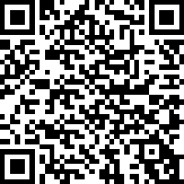
Submitting Posters for print
Communications & Engagement prints UND School of
Medicine & Health Sciences Posters (one/event) for no charge
To submit your poster, use the Project Request form.
Link to: Project Request Form:
QR code for
Project Request Form

Slide 31
Submitting Posters for print
Please provide the following information: Paper choice
    Regular –
      Greener option
      Can be recycled/environmentally friendly and perfect for one-time use
      Acid-free polypropylene
    Cannot be recycled, does not tear or fade easily, best choice if using poster more than once
    Inks often appear brighter and grays often appear more true.
Both options are printed on the same machine with the same pigment-based inks.
    If you don’t specify which paper you want, we will print the poster on regular paper.

Slide 32
Proofing
Fonts
Bullets (are they showing up how you built the poster?)
Super- or sub-scripts (are they still there?)
Images, charts, graphs (are they still there?)
Greek characters and symbols (are they still there?)
Spelling and typos (this is your last chance)
Colors (color looks different on monitors than when printed. Inks often appear darker.)

Slide 33
Submitting Posters for print
Submit a pdf
Communications & Engagement will print this file full size
  We only print one poster/event/student=no reprints
    Make sure your poster is error-free
  Communications & Engagement will not edit a pdf
  PDF files appear consistent on different computers
  Please have only one slide in the poster file

Slide 34
Information Resources Print Options
Communications & Engagement prints on 42”-wide rolls of paper (1/2” is needed for grip – an unprintable area on the margins).
Regular paper: a green option for printing.
  Name your poster:
  firstname-lastname-poster/eventinfo-Regular (or) Poly.pptx
    Example: laura-stutrud_BuildPoster_HowConference-poly.pptx

Slide 35
Other Print Vendors
UND Duplicating
EERC
FedEx on Columbia Rd
Online vendors

Slide 36
Questions
Any questions?

